Slide 1
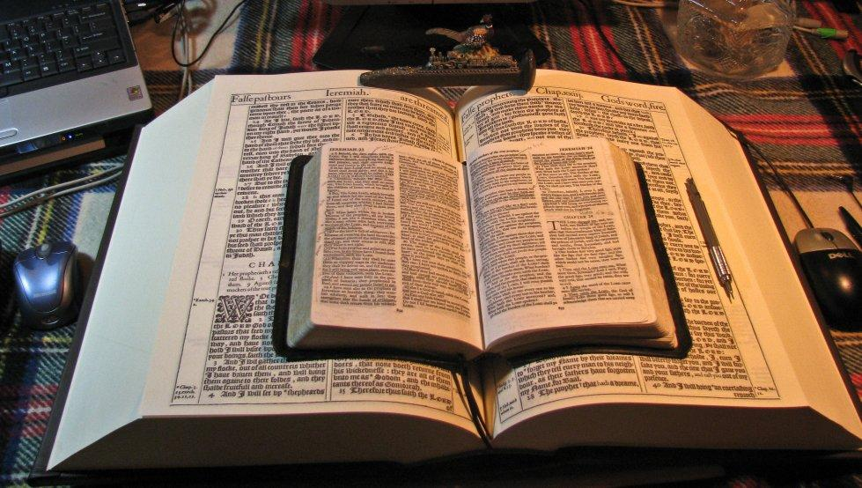
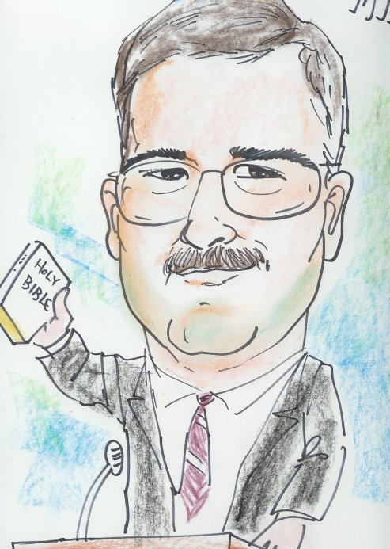
This PowerPoint was designed by Mike Paulson, June, 2016 – www.scatteredchristians.org
This presentation is not copyrighted, of course, so if you can add more, and there is a lot more that I am sure can be added to this, feel free to do so. My only expectation and requirement is that you use ONLY a King James 1611 Bible. Actually, that is not a huge concern of mine because if you tried to use any other modern bibles, you would find they wouldn’t work with this anyway, thus we see once again, the importance of a rightly divided 1611 KJB ONLY. ☺
If you do add more comments, scripture references, etc. for your own use – or to pass on to others,
please pass it on to me, as well. I would be glad to update yours to the website.
So, click away – and do with this what you may!

Slide 2
A World Without the Living God
Religion is Never Truth
Truth is Never Religion

Slide 3
A World Without the Living God
Has a Religion
The Holy Spirit has travelled from Antioch to Europe, Africa, America, Asia and back. The ‘infamous’ and historically popular revivals of Europe, USA, China, etc. were smoke screens to the truth of a rightly divided KJB. The ‘truth’ was always quickly replaced with a popular, less persecuting, guilt-causing, ‘hard’ preaching ‘Christianity’ as the Great Commission’s Jewish signs and wonders replaced Paul’s Greater Commission of the words and faith ‘of’ the risen Jesus Christ – all in preparation for the global arrival of the antichrist - ‘another Jesus - vs the return of the real Christ. Rev 6 vs Rev 19.
The study of the music of Shem, Ham and Japheth reveals the global coming together as people worship the antichrist with of ‘all kinds of music’ (Daniel 3). Music has always preceded history – and can show you what has happened, is happening and will happen.
Note the ecumenical acceptance from the Protestant denominations as they return to the Catholic mother ship while the world continues to move towards a global one-world religion.
Note the presentation and forced acceptance of the Islam religion, as portrayed by the ‘media’ as a religion of love through the ‘needs’ of the Islamic refugees that are nothing but part of a war started by Ishmael and will NEVER be stopped. The media directed cause for allowing these Israel-hating invaders hiding among the ‘refugees’ to come in to destroy the rest of the world is the proclamation of ‘religious freedom.’
Note the rejection of the US Constitution and thanklessness to all that America has provided (food, inventions, rebuilding monies, debt forgiveness, clothes, civilized lifestyles, etc. and the global reaction about America being the so-called powerful nation.
Note the design, growth, acceptance and the media’s common sense presentation of the mark of the beast / chip towards a global economy, one that will convince or make everyone ‘join in’ while giving the governments 100% taxed income control.
Note the global ‘love’ and tolerance of perverted life styles and the global ‘hate’ and intolerance towards Christian morals, etc., especially from within America itself. ’Envy’ has destroyed America like ‘envy’ was the cause of Jesus’ death, etc.
The devil himself, portraying ‘another Jesus’ to the world, is trying to complete his desire
to be ‘like the most high’ in all the world. Isaiah 14:14.

Slide 4
A Nation Without the Living God
Has a Religion
Even though America has been a provider of the King James Bible for years, its religious leaders replaced it with the ASV, NIV, etc. Most of the dealings within the congregations were a financial payoff to the pastor to get the KJB out of their denomination, thus they contributed and even caused this nation to fall into temptation, a snare and into many foolish and hurtful lusts. Money has become the major coveted item making this nation to err from the faith; the people as well as the nation have pierced themselves through with many sorrows. It isn’t God’s judgment we are seeing – it is the result of the work of the pastors.
America has become a nation full of pride, fullness of bread with an abundance of idleness. Instead of strengthening the hand of the poor and needy, we have become a welfare nation making everyone weaker. We have become haughty and commit abominations with all the tolerance of the new perverted lifestyles. America has taken on a religion – they have a god but it is NOT the Creator. America will soon usher in, if not even finance, the coming of the antichrist.
In this nation, as in all others now, children have become the oppressors, and women rule over the land more and more. Men have become as women and women as men. This nation is seeking to be replenished from the east.
In this nation, there is an increase of evil being called good and good being called evil; darkness is replacing light; bitter for sweet and sweet for bitter! People are becoming wise in their own sight. Vile people are electing vile leaders.
Because of this nation changing the truth of God into a lie and are now worshipping themselves – ‘the creature’ – God has given this nation up unto vile affections and over to a reprobate mind.
As a nation, America is increasing their choosing to go against Israel; but it isn’t the physical blessings that America is losing by making this decision, it is the promise of Abraham’s imputed righteousness that people in this nation will miss.
This nation despises and rejects the riches of God’s goodness and forbearance and longsuffering; not knowing that the goodness of God would lead the citizens of America to repentance. The face that Gentile people should be seeking is the face of the risen Saviour – not the earthly Jesus.
The ‘Christianity’ in the churches of America today has been a false Christianity for many years. It is nothing but an empty ‘game-playing’ social group being run by gainsayers and evil men and seducers that are waxing worse and worse, deceiving and being deceived as their profane an vain babblings lead the people of this nation into an increase unto more ungodliness… all the while proclaiming that there is a revival going on in America – but alas, it is a false revival.
The affairs of this life / of this nation are the affairs of which we are not to be entangled. Yes, we must endure hardness, but these are not our wars. However, remember that this hardness is NOT for us to endure ‘to the end’ – it is just what happens when one chooses to try to live godly according to Paul.

Slide 5
A Church Without the Living God
Has a Religion
It teaches the Great Commission which is supposed to be ‘confirmed’ by these signs: casting out devils; speaking with new tongues; taking up serpents, drinking any deadly thing and not be hurt; laying hands on the sick and they shall recover. That teaching was revived by William Carey in 1792, the so-called Father of Modern Missions. His book drove the truth away from the Gentiles, God’s command to Paul and his writings, not the gospels with the 12 apostles. The Gospels were written about and TO the Jews. Paul is the only apostle TO us, the Gentile nation today. Today’s Great Commission, if taught to be applied ‘to’ us today, is a false teaching today that was started by Baptist Missions, yet the Baptists preach against signs, wonders, tongues, etc. Go figure!
Today’s emphasis in our local churches is from the Gospels, Acts, Hebrews, James, I II Peter, I II III John and Jude. However, those ‘teachings’ conflict with Paul’s books of Acts 9 through Philemon. Of course we must learn Genesis to Revelation, but only Paul’s books are written TO us as Gentiles today. The preaching should be the words of the Risen Christ to the Gentiles, not the teachings of the earthly doctrine of Jesus that was to be given to the Jews only.
When today’s pastors, etc. do not teach and preach a rightly divided 1611 KJB, they are preaching profane and vain babblings which will increase unto more ungodliness and will overthrow people’s faith. They are men of corrupt minds, reprobate concerning the faith as they continue to resist the truth. They are proud, knowing nothing. They dote about questions and strifes of words, whereof cometh envy, strife, railings, evil surmisings. Yet, they blame others for causing division when in God’s eyes, it is them who are causing the strifes of words, etc. They are men of corrupt minds and destitute of the truth. They teach that gain is godliness, thus the big churches and ‘plants’ and programs, etc.
Because of that modern false gospel that pastors teach, God calls them deceitful workers. They are labeled as ministers of righteousness but the righteousness that they teach is their own, not God’s own righteousness that He imputes to His believers. Concerning the truth, they have erred! In their own deceitfulness, they cause others to also be deceitful as well as greatly educated to deceive others. These are evil men and seducers that shall wax worse and worse.
Today’s local church design and purpose is based on Acts 2:41-47 instead of Paul’s Ephesians 4:12-16. No wonder the local churches have become a social gospel as they try to have favour with all the people. They do the water baptisms instead of the spiritual baptism that Paul teaches; they teach the apostles doctrine instead of Paul’s; they preach fear and guilt with the severity of God instead of the riches of understanding, a peace which passeth all understanding, etc. through the goodness of God, which promises to lead people to repentance today.
We are not only not to be ashamed of the testimony of our Lord, but we are also not to be ashamed of the testimony of Paul. The risen Saviour tells the pastors today to bring the people into remembrance of Paul’s ways which be in Christ – and are to be taught every where in every church.
While our works will be judged by Jesus Christ, He will be using His teachings to us Gentiles through Paul, the manner of life we are to strive to follow. We are to be stablished by Paul’s gospel, and the preaching of Jesus Christ, ACCORDING to the revelation of the mystery – which is exactly what ‘only Paul’ teaches.
Simply stated, today’s modern Christianity that is taught in all denominations today is a perverted gospel of Christ, of which Paul warns about in Gal 1:6-12 and II Cor 11:1-4.

Slide 6
A Family Without the Living God
Has a Religion
The kids will see: the false religion of their parents; an extortioner lying shyster of a ‘nice guy’ pastor with his empty pastoral promises and signs with no results other than his parents spending lots of money because of his guilt producing sermons; prayers with no answers; their obedience not followed with blessings; their rebellion not followed by God’s chastisement. They will not see the success of the signs, wonders and miracles that denominations put forth through the Great Commission teaching.
The kids will long for: the feeding of their growing flesh and their newly acquired desires; friends and family members who are wise to their parent’s false religion; the days when they can escape from the domination, the ‘cruelty’, the unfun and unpleasant life of a false threatening scaring and guilt producing religion that their ‘mean’ and ‘unloving’ parents exhibit with their threats and teachings of the severity of God! They miss the simple goodness that would lead their kids to repentance and a growth full of understanding, nurturing, etc. through their knowledge of the RISEN SAVIOUR!
…or, the kids will get tired of all the lovey-dovey butterfly sweet sugary huggy Christians that also produce nothing but other love-dovey butterfly Christians that show little if anything of the truth in their lives – just a wishy washy false love.
The spouses will eventually leave each other, if not in an official divorce, at least in relationship. The kids will not see ‘true love’ within the household so their future household will never develop that love of truth and grace that the risen Saviour offers through Paul. They will in fact, want nothing to do with ‘any’ God – be it the Risen Saviour or not.
With the wife having become the ‘leader’ of the home because she was taught that she is the Holy Spirit of the family, etc. and that the man no longer follows the strong male role God would have him follow, etc. the boys will become effeminate as the weaker male and now possibly even reverse their entire physical and sexual structure as well as their behavior around to the female side. The girls then, will become the strong, sports oriented, educated leader of her future family, and her marriage will eventually fail “because her coaches taught her to be strong and aggressive, etc. – even IF she were to ever desire to live the religious marriage design.
In order for the parents to ‘keep’ their child happy at home, they will have to give in to their wants, whining's and wishes. Essentially, the children become the oppressors of their home and school – and will eventually turn into great members of the ’entitled beggars’ society.
The wives will not adorn themselves in modest apparel or behavior; they will participate in or even cause riotous behavior; they will have no shamefacedness and sobriety; they will wax wanton against the risen Christ and will thus cast off their ‘first’ faith (if they ever even had one to cast off); they will be easily turned aside after Satan; they will be easily led away with divers lusts because they will be silly women laden with sins.
The number one love for the family will be for all members to work so they can make enough money to have the lusts they want. With money as their true god, they will fall into temptation and a snare, and into many foolish and hurtful lusts which will drown them in destruction and perdition. They will covet money so much that they will err from the faith and will pierce themselves through with many sorrows; and once all that damage starts taking place, ‘sure as shootin’, they will blame God for ‘not being there’ – for ‘not loving them’ – and eventually they will either 1) no longer believe in any God; or 2) seek a denomination, cult OR an Eastern religion that will promise to bless / care for them physically and financially.
A family with a religion instead of the living God does not have a home;
they have a place just for everyone to live – and it will be as empty as a motel room during a long and boring vacation!

Slide 7
A Person Without the Living God
Has a Religion
One of the greatest deceptions being taught from modern bible versions is the command to be ‘imitators’ of God, Paul, Jesus, the body of Christ, of faith… when the KJB says be ‘followers.’ An imitator is NOT a follower but is s copy – a fake – a fraud – a phony. Being an imitator of God is to be ‘like’ God, ‘like’ Jesus, ‘like’ Paul, ‘like’ the body of Christ, ‘like’ his faith - only that makes them a liar, a fake, an antigod, an antichrist!
Religion Makes Imitations
Imitation Scriptures
Imitation Spirit
Imitation Churches
Imitation Pastors
Imitation Signs
Imitation Saviour
Imitation Salvation
Resemble the Real Thing
In Sight
In Sound
In Success
Devilish
Physical Baptisms
Appearance
Professional
Pleasing
Phony
Signs were ‘to’ the Jews during the days of the Gospels, NOT ‘to’ the Gentiles today during the ‘dispensation of grace’
Was Formed in Eternity
But not as Jesus’ brother or /God manifest in the flesh’
Resembles the Truth
Appears to be Righteous
Appears to be Real
Appears to Appeal
Disgusting
Ungodly
Unclean
Unhealthy
Unreal
Apostles Doctrine
Apostles Fellowship
Receive Praise from
the Religious
Unsaved
Ungodly
Unbelieving
Breaking of Bread
Attitude
Causes Deception
Creates Division
Contradicts Doctrine
Circulates Doubt
Signs were for confirming the
‘Great Commission’ during the days of the Gospels
Removes the Shed Blood
Replaces it with Water
Replaces it with Works
Replaces it with
Wishful thinking
Dynamic
Supernatural in:
Strength
Signs
Secrets
Imitation Prayer
Is Feminine
Images always show long hair, soft lips, etc.
Portrayed as either soft, married or as sodomite, ‘gay’, or whatever you want him to be for you – your pal, buddy, etc.
Fear of God’s Severity
Robs Reliability of the Truth from the Readers
Of their Beliefs
Of their Behavior
Of their Battles
False Signs, Miracles
and Wonders
Appetites
Wealth
Women
The Weak
The signs that God did in the PAST are now the signs that the Devil does in the PRESENT as he performs them for the deceptions of the FUTURE
Rewards Sinner with Good Deeds with a…
Plan instead of a Man
Pride instead of a Master
Payment instead of Mercy
Directing
Against God’s: Word, Words, Ways & Wisdom
New Tongues
Doctrinal
Counterfeit Bibles to Phony Walks & Ways
Unity Demanded
Abilities
None to Perceive
the Truth!
None to Preach
the Truth!
None to Practice
the Truth!
Removes the Realities of the Faith of Christ
…by putting the emphasis on the faith of the people themselves instead of the faith
OF Jesus Christ
Sold / Give Away
All Possessions
Is Frail
In his Physique
In his Preaching
Results in Sorrow
Doubts in the Head
Deadness in the Heart
Damnation for the Soul
Distressing
Disturbance in Soul
Distrust in Scriptures
Doubts about Salvation
Continue ‘Daily’ with One Accord in the Temple
The working of Satan is in all power and signs and lying wonders to deceive people into thinking ‘he’ is the real Jesus.
Those who are deceived will be part of the devil’s army when the real Jesus does come.
Gladness from
False Unity
Is a Failure.
Unable to save
Unable to Secure
Unable to Strengthen
Do you have the Living God
or the Imitation?
Deceiving
In Final Judgment
Fake or Real Saviour
Sought Favor with
all the People

Slide 8
THE COMING OF SATAN – AS ANTICHRIST Revelation 6 | THE SECOND COMING OF JESUS CHRIST Revelation 19
War follows his arrival – a war among themselves! 6:4 | In righteousness he doth judge and make war! 19:11
His ministry ends up with the great day of God’s wrath! 19:15 | He is God’s wrath! 19:12-15
Comes with a bow! 6:2 | Comes with a sword! 19:15
Comes with no name! | Called Faithful and True! 19:11
Crown is given to him! 6:2 | Comes with many crowns! 19:12
Death and hell as they fight against themselves! 6:8 | Death and hell for those that fight against Him! 19:17-21
Comes to conquer! 6:2 | Has already overcome! His kingdoms are now! Jn 16:33; 5:45, Rev 11:15
Takes peace from the earth! 6:4 | Makes peace on the earth! 19:15
People make war amongst themselves! 6:8 | People make war against Him! 19:15
A sword is given to him! 6:4 | Comes with a sharp sword out of his mouth! 19:15
Measures out food… famine follows! 6:5-8 | Christ feeds those people to the birds! 19:17-18
Kills people for their testimony and the word of God! 6:9-11 | His people are killed for their testimony and His words! 6:9-11
Has a city who is a bride: Babylon! 17:1-18 | Has a city who is a bride! 21,22
An ‘angel of light’! II Corinthians 11:14 | The “light of the world”! John 8:12; 9:5
King over all the children of pride! Job 41:34 | King of Kings! 19:16
“Prince of this world!” John 14:30 | “Prince of Peace!” Isaiah 9:6
The “god of this world”! II Corinthians 4:4 | “My Lord and God”! John 20:28
He corrupted Scriptures by saying, “It is written…”! Luke 4:10 | He quoted Scriptures to Satan saying, “It is written…”! Luke 4:4,8
“Adversary – as a roaring lion”! I Peter 5:8 | “Lion of the Tribe of Judah”! 5:5
Author of all modern bibles! John 8:44 | Author of King James 1611 Bible I Corinthians 13:8-10

Slide 9
King James 1611 Bible
Ever learning, and never able to come to the knowledge
of the truth.
The Truth

Slide 11
Get one while you still can!
Behold, the days come, saith the Lord GOD, that I will send a famine in the land, not a famine of bread, nor a thirst for water, but of hearing the words of the LORD.
And they shall wander from sea to sea, and from the north even to the east, they shall run to and fro to seek the word of the LORD, and shall not find it.
www.scatteredchristians.org

Slide 12
This is just a friendly reminder that this PowerPoint was designed by Mikel Paulson,
June, 2016 – www.scatteredchristians.org
This presentation is not copyrighted, of course, so if you can add more information, and there is a lot more that I am sure can be added to this, feel free to do so. My only expectation and requirement is that you use ONLY a King James 1611 Bible. Actually, that is not a huge concern of mine because if you tried to use any other modern bibles, you would find they wouldn’t work with this anyway, thus we see once again, the importance of a rightly divided 1611 KJB ONLY. ☺
If you do add more comments, scripture references, etc. for your own use – or to pass on to others,
please pass it on to me, as well. I would be glad to update yours to the website.
But watch thou in all things, endure afflictions,
do the work of an evangelist, make full proof of thy ministry.
One more thing: everything stated within this presentation is supported by KJB Scripture. If you want to know the scriptures used, then contact me, or look them up yourself. They are in there!
- KJB ONLY -

Slide 13
The grace of our Lord Jesus Christ be with your spirit. Amen

