Slide 1
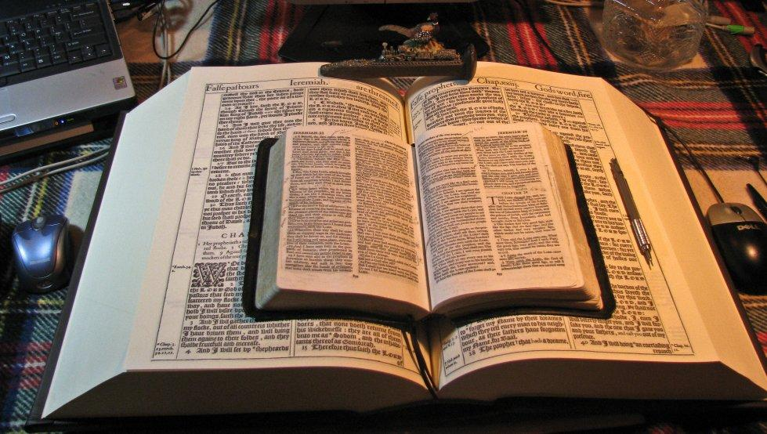
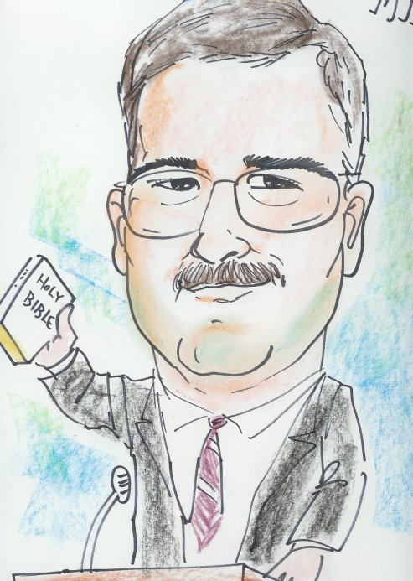
This PowerPoint was designed by Mike Paulson, June, 2016 – www.scatteredchristians.org
This presentation is not copyrighted, of course, so if you can add more, and there is a lot more that I am sure can be added to this, feel free to do so. My only expectation and requirement is that you use ONLY a King James 1611 Bible.
And truthfully, that is not a huge concern of mine because if you do try to use any other modern bibles, you will find they wouldn’t fit with this anyway; thus we see once again, the importance of a rightly divided 1611 KJB ONLY. ☺
If you do add more comments, scripture references, etc. for your own use – or to pass on to others,
please pass it on to me, as well. I would be glad to update yours to the website.

Slide 2
This PowerPoint was designed by Mike Paulson, June, 2016 – www.scatteredchristians.org
I was recently asked about my seemingly angry attitude towards religion. My answer: You know, quite often, MOST religious people are good people. Of course they are – they have to be –they are trying to work their way to heaven – or wherever they are hoping to go eventually. But then there are those who would do anything – even violence – to get you to be ‘swayed’ their way; and honestly, what people choose in their lives is their business.
But for me – I try to respond with Paul’s ways as to how I try to design my own walk and attitudes, etc. Acts 19:22-30. Paul has taught his ‘followers’ to despise the temple of the great goddess Diana and her magnificence should be destroyed. So I see from Paul’s example, I also need to despise religion and want to help destroy the magnificence of it all.
I don’t mean despise and destroy the people or property – just the magnificence of religion / religions /denominations. This presentation is a small way of showing my despising and attempts at destroying the magnificence of religion today. That’s all it is. I am not bitter nor am I angry or hateful towards the people; just the religion / and what the preachers are doing to put forth that false magnificence. I am sorry to say I have been there / done that – but no more! It is time for me to have the correct attitude towards religion, religions, denominations – all of them. You can see a few of the reasons within this presentation. My personal reasons will come later.

Slide 3
RELIGION
S
What a Mess

Slide 4
RELIGION
RELIGION

Slide 5
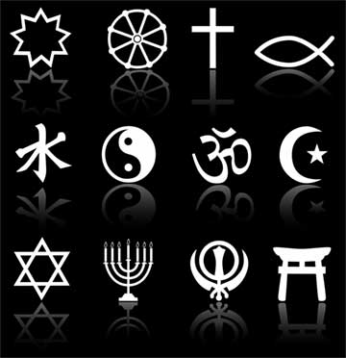
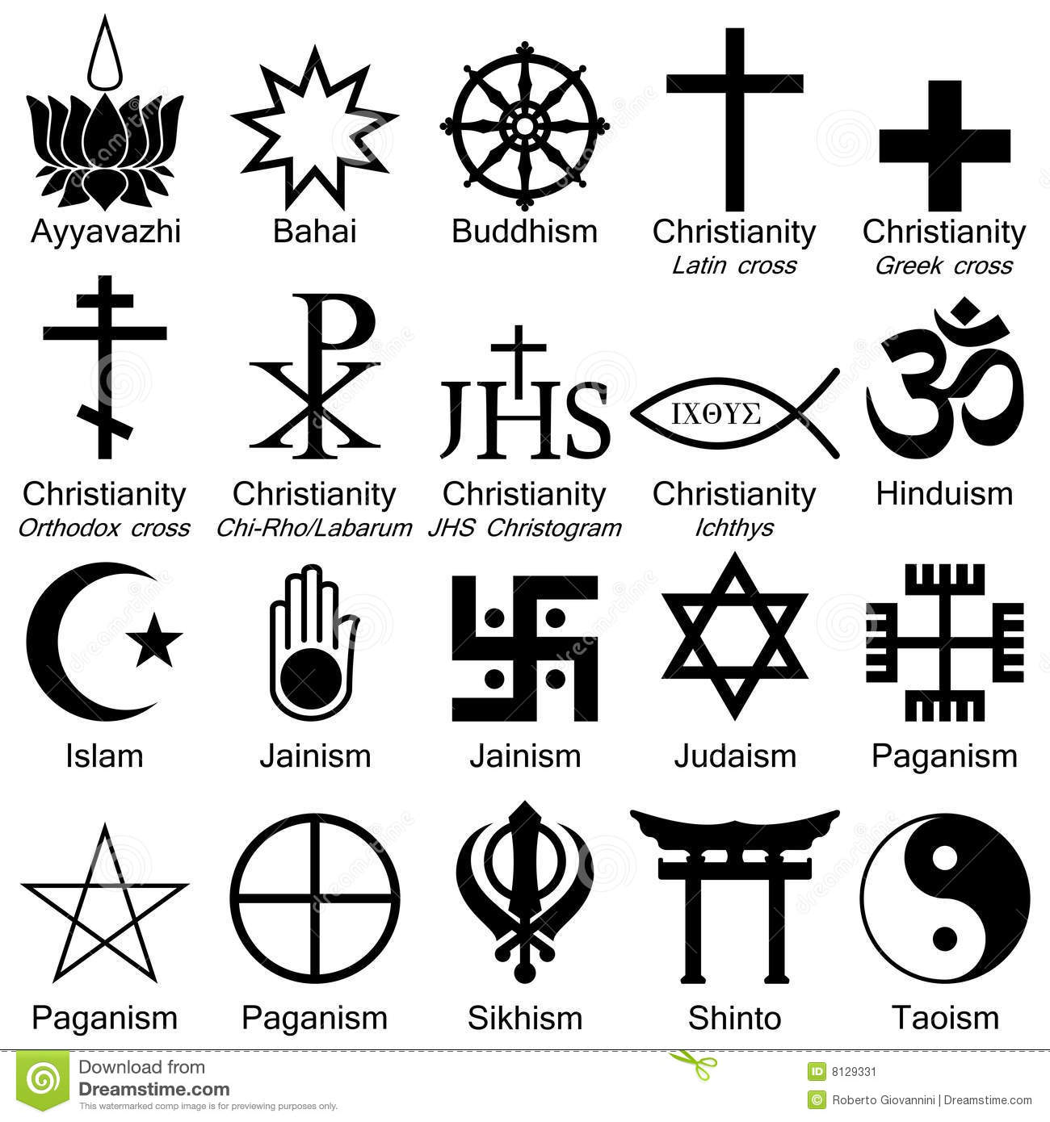
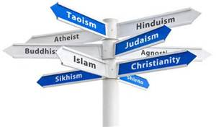
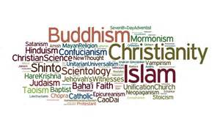

Slide 6
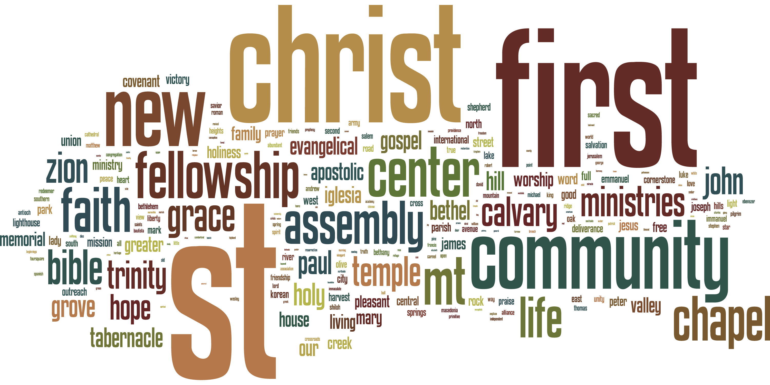
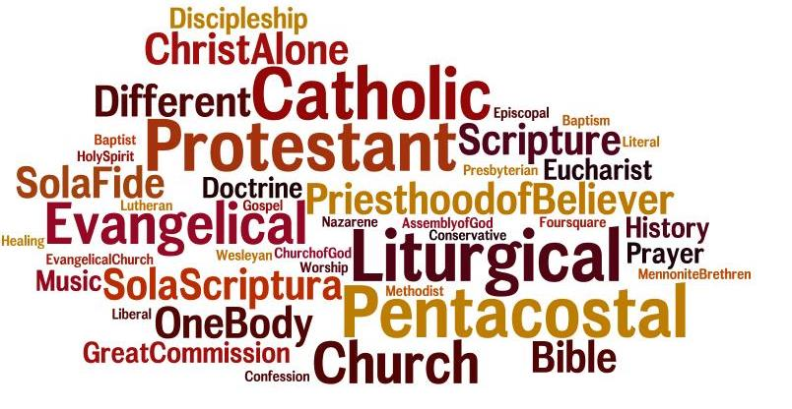
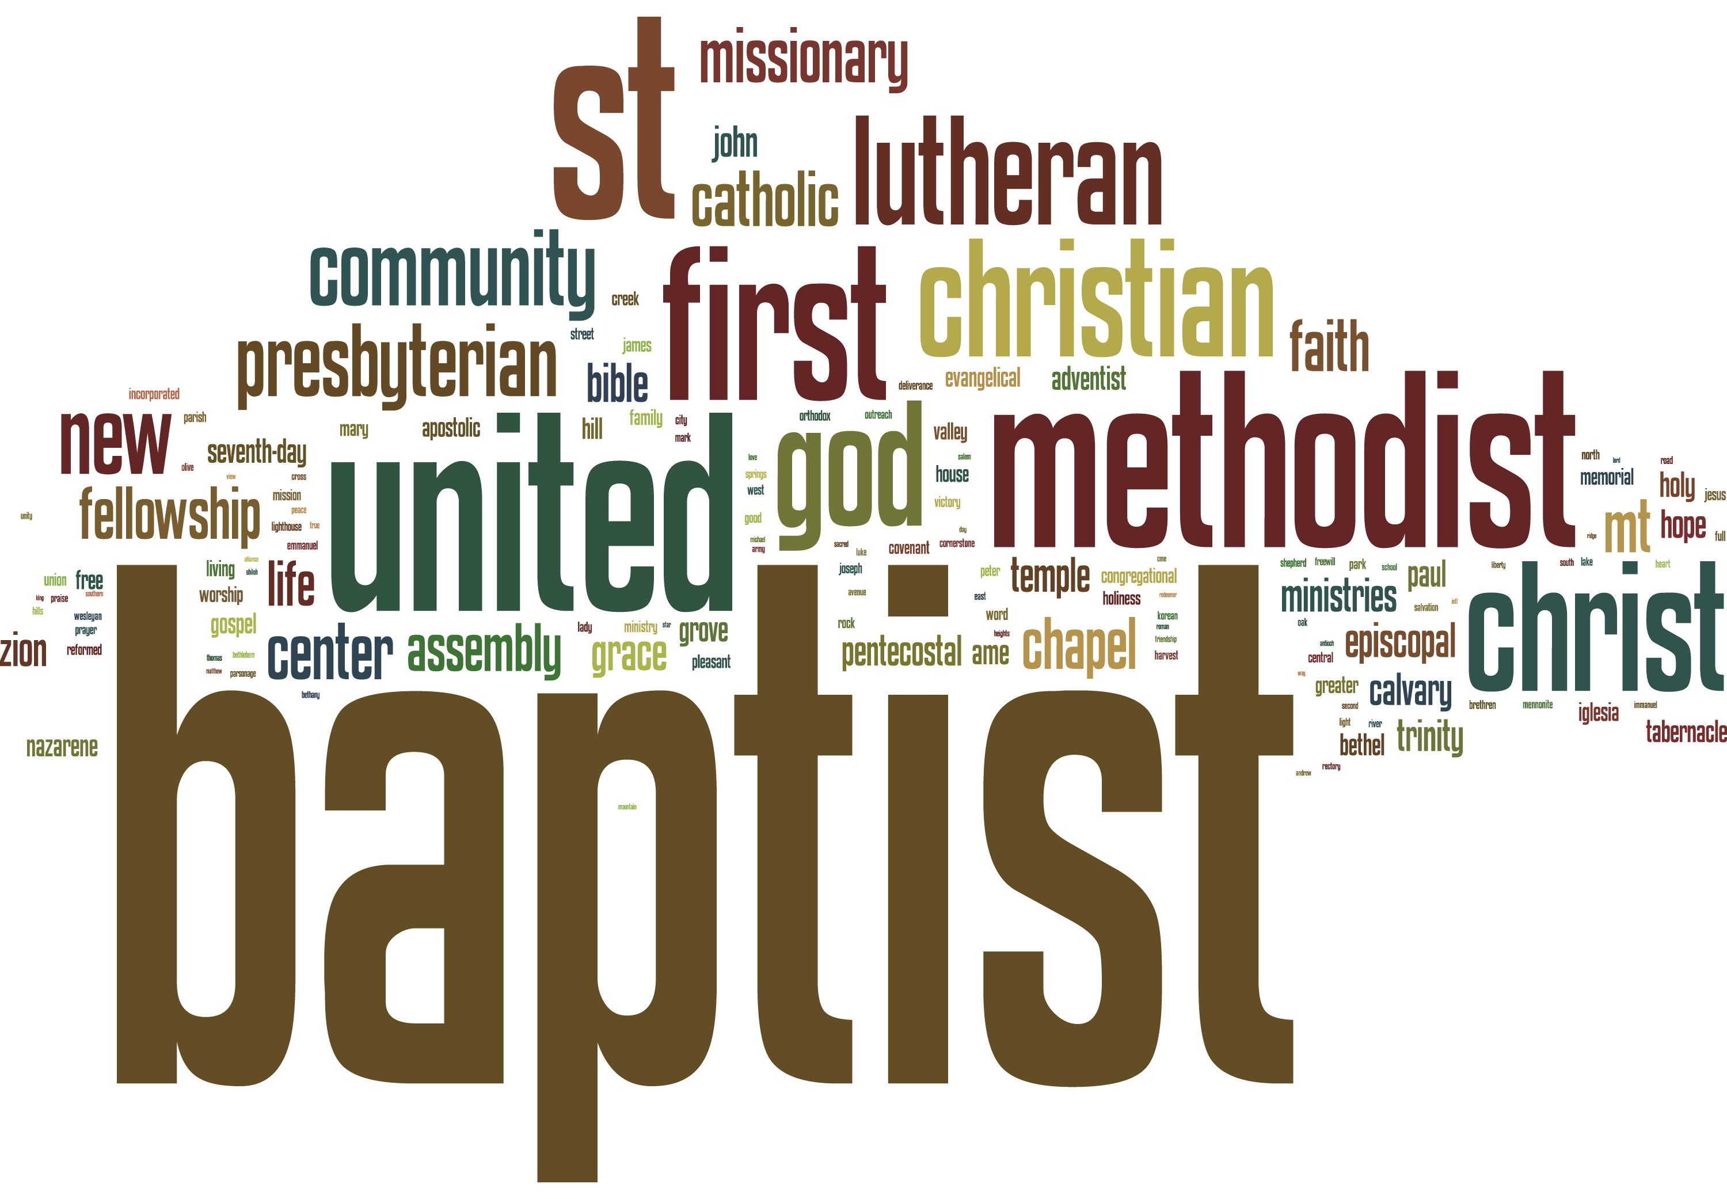

Slide 7
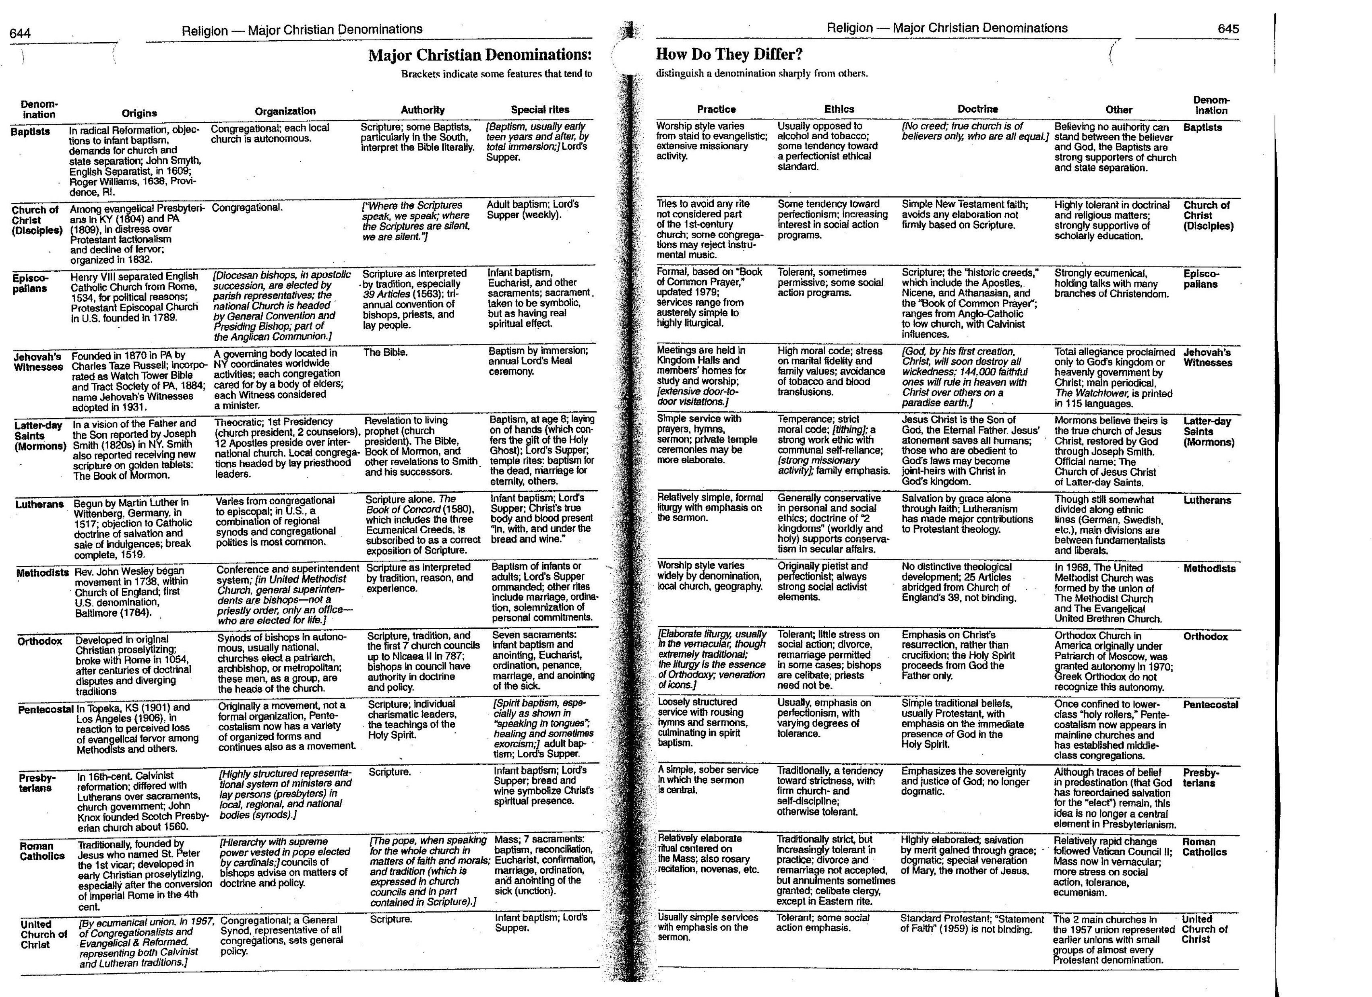
“Christian” denominationalism began when Paul noticed differences developing and said, “Now I beseech you, brethren, by the name of our Lord Jesus Christ, that ye all speak the same thing, and that there be no divisions among you; but that ye be perfectly joined together in the same mind and in the same judgment.
For it has been declared unto me of you, my brethren, by them which are of the house of Chloe, that there are contentions among you.
I Corinthians 1:10-11

Slide 8
Alliance of Baptists
American Baptist Association
American Baptist Churches USA
Association of Reformed Baptist Churches of America
Association of Regular Baptist Churches
B
Baptist Bible Fellowship International
Baptist Church of Christ
Baptist Convention of Costa Rica
Baptist Convention of Western Cuba
Baptist General Conference
Baptist General Conference of Canada
Baptist Missionary Association of America
C
Canadian Baptists of Ontario and Quebec
Canadian Baptists of Western Canada
Canadian National Baptist Convention
Central Baptist Association
Christian Unity Baptist Association
Church of Christ, Instrumental
Conservative Baptist Association of America
Conservative Baptist Association of the Southeast
Continental Baptist Churches
Convention of Atlantic Baptist Churches
Cooperative Baptist Fellowship
Covenanted Baptist Church of Canada
E
Baptist Convention of Eastern Cuba
Enterprise Association of Regular Baptists
Evangelical Free Baptist Church
F
Fellowship of Evangelical Baptist Churches in Canada
Fellowship of Independent Reformed Evangelicals
Free Will Baptist
Full Gospel Baptist Church Fellowship
Fundamental Baptist Fellowship Association
Fundamental Baptist Fellowship International
G
General Association of Baptists
General Association of General Baptists
General Six-Principle Baptists
…and then we have the…
Baptists
In North America
O
Ohio Valley Association of the Christian Baptist Churches of God
Old Regular Baptists
Original Free Will Baptist Convention
P
Pentecostal Free Will Baptist Church
Primitive Baptist Conference of New Brunswick, Maine and Nova Scotia
Primitive Baptist Universalist
Primitive Baptists
Progressive National Baptist Convention
Progressive Primitive Baptists
S
Separate Baptists
Separate Baptists in Christ
Seventh Day Baptists
Southwide Baptist Fellowship
Sovereign Grace Fellowship of Canada
The Spiritual Baptist Archdiocese of New York, Inc.
T
Transformation Ministries
Triennial Convention
Two-Seed-in-the-Spirit Predestinarian Baptists
U
Ukrainian Evangelical Baptist Convention of Canada
Union Baptists
Union of French Baptist Churches of Canada
Union of Slavic Churches of Evangelical Christians and Slavic Baptists of Canada
United American Free Will Baptist Church
United American Free Will Baptist Conference
Template:US Baptist denominations
W
Wisconsin Fellowship of Baptist Churches
World Baptist Fellowship
H
Holiness Baptist Association
I
Independent Baptist
Independent Baptist Church of America
Independent Baptist Fellowship International
Independent Baptist Fellowship of North America
Institutional Missionary Baptist Conference of America
Interstate & Foreign Landmark Missionary Baptist Association
L
Landmark Missionary Baptist Association of Quebec
Liberty Baptist Fellowship
List of conventions affiliated with the National Baptist Convention
Lott Carey Foreign Mission Convention
M
Missionary Baptists
N
National Association of Free Will Baptists
National Baptist Convention of America, Inc.
National Baptist Convention of Mexico
National Baptist Convention, USA, Inc.
National Baptist Evangelical Life and Soul Saving Assembly of the U.S.A.
National Missionary Baptist Convention of America
National Primitive Baptist Convention of the U.S.A.
National Union of Baptist Churches
New Baptist Covenant
New England Evangelical Baptist Fellowship
North American Baptist Conference

Slide 9
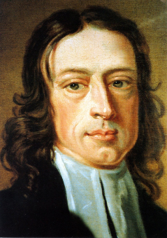
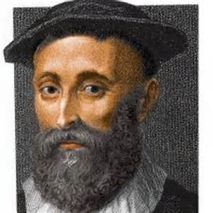
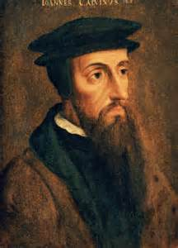
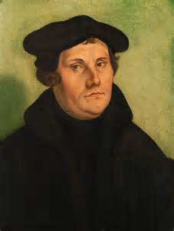
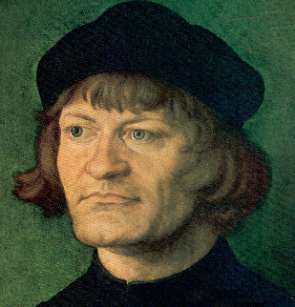
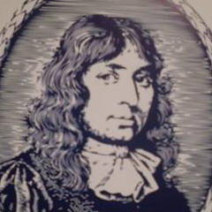
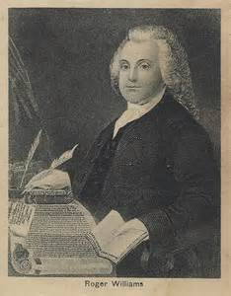
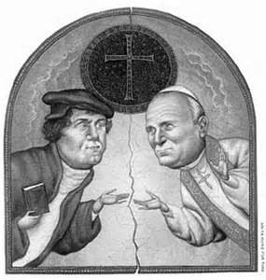
The Great Reformation, which guided people away from the Catholic Church, which created the Lutherans, which then led to the creation of the rest of the Protestant groups, has now been officially declared ‘done’ – ‘over’ – ‘kaput’ – ‘ended’ – ‘in history only’ – ‘fine’ – ‘terminado’ – ‘fertiggestellt’.
John Wesley
John Knox
John Calvin
Martin Luther
Ulrich Zwingli
John Smyth
Roger Williams
“Today, the heirs of the acrimony and fracture, the leaders of the Lutheran and Roman Catholic Churches, signed a document that officially settles the central argument about the nature of faith that Luther provoked. The agreement declares that it was all a misunderstanding ...
The agreement is significant beyond the dispute over doctrine that it resolves. It has deep implications for future relations among Catholics and Protestants, said theologians and church leaders. Many said the accord gives added promise to the ideal of their denominations champion - of full communion, or merger, between the churches.“ (The Washington Post, Nov.1, 1999)
“RC and Lutherans made another step toward joint commemoration of the 500th anniversary of the Reformation in 2017 by issuing common liturgical guidelines for ecumenical services to mark the occasion. The guidelines, called “Common Prayer,” provide a template for an ecumenical service complete with suggested prayers, hymns and themes for sermons.”
“I’m carried by the profound conviction that by working toward reconciliation between Lutherans and Catholics, we are working toward justice, peace and reconciliation in a world torn apart by conflict and violence.”
“Common Prayer stresses the shared beliefs between RC’s 2.3 billion members and the 75 million Lutherans worldwide. It advises readers the recommendations can be adjusted according to the country and language in which they are used.”
[Methodists] are grateful that on the basis of such an agreement as this, Lutheran and Methodist Churches…have recognized one another as belonging to the one Church of Jesus Christ and have declared full communion of pulpit & altar.
It is our deep hope that in the near future we shall also be able to enter into closer relationship with Lutherans in other places and with the Roman Catholic Church in accordance with this declaration of our common understanding of the doctrine of justification.“ http://www.protestant-reformation.org/ecumenism-today.html
Martin Junge, general secretary of the Lutheran World Federation, regarding Pope Francis’ October trip to Sweden to mark the 500th anniversary of the Protest Reformation.

Slide 10
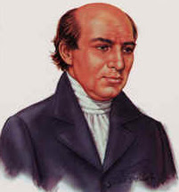
Great
Commission
William Carey, called the “Father of Modern Missions”, a Baptist missionary, wrote a book in 1792 that brought back from the OT Gospels the ‘Great Commission’ and through the use of ‘false’ miracles, signs and wonders, pushed out Paul as the ‘only’ apostle and brought back the apostolic doctrine – of which has everything to do today with the teaching, preparation and the arrival of the antichrist in Rev. 6 through the profane and vain babblings of preachers preaching the wrong gospel today while completely rejecting Paul’s teachings of the 2nd coming of the Risen Christ in Rev. 19
A N
E N Q U I R Y
INTO THE
OBLIGATIONS OF CHRISTIANS,
TO USE MEANS FOR THE
C O N V E R S I O N
OF THE
H E A T H E N S.
IN WHICH THE
RELIGIOUS STATE OF THE DIFFERENT NATIONS
OF THE WORLD, THE SUCCESS OF FORMER
UNDERTAKINGS, AND THE PRACTICABILITY OF
FURTHER UNDERTAKINGS, ARE CONSIDERED,
BY WILLIAM CAREY.
His convincing words brought back miracles, signs, wonders into the jungle which American pastors brought back into their own pulpits. “I wish with all my heart, that everyone who loves our Lord Jesus Christ in sincerity, would in some way or other engage in it [Great Commission]. But in the present divided state of Christendom, it would be more likely for good to be done by each denomination engaging separately in the work, than if they were to embark in it conjointly.
There is room enough for us all, without interfering with each other; and if no unfriendly interference took place, each denomination would bear good will to the other, and wish, and pray for its success, considering it as upon the whole friendly to the great cause of true religion; but if all were intermingled, it is likely their private discords might throw a damp upon their spirits, and much retard their public usefulness. “Enquiry…” –page 36 – William Carey

Slide 11
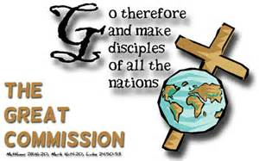
Paul’s Greater Commission
Acts 13:47 For so hath the Lord commanded us, saying, I have set thee to be a light of the Gentiles, that thou shouldest be for salvation unto the ends of the earth.
Be ye followers of me, even as I also am of Christ. I Cor 11:1
Mark 16:15,16 And he said unto them, Go ye into all the world, and preach the gospel to every creature. He that believeth and is baptized shall be saved; but he that believeth not shall be damned.
How that by revelation he made known unto me the mystery… Which in other ages was not made known… as it is now revealed… That the Gentiles should be fellow-heirs, and of the same body, and partakers of his promise in Christ by the gospel; Whereof I was made a minister… that I should preach among the Gentiles the unsearchable riches of Christ; And to make all men see what is the fellowship of the mystery, which from the beginning of the world hath been hid in God... Eph 3:1-12
However, preachers & pastors ignore the next 4 verses:
Mark 16:17-20 And these signs shall follow them that believe; In my name shall they cast out devils; they shall speak with new tongues; They shall take up serpents; and if they drink any deadly thing, it shall not hurt them; they shall lay hands on the sick, and they shall recover.
So then after the Lord had spoken unto them, he was received up into heaven, and sat on the right hand of God. And they went forth, and preached every where, the Lord working with them, and confirming the word with signs following. Amen.
Now to him that is of power to stablish you according to my gospel, and the preaching of Jesus Christ, according to the revelation of the mystery, which was kept secret since the world began… Romans 16:25
Be not thou therefore ashamed of the testimony of our Lord, nor of me his prisoner: but be thou partaker of the afflictions of the gospel according to the power of God; II Timothy 1:8
For this cause have I sent unto you Timotheus, who is my beloved son, and faithful in the Lord, who shall bring you into remembrance of my ways which be in Christ, as I teach every where in every church. I Cor 4:17
Jesus told the apostles this ‘Great Commission’ was to be preached only to Jews; it was not to be preached unto Gentiles; So, it has been completed – done – no more – not to us today!
Paul’s greater commission is to the Gentiles today, US! You and Me - not to the Jews. It is not done! It is still in effect - until the Gentiles no longer are interested. Romans 11:22

Slide 12
Religion is and religions are a dangerous & disastrous mess, including today’s “America’s Ecumenicalized Great Commission Churches” !
Heyyyyyyyyyyyyyyyyyyyyyyyyyyyyyyyyy

Slide 13
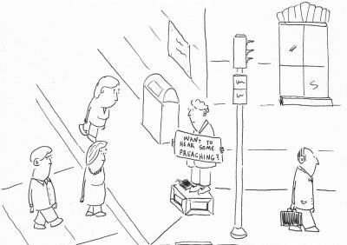
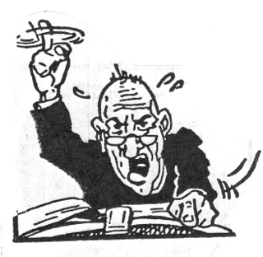
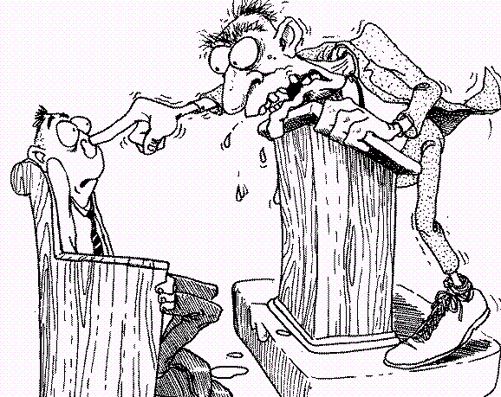
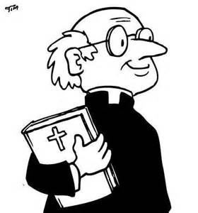
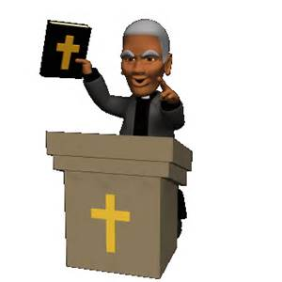
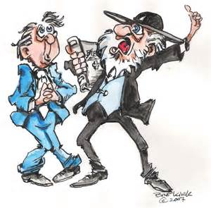
By the way: The pastors that preach the Great Commission may be great, sincere, tough skilled preachers & teachers, loving, caring, wonderful, friendly, enjoyable, creative, educated, helpful, polite, giving, husband of one wife with great kids, not self-willed, not soon angry, not given to wine (rare), no striker, a lover of hospitality…
But they are WRONG in their…
But evil men and seducers
shall wax worse and worse, deceiving, and being deceived.
II Timothy 2:13
Doctrine
Church Design
Church Purpose
For there are many unruly and vain talkers and deceivers, specially they of the circumcision: Whose mouths must be stopped, who subvert whole houses, teaching things which they ought not, for filthy lucre's sake.
Church Worship
Church Music
Sermons
Sources
Wherefore rebuke them sharply, that they may be sound in the faith; Not giving heed to Jewish fables, and commandments of men, that turn from the truth. Titus 1:10-14
Attitude
Witness
Words
However, this presentation is about religions,
not the people that promote them.
I will save those comments until the next presentation.
Faith

Slide 14
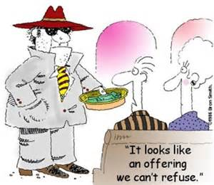
RELIGION
Uses and Abuses
Religions preach a message of extortion through ‘giving’ – ‘offerings’ – ‘donations’ – ‘forced payments’ - etc.
Religions preach ‘guilt trips galore’ to those who don’t ‘give’ and/or ‘give in’.
They Always Have and Always Will!
Woe unto you, scribes and Pharisees, hypocrites! for ye make clean the outside of the cup and of the platter, but within they are full of extortion and excess. Matthew 23:25
Most Christian denominations misuse Bible verses to ‘demand’ a minimum 10% tithe / offering
They preach Old Testament fear and guilt!
Will a man rob God? Yet ye have robbed me. But ye say, Wherein have we robbed thee? In tithes and offerings. Ye are cursed with a curse: for ye have robbed me, even this whole nation. Bring ye all the tithes into the storehouse, that there may be meat in mine house, and prove me now herewith, saith the LORD of hosts, if I will not open you the windows of heaven, and pour you out a blessing, that there shall not be room enough to receive it. Malachi 3:8-10
And / or they go to the Tribulation books!
But whoso hath this world's good, and seeth his brother have need, and shutteth up his bowels of compassion from him, how dwelleth the love of God in him? I John 3:17

Slide 15
RELIGION
Rules the Day
Humanism in the world / government / schools, etc. is considered an official religion.
“…a federal judge in Oregon declared ‘secular humanism’ to be a religion, opining that those who profess to be atheists and secular humanists should be afforded equal protection rights under the Establishment Clause of the U.S. Constitution and be allowed to enjoy the same liberties to practice religion that religious groups are able to enjoy.” See link
Humanism placed the human being at center stage in the universe. No longer God is the protagonist of intellectual endeavors: everything is now seen from the perspective of human beings. God created humans, beings with reason, and it is from the human perspective that we should understand worldly phenomena; after all, no other perspective is really possible.
Humanism is directly correlated to liberalism, although the connection often goes undetected. The importance that the individual assumes in Western philosophy much owes to the humanistic emphasis over the centrality of human reason in the universe.
The ‘created’ now worship the ‘creature’ – themselves.
Because that, when they knew God, they glorified him not as God, neither were thankful; but became vain in their imaginations, and their foolish heart was darkened.
Humanism link
The emphasis on the individual rights and duties, on freedom and responsibility, that much characterizes Western culture, hence developed from Humanism.
See Romans 1:18-32
Professing themselves to be wise, they became fools, And changed the glory of the uncorruptible God into an image made like to corruptible man, and to birds, and fourfooted beasts, and creeping things.
Can you now see how even Christian ‘denominations’ have become humanistic in their approach? They are ‘after all’ as they wrongly use Acts 2:47 for one of their basic goals - …and having favour with all the people…”
Who changed the truth of God into a lie,
and worshipped and served the creature more
than the Creator, who is blessed for ever. Amen.
For this cause God gave them up unto vile affections:
And even as they did not like to retain God in their knowledge, God gave them over to a reprobate mind,
to do those things which are not convenient;
Wherefore God also gave them up to uncleanness through the lusts of their own hearts, to dishounour their own bodies between themselves:

Slide 16
RELIGION
RELIGION
Causes Confusion
…has no simple single final authority which can be read, studied, believed, shared, understood, etc.
…has loads of, countless, several, various, scores of, sundry, voluminous, abundant, profuse, abounding, bounteous, bountiful, copious, divers, innumerable, legion, lousy with, manifold, multifarious, multifold, multiplied, multitudinous, myriad, no end of, numberless denominations / types / styles.
…has an unending and constantly increasing amount of books, so-called bibles, commentaries, lexicons, study helps, websites, cd’s, video’s, tapes, etc. – from each denomination / religion etc. to read, carry, purchase, show of in bookshelf, etc. and even study – one can find a book that matches their own beliefs.
…shows various miracles, signs and wonders, all to confuse what they hear with what people will see. According to the KJB Scriptures, NONE of them are by God today, IF that ‘miracle’ was done by man’s involvement. God can do what He wants when He wants, but He will not use miracles, signs and wonders to prove His existence during today’s Dispensation of Grace!
…has all the various doctrines anyone would want for themselves! One can find a doctrine that matches their own emotions, feelings, beliefs, social and enjoyment factors, desired flash and pizzazz, attitudes and actions.
If history is your source of truth, remember, there many different histories written from many different perspectives and ‘schools of thought’, etc. You can find whatever history YOU find most interesting to follow.
Unless God’s words alone are your final authority in all matters of faith and practice, then YOU become YOUR own final authority, YOU make your final decisions based on all YOU read, study, hear, learn, see, feel, etc.

Slide 17
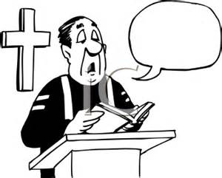
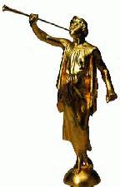
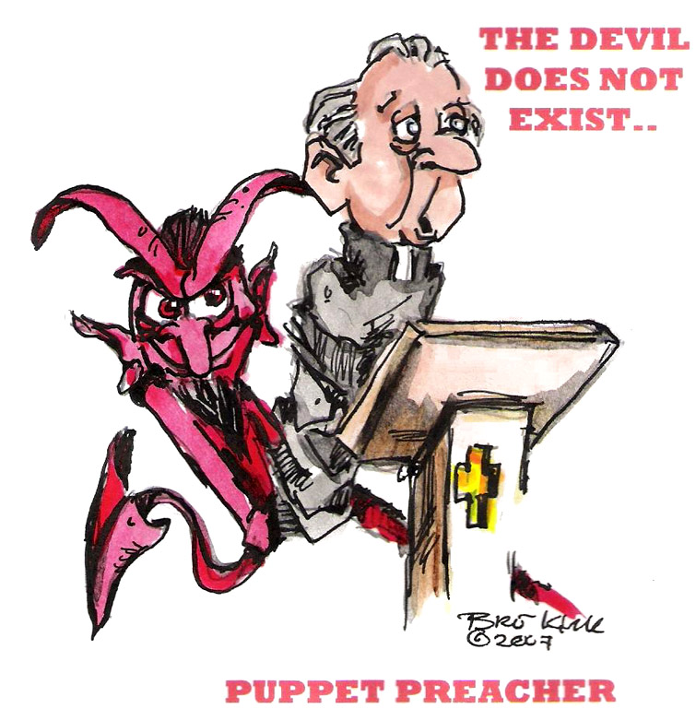
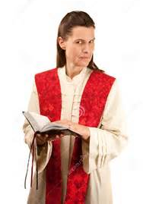
RELIGION
“Great Commission”
Deceives
NIV
But evil men and seducers shall wax worse and worse, deceiving, and being deceived.
II Timothy 3:13
But though we, or an angel from heaven, preach any other gospel unto you than that which we have preached unto you, let him be accursed. As we said before, so say I now again, If any man preach any other gospel unto you than that ye have received, let him be accursed. Galatians 1:8,9
Would to God ye could bear1 with me a little in my folly: and indeed bear with me. For I am jealous over you with godly jealousy: for I have espoused you to one husband, that I may present you as a chaste virgin to Christ. But I fear, lest by any means, as the serpent beguiled Eve through his subtilty, so your minds should be corrupted from the simplicity that is in Christ.
For if he that cometh preacheth another Jesus, whom we have not preached, or if ye receive another spirit, which ye have not received, or another gospel, which ye have not accepted, ye might well bear with him. II Corinthians 11:1-4
For such are false apostles, deceitful workers, transforming themselves into the apostles of Christ.
And no marvel; for Satan himself is transformed into an angel of light. Therefore it is no great thing if his ministers also be transformed as the ministers of righteousness; whose end shall be according to their works. I Corinthians 11:13-15
For they that are such serve not our Lord Jesus Christ, but their own belly; and by good words and fair speeches deceive the hearts of the simple. Romans 16:18
Let no man deceive you by any means: for that day shall not come, except there come a falling away first, and that man of sin be revealed, the son of perdition; II Thessalonians 2:3
That we henceforth be no more children, tossed to and fro, and carried about with every wind of doctrine, by the sleight of men, and cunning craftiness…
Whereby they lie in wait to deceive
Ephesians 4:14

Slide 18
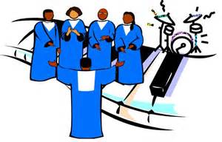
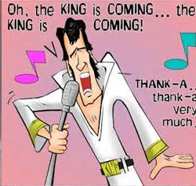
RELIGION
Presents a False Worship
Worship has become a musical performance that does not please God…
because ‘Christian’ music today emphasizes and feeds the flesh!
Music has become the great ‘ecumenicalizer’ as all denominations can now ‘worship’ together, in spite of ‘doctrinal’ differences.
Three basic elements of music: Melody, Harmony, Rhythm.
Melody…
Influences spirit – man’s spirit / God’s Spirit
Music has replaced the sermon in importance!
Harmony…
Influences mind – emotions, feelings
The ‘worship leader’ is more important than the pastor.
Rhythm…
Influences body – physical – flesh – the beat
Worship teams have been created to help bring ‘favour’ to all people.
But put ye on the Lord Jesus Christ, and make not provision for the flesh, to fulfil the lusts thereof. Romans 13:14
Music has become the money maker for the church coffers as well as the means for missionaries to get their ‘deputational’ income.
For I know that in me (that is, in my flesh,) dwelleth no good thing: for to will is present with me; but how to perform that which is good I find not. Romans 7:18
While there are those who ‘make a joyful noise’ with their heart, most music has become professional in sound and design – thinking they will impress God with their talents and musical performance.
That no flesh should glory in his presence. I Corinthians 1:29
Expensive 1st class techy video and audio equipment with their fancy visual helps and presentations on large screens, etc. are all designed to attract people and impress God.
As many as desire to make a fair shew in the flesh… Galatians 6:12
God that made the world and all things therein, seeing that he is Lord of heaven and earth, dwelleth not in temples made with hands;
Satan, the great musician, (Ezekiel 28:13-19) is using music as the power to bring his desire to fruition – and is already receiving his worship.
Neither is worshipped with men's hands, as though he needed any thing, seeing he giveth to all life, and breath, and all things; Acts 17:24,25
Satan says: I will be like the most High. Isaiah 14:14
NOTE:
…all kinds of musick
That at what time ye hear the sound of the cornet, flute, harp, sackbut, psaltery, dulcimer, and all kinds of musick, ye fall down and worship the golden image that Nebuchadnezzar the king hath set up: Daniel 3:5
Speaking to yourselves in psalms and hymns and spiritual songs, singing and making
melody
in your heart to the Lord. Ephesians 5:19

Slide 19
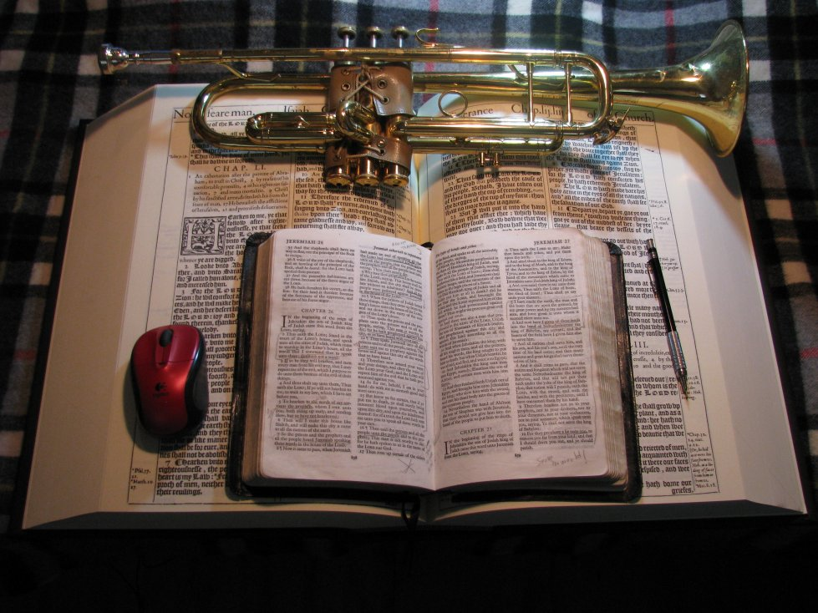
Music & Bible at: www.scatteredchristians.org
You are invited to visit my website; in it you will find 160,000+ MB of audio/video sermons and written studies on Bible subjects and music from 13 years of ‘live’ pastoring, 32 years of preaching the KJB ONLY, 13 years teaching rightly dividing the risen Saviour through Paul ONLY, 44 years of teaching music with 58 years of musical knowledge, experience and observation
… and with 66 years of life… so far!

Slide 20
RELIGION
Creates Pride
People tend to be deeply proud of their ‘church’ – their ‘religion’ – their ‘pastor’ – their music / musicians / band – their building – their programs – their activities – in themselves and how ‘good’ they have become, etc.
A ‘religion’ / ‘denomination’ that teaches that ‘good works’ result in God’s physical blessings, develops a pride that is in themselves for how they think they have earned God’s blessings in their lives.
Teaching the Great Commission, etc. produces a pride in that they believe their miracles, sign and wonders are brought about by either their own good works, their great prayer life, their financial giving, church growth, etc. They do not understand that the teachings from the Risen Saviour are to the Gentiles today – and that the Great Commission was to be taught to the Jews while Jesus was on the earth.
For I would not, brethren, that ye should be ignorant of this mystery, lest ye should be wise in your own conceits; that blindness in part is happened to Israel, until the fulness of the Gentiles be come in. Romans 11:25
For where a testament is, there must also of necessity be the death of the testator. For a testament is of force after men are dead: otherwise it is of no strength at all while the testator liveth. Hebrews 9:16,17
Learning and applying Paul’s Greater Commission’s teachings which are from the risen Saviour ONLY - then one realizes:
1. …you have no reason to be prideful / just thankful, because your blessings are spiritual. Any physical ‘blessings’ would be because you have money and/or spiritual wisdom and direction from your KJB study, etc. – but you must remember that we still live in a cursed politically correct world. Living the manner of life that Paul teaches will bring about persecution.
2) …you understand the conceit of those who follow the teachings of the Great Commission or other religions.
3) …that what you have spiritually is all HIS – given to you by HIM. It is HIS salvation, His righteousness, His grace, His understanding, His knowledge, His Sword, His words, His wisdom, etc.
So because of the false teachings of today’s religions producing pride, we see why there is war, hard feelings, anger, fighting, disagreement, little to no toleration towards others, politically correctness today, etc. Pride!
Only by pride cometh contention. Proverbs 13:10

Slide 21
RELIGION
Produces Envy
EN'VY - uneasiness, mortification or discontent excited by the sight of another's superiority or success, accompanied with some degree of hatred or malignity, and often or usually with a desire or an effort to depreciate the person, and with pleasure in seeing him depressed. Websters 1828
They were envious of Joseph
…so they threw him into a hole!
And the patriarchs, moved with envy, sold Joseph into Egypt: but God was with him, Acts 7:9
They were envious of Jesus
…so they killed him!
For he knew that for envy they had delivered him. Matthew 27:18
For he knew that the chief priests had delivered him for envy. Mark 15:10
They were and still are envious Paul
They tried to kill him then and still do today; they reject and ignore him as they try to kill his influence while they verbally attack and criticize those that follow him and the teachings of the risen Saviour ONLY.
But when the Jews saw the multitudes, they were filled with envy, and spake against those things which were spoken by Paul, contradicting and blaspheming. Acts 13:45
But the Jews which believed not, moved with envy, took unto them certain lewd fellows of the baser sort, and gathered a company, and set all the city on an uproar, and assaulted the house of Jason, and sought to bring them out to the people. Acts 17:5
…Festus said with a loud voice, Paul, thou art beside thyself; much learning doth make thee mad. Acts 26:24
And when it was day, certain of the Jews banded together, and bound themselves under a curse, saying that they would neither eat nor drink till they had killed Paul. And they were more than forty which had made this conspiracy. Acts 22:12,13
They were and still are envious the 1611 KJB
So they changed it, corrupted it, corrected it, rejected it, hid it, criticize those who use it ONLY – all in the name of scholarship and money – they are…
…proud, knowing nothing, but doting about questions and strifes of words, whereof cometh envy, strife, railings, evil surmisings, I Tim 6:4

Slide 22
God’s Righteousness Imputed to You
RELIGION
The Whole Armour of God
Being Dead From Sin
Denies
Eternal & Everlasting Life
Riches of His Glory
Mystery of Christ
By following an imitation Jesus, an imitation spirit, an imitation gospel, an imitation god, an imitation church, an imitation pastor, an imitation bible, all the members of religion are denied:
The Riches both of the Wisdom and Knowledge of God
The Faith of Jesus Christ
The Spirit of God
True Friendly Fellowship
The Goodness of God
The truth
Knowledge of the Risen Saviour
1611KJB
The Gospel of Christ
Pastors and Teachers of the Truth
The Hope of the Gospel
Personal Inner Joy
A Proper Witness To and For Others
God Breathed and Preserved Holy Scriptures
The Promises from the Living God TO Them
The Kindness of God
Everlasting Consolation and Good Hope Through Grace
The Fruits of Righteousness
The True Body of Christ
Spiritual and Physical Wisdom
The Riches of His Goodness and Forbearance and Longsuffering
Sincere Hope Toward God
God’s Constant Grace
The Fellowship of the Mystery
A Very Small Library
Confidence
A Proper Local Church
Our Only Apostle Paul
Spiritual Circumcision
God Pleasing Manner of Life
Longsuffering of God
The Sword of the Spirit
Riches of the Glory of his Inheritance
A Peace that Passeth all Understanding
Boldness
True Prayer with Answers
The Love of Christ
A True Awareness & Understanding of the Past / Present / Future
True Salvation
100% Assurance of Salvation
24/7 Contact with the Living God
Sound Doctrine
The Riches of the Full Assurance of Understanding
The Riches of His Grace in His Kindness

Slide 23
God’s sword is any and all modern Bibles?
Any book is God’s Word?
RELIGION
Obey ten commandments?
Baptism as ‘baby;,’ as adult for salvation; after for ‘type’?
Good works?
Decent works?
Beanie on head?
Tithing Properly?
Teaches You False ‘Ways’
Shedding some of your own blood for ‘certain’ sins you have committed?
Reject all blood transfusions?
You “Meant Well”?
Uncut facial hair?
WRONG!
Different Ways to the Same God?
WRONG!
Any gospel?
Fear to lose your salvation?
Following religious dogma exactly?
Obey the Sabbath?
Only One Way
Confession?
Following your pastor’s guidelines and example?
There is one body, and one Spirit, even as ye are called in one hope of your calling; One Lord, one faith, one baptism, One God and Father of all, who is above all, and through all, and in you all. Ephesians 3:4-6
Maybe just not make it the ‘top’ heaven?
Apostle’s Doctrine Only during Gospel days.
Holy Communion with wine or grape juice; weekly, monthly, etc.?
Only of the chosen / elected?
Jesus saith unto him, I am the way, the truth, and the life: no man cometh unto the Father, but by me. John 14:6
Apostle Paul’s Doctrine Only Today
Long hair on women?
But when it pleased God, who separated me from my mother's womb, and called me by his grace, To reveal his Son in me, that I might preach him among the heathen; immediately I conferred not with flesh and blood: Galatians 1:15,16
For this cause I Paul, the prisoner of Jesus Christ for you Gentiles, If ye have heard of the dispensation of the grace of God which is given me to you-ward: How that by revelation he made known unto me the mystery; (as I wrote afore in few words, Whereby, when ye read, ye may understand my knowledge in the mystery of Christ) Which in other ages was not made known unto the sons of men, as it is now revealed unto his holy apostles and prophets by the Spirit;
That the Gentiles should be fellowheirs, and of the same body, and partakers of his promise in Christ by the gospel: Whereof I was made a minister, according to the gift of the grace of God given unto me by the effectual working of his power. Unto me, who am less than the least of all saints, is this grace given, that I should preach among the Gentiles the unsearchable riches of Christ; Ephesians 3:1-8
It All Changed in 1611
The KJB Cuts and Saves During the Operation of God
But when that which is perfect is come, then that which is in part shall be done away. I Corinthians 13:10
In whom also ye are circumcised with the circumcision made without hands, in putting off the body of the sins of the flesh by the circumcision of Christ: Buried with him in baptism, wherein also ye are risen with him through the faith of the operation of God…. Col 2:11,12a
Arrival of King James 1611 Bible
And take … the sword of the Spirit, which is the word of God: Ephesians 6:17
And It Is About to Change for the Gentiles for the Last Time
Behold therefore the goodness and severity of God: on them which fell, severity; but toward thee, goodness, if thou continue in his goodness: otherwise thou also shalt be cut off. Romans 11:22
Behold, the days come, saith the Lord GOD, that I will send a famine in the land, not a famine of bread, nor a thirst for water, but of hearing the words of the LORD: Amos 8:11

Slide 24
RELIGION
Presents a False Near Future
Some preachers have us in the Tribulation right now! Have they not read the biblical description in Matthew and Revelation? Do they not know the difference between the ‘what’ and ‘when’ of the severity of God, the Great Commission and God’s goodness, Paul’s Commission?
Sincere Christians don’t seem to realize their next event - after either the rapture or their death - will be their personal judgment seat. They seem to be more interested in preparing for the tribulation instead than prepping now with their manner of life for their judgment seat of Christ. See Romans 2:16
Some preachers are telling folks they all will have to still go through the Tribulation as Christians! They have no clue about the doctrinal change that has to take place. See Romans 11:22
Lots of preachers teach their folks that if they want to receive God’s blessings and money… they need to start giving more, coming to church more often, be better with visitation, be nicer and more tolerant to others with ‘God’s love’, etc. See Malachi 3:8 with Great Commission sermons.
More and more are losing ‘hope’ in the rapture as their ‘escape’, but they apparently don’t love His appearing, just their disappearing. See II Timothy 4:8
Lots of preachers teach their folks that if they would start taking and giving harder preaching to folks, get into people’s faces more, scream louder on the street corner, care even less about their fatness and sloppy appearance, beat their kids more into obedience, argue at work more, do whatever they can do to conquer the lost and win them to the Lord, etc. they would receive God’s blessings and money. See Jeremiah and other OT prophets
Just about all the preachers of any and all denominations are unknowingly prepping their people for ‘a’ soon coming, etc. They seem to have forgotten Rev 6 must come before Rev 19. They are doing a good job, though, as they preach the Great Commission, which is exactly what they will be preaching during the Tribulation. So at least their congregation will be ready when it does come’s first for them.
Preachers still tell Americans to seek his face and pray… and God will heal this nation. That is an OT bogus claim! Just one more Pastoral lie exposed by rightly dividing the word of truth instead of listening to their profane and vain babblings. See I Chronicles 16:11; II Timothy 2:15,16
Even though most ‘Christians’ believe that Jesus died and rose again, they insist on ignoring what He taught after He rose! It is Paul that presents the ‘new testament’ today. See Hebrews 9:16,17
It seems those preachers who tend to lean on Paul’s teachings in their ‘Grace’ churches still tend to ignore the ‘manner of life’ preaching from Paul. I have heard folks flat out say they don’t want the persecution that comes with it. See II Timothy 2:12
Most Christians, according to the Scriptures, etc. will soon be finding themselves in the wrong army during Revelation 19, at the wrong judgment, on the wrong side of the ‘fence’. See Revelation 16:14; I Corinthians 11:1-4; Daniel 7:9,10
That ye be not soon shaken in mind, or be troubled, neither by spirit, nor by word, nor by letter as from us, as that the day of Christ is at hand. Let no man deceive you by any means: for that day shall not come, except there come a falling away first… See II Thessalonians 2

Slide 25
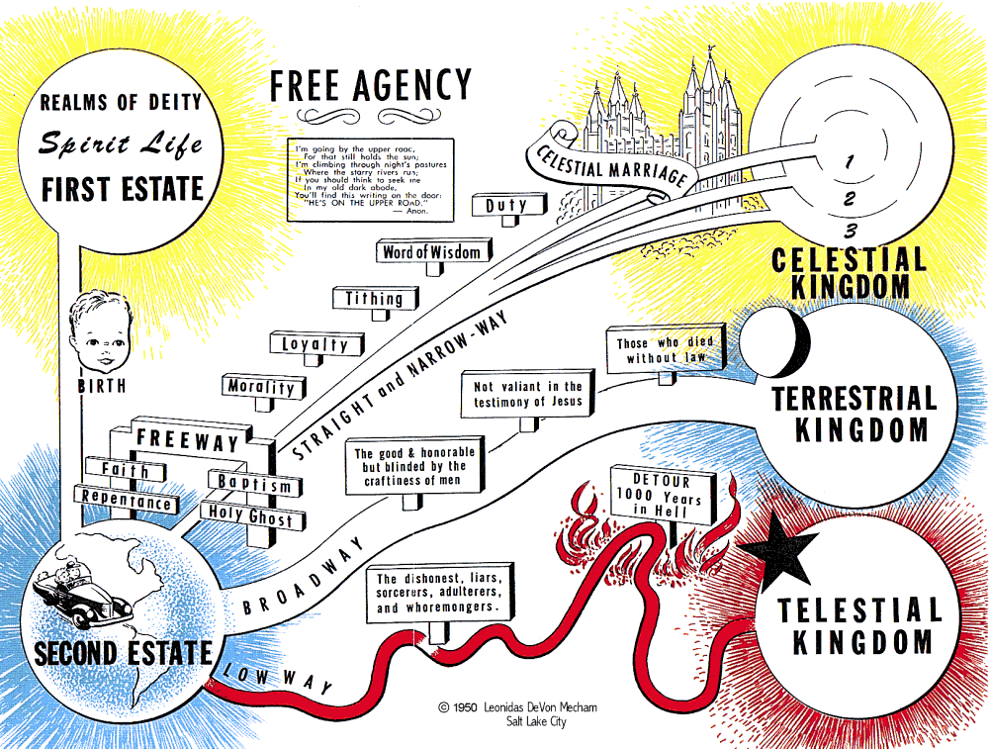
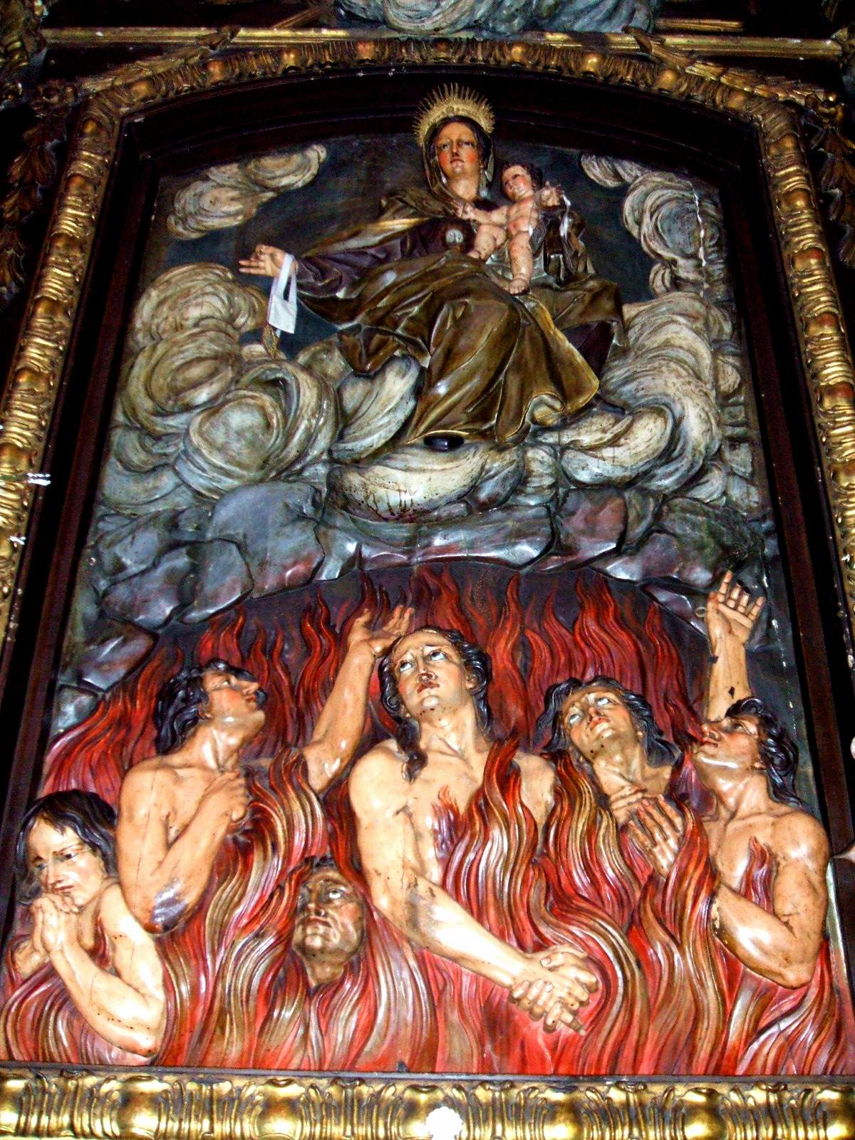
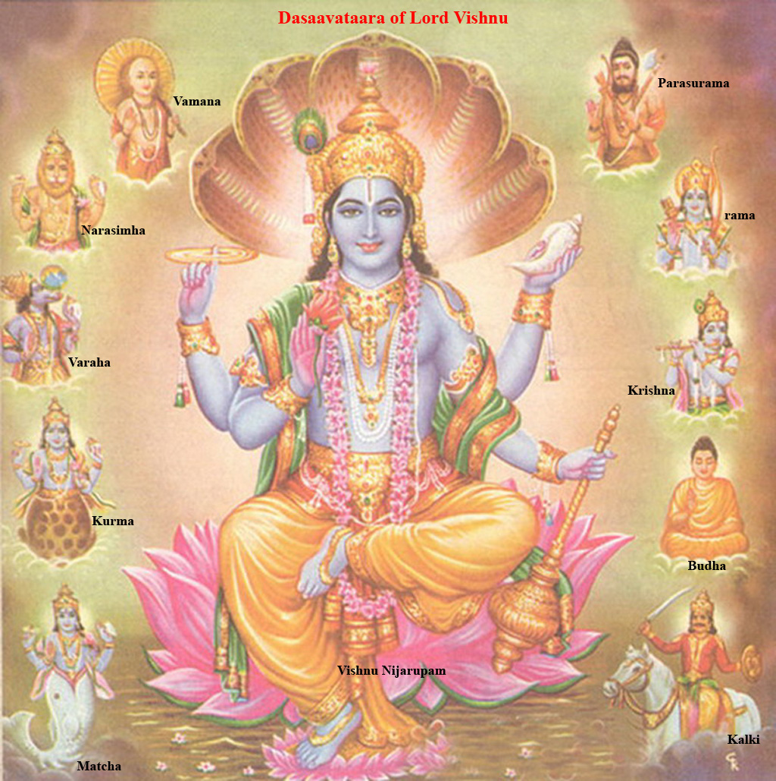
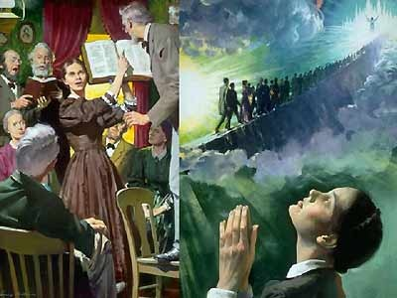
RELIGION
Presents a False Eternal Future
Mormon’s Plan
Islam’s Plan
Catholics Purgatory Plan
Hinduism Plan
Seventh Day Adventist’s Plan
Most Everybody’s Religion Plan Today

Slide 26
King James 1611 Bible
Scholarship, Education, Degrees, Bible Institutes, Courses, Workshops, Retreats, Conventions – books, books, books,
and more books…
Religion
S
Ever learning, and never able to come to the knowledge
of the truth.
The Truth

Slide 27
Get one while you still can!

Slide 28
Behold, the days come, saith the Lord GOD, that I will send a famine in the land, not a famine of bread, nor a thirst for water...
…but of hearing the words of the LORD
And they shall wander from sea to sea, and from the north even to the east, they shall run to and fro to seek the word of the LORD,
…and shall not find it.
Amos 8:11,12
www.scatteredchristians.org

Slide 29
This is just a friendly reminder that this PowerPoint was designed by Mikel Paulson,
June, 2016 – www.scatteredchristians.org
This presentation is not copyrighted, of course, so if you can add more information, and there is a lot more that I am sure can be added to this, feel free to do so. My only expectation and requirement is that you use ONLY a King James 1611 Bible. Actually, that can’t be a big problem because if you tried to use any other modern bibles, you would find they wouldn’t work with this anyway, thus we see once again the importance of a rightly divided 1611 KJB ONLY. ☺
If you do add more comments, scripture references, etc. for your own use – or to pass on to others,
please pass it on to me, as well. I would be glad to update yours to the website.
But watch thou in all things, endure afflictions,
do the work of an evangelist, make full proof of thy ministry.
One more thing: everything stated within this presentation is supported by KJB Scripture. If you want to know the specific verses used, then contact me, or look them up yourself. They are in there, and they are taken from the correct books written TO us today – Paul’s!!
- KJB1611 ONLY -

Slide 30
Religion is Never the Truth
The Truth is Never a Religion

Slide 31
The grace of our Lord Jesus Christ be with your spirit. Amen

