Slide 1
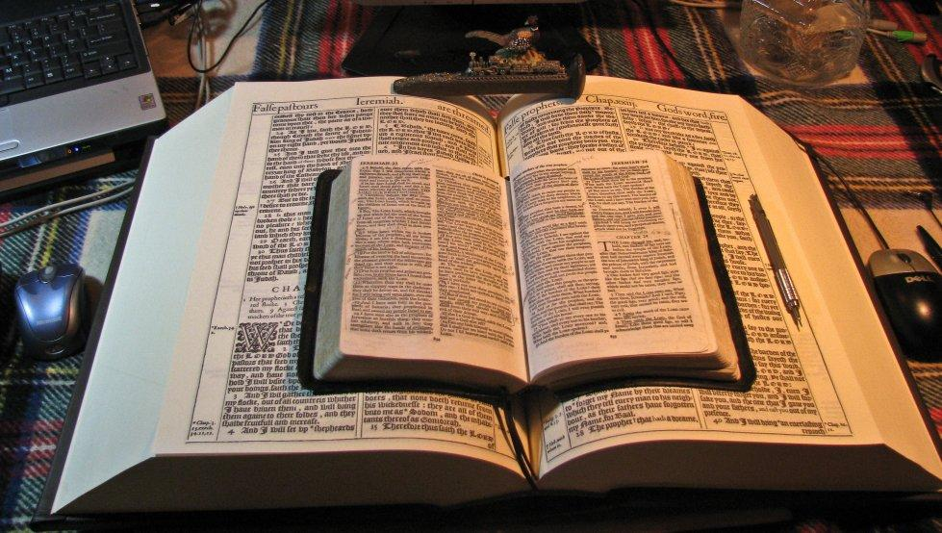
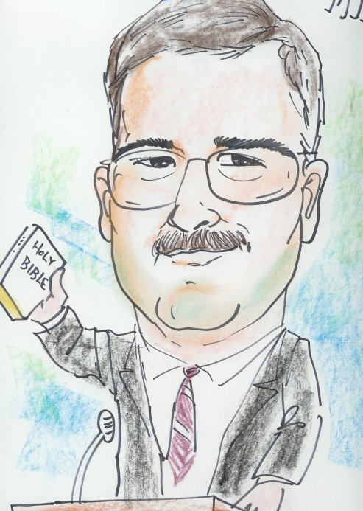
This PowerPoint was designed by Mike Paulson, June, 2016 – www.scatteredchristians.org
This presentation is not copyrighted, of course, so if you can add more, and there is a lot more that I am sure can be added to this; feel free to do so. My only expectation and requirement is that you use ONLY a King James 1611 Bible for your specific scripture references.
But truthfully, I suppose that is not a huge concern of mine because if you do try to use any other modern bibles, you will find they wouldn’t fit with this anyway; thus we see once again, the importance of a rightly divided 1611 KJB ONLY. ☺
If you do add more comments, scripture references, etc. for your own use – or to pass on to others,
please pass it on to me, as well. I would be glad to update yours to the website.

Slide 2
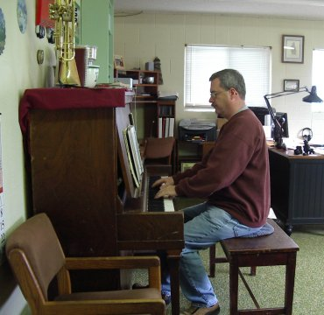
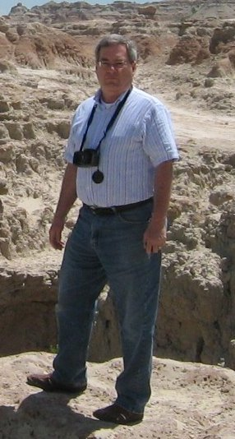
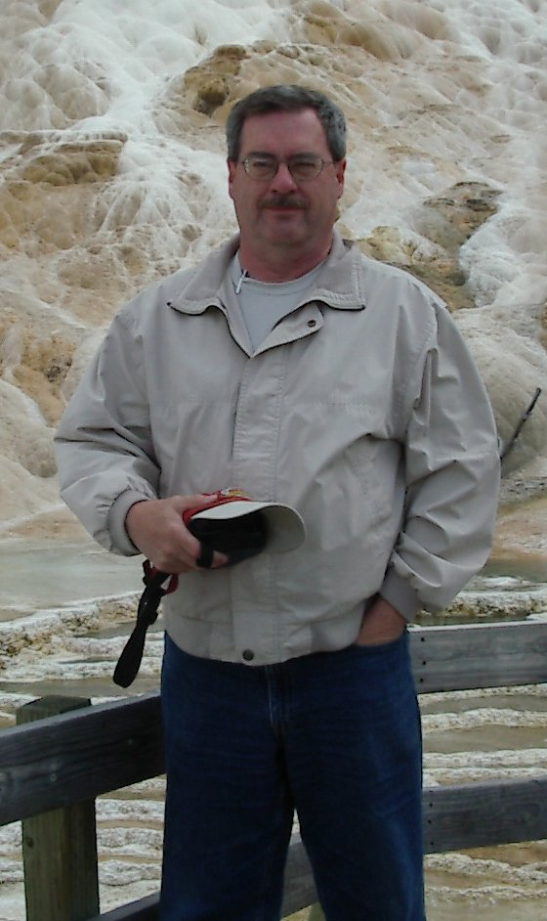
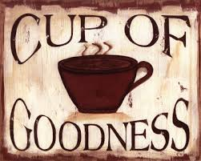
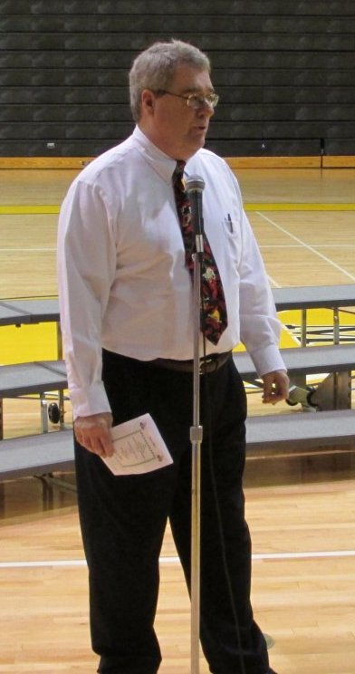
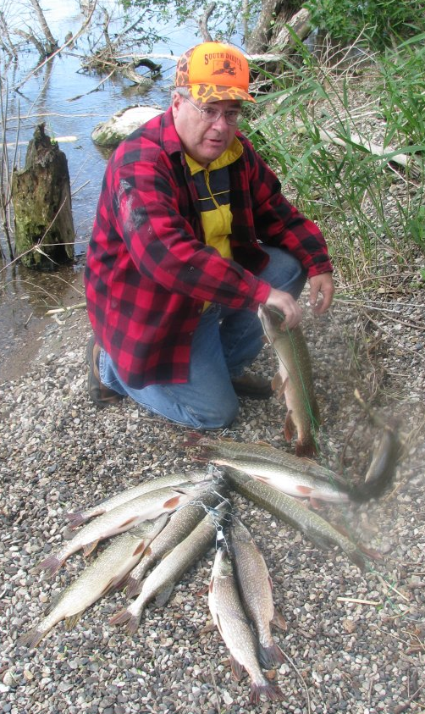
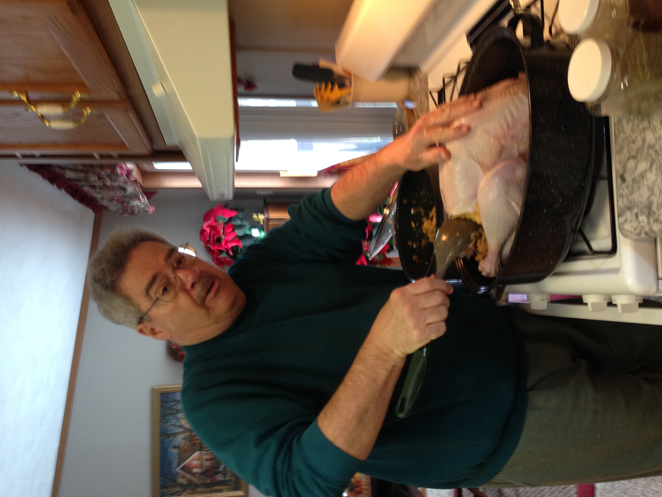
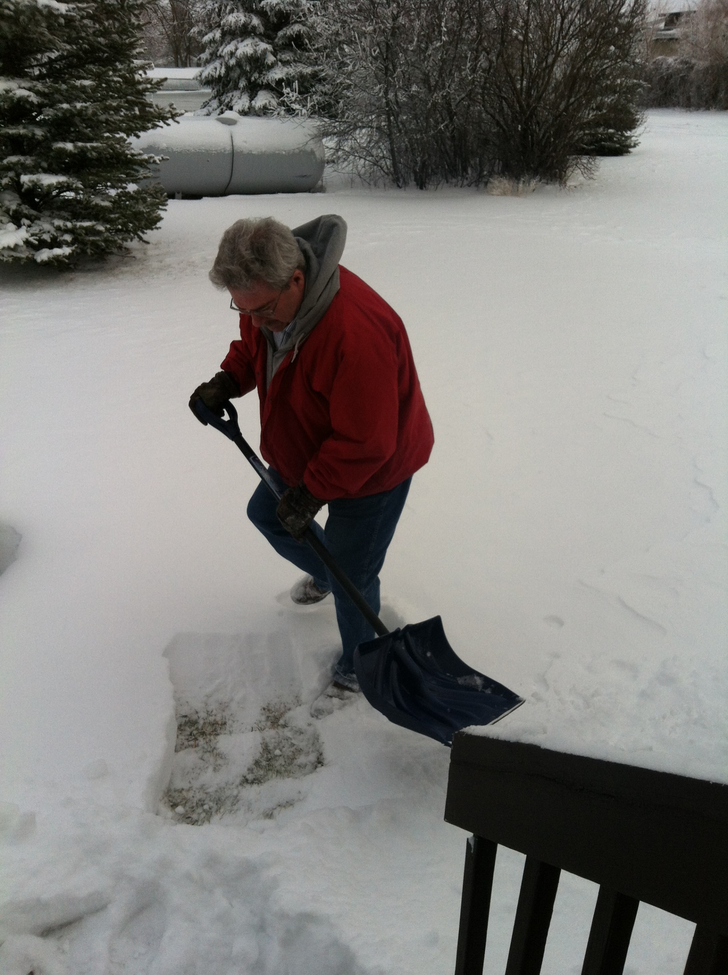
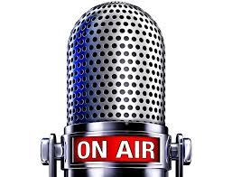
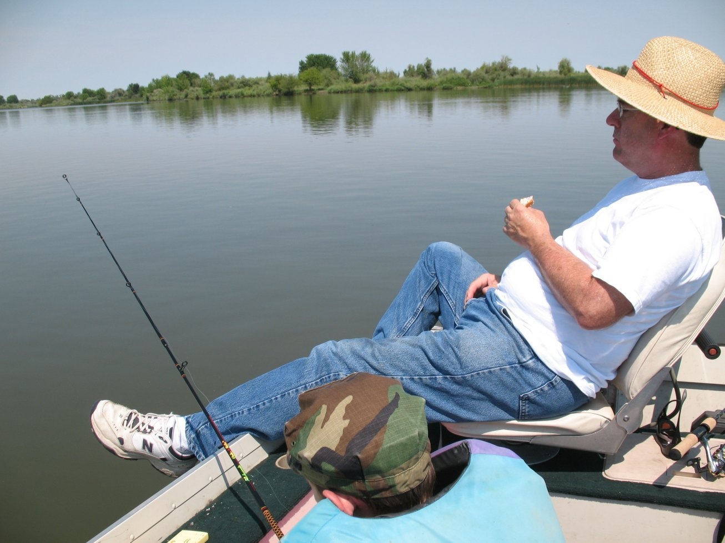
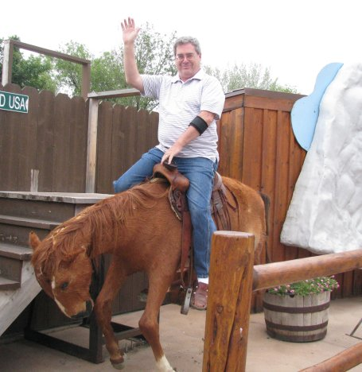
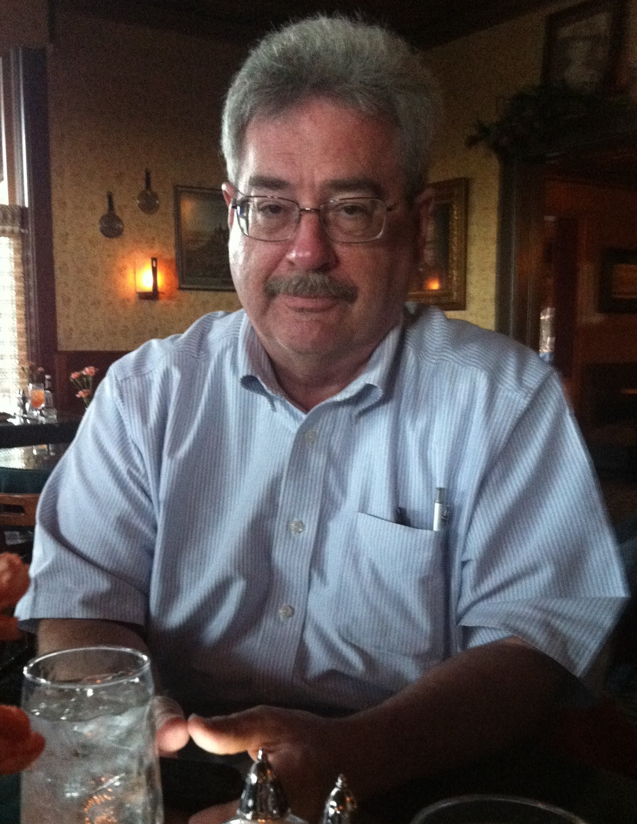
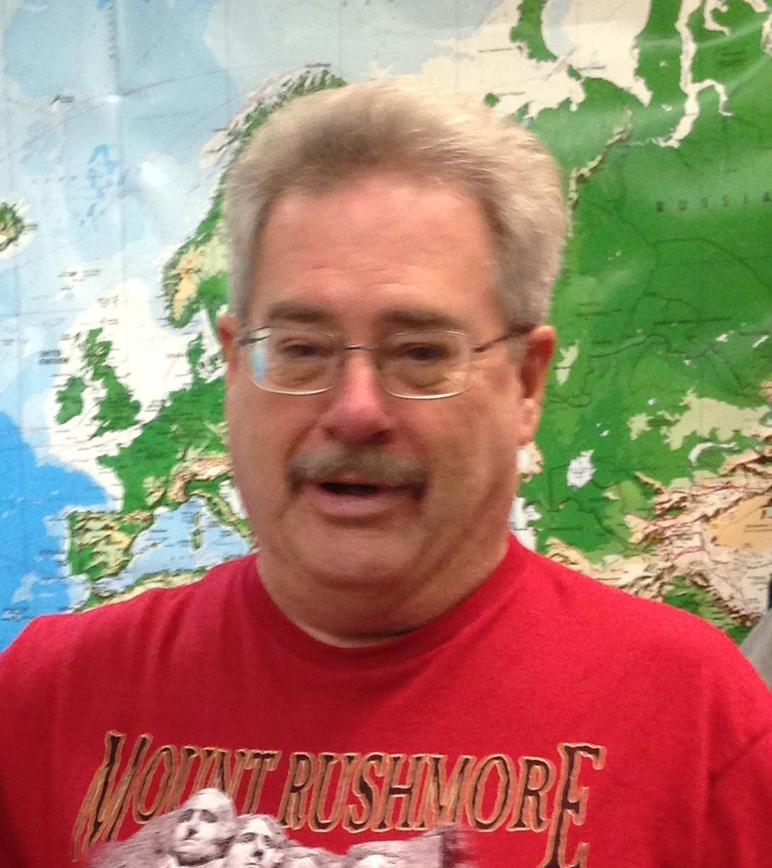
The first half of this ‘sermon presentation’
consists of Scriptures only. It has always been my goal
to help people learn to read the KJB by themselves – no other book needed – no Hebrew/Greek knowledge, special history/ dictionaries, etc. are necessary; and because so many pastors are deceitful in their loving yet lying approach, I want folks to realize they can actually learn to understand their KJB themselves, without any outside “modern scholarly” pastoral assistance.
Welcome to my visual video
‘Bible Sermon /Bible Study’ Presentation.
Mikel Paulson
The Holy Spirit is all one needs to understand the KJB! However, one must also be able to know the difference between God’s words and Satan’s words; the truth of the Holy Spirit vs their own good ‘feelings’.
In the second half of this ‘presentation,’ I include a few of my notes and references I would normally want to mention if I were to try to teach this particular subject ‘live’ to any and all who would be wanting to listen.
Ah yes, as you will see, it is still really hard for me not to stick my teaching into my preaching as well as it being equally hard for me to not add preaching into my teaching.

Slide 3
Today’s Presentation Study
This is a simple study – one verse. However, as simple as I believe it is to be ‘understood,’ it seems to be a very difficult if not impossible verse for today’s pastors / preachers to understand and thus preach truthfully..
Mikel Paulson
But when that which is perfect is come,
then that which is in part shall be done away.
We will look at this verse in I Corinthians 13:10 – and answer these questions…
1. What is …that which is perfect…?
2. When is when and then?
3. To what is in part referring?
4. What is the significance of this verse today?
Once again and as always in my audio & video Bible sermons as well as with my many written studies, you will see how important I believe the
King James Bible ‘was’ in history past, ‘still is’ in today’s present,
and ‘will be’ in tomorrow’s future.

Slide 4
Part I
Scriptures Only
This section has no added commentary, opinions, footnotes, references, teachings, etc.
You will be reading the simple, inspired and preserved plain text from a 1611 King James Bible – nothing else.

Slide 5
But when that which is perfect is come,
then that which is in part
shall be done away.
I Corinthians 13:10

Slide 6
Part II
Scriptures With Written Comments
Ok, there ya go. That was quick, eh! I trust you read those words very carefully, very slowly and with great meditation. Hopefully, you were able to discern what God would have you learn from His very words, inspired and preserved, just as He promised.
So now, as a former pastor / Bible teacher, I have some things I would like to emphasize and point out to my readers that I believe to be comments worth your while.
Click-on, if you would…

Slide 7
But when that which is perfect is come, then that which is in part
shall be done away.
I Corinthians 13:10
Let’s begin with the conclusion: That which is perfect has to be Paul referring to the coming of the King James Bible in 1611!
It can’t be anything else or even anyone else. Pastors today say it is referring to the 2nd coming of Jesus Christ or of us in the future.
Those would be your only three choices: the future coming of the King James Bible, the second coming of Christ or us in eternity.
I believe without a shadow of doubt that when Paul was having his face to face meetings with the risen Christ, he was told about the coming of the King James Bible – the spoken words from God. All of the past, present and future - all of life from creation on - were going to be written into a book for everyone to own, read & study.
I also believe that the coming of this KJB was one of the things Paul learned but was told not to ‘utter’ to any of the people on his return. II Cor 12:4
Are there any other verses that will help in this specific study?
I am glad you asked that – because there sure are!
II Chronicles 8:16
I Corinthians 13:8,9
I Corinthians 13:11-12
I Corinthians 13:13
I Corinthians 14:1
How’s that for an introduction? So are you ready to get on with this and see why I Corinthians 13:10 is so important?
So important, I say? Yes, I believe that this one of the many ‘most important and greatest verses’ one can find ‘only’ in a KJB today.
Allow me to explain – so let’s continue…

Slide 8
But when that which is perfect is come, then that which is in part
shall be done away.
I Corinthians 13:10
Let’s start off with a simple definition;
the definition of the word perfect.
Does perfect in this context mean ‘without error’ – ‘without mistake,’ as so many tend to believe? Even preachers of the KJB like to use the word perfect when they talk about the KJB but they only are meaning it has no mistakes or needed corrections.
Well, it is true, the KJB does not have any mistakes nor does it ever need correction – but the word perfect is not the word to use when making those points. The word ‘inerrant’ would be the correct word for that use.
Whenever I hear the word perfect used in that manner from those pastors, I just wag my head knowing they have no idea what the word perfect actually means in that context. It seems that those pastors do not know that words are even self-defined from within their KJB itself.
One of the many ‘features’ of the KJB is that not only do we not need commentaries, lexicons, etc. that so many lean on for their attempt at understanding, but we also do not really need a dictionary.
Although, if you want to use a dictionary, a Webster’s 1828 is the recommended one because it uses Biblical definitions, not like today’s weakened modernized definitions.
The King James 1611 Bible will define it’s own words from context use and what we call the ‘first use’ method.
The first time a word is used in the same context from which we are seeking the definition, a KJB will define that word by how it is being used – that first time.

Slide 9
But when that which is perfect is come, then that which is in part
shall be done away.
I Corinthians 13:10
Ok, first let’s look into the word perfect from within the KJB itself.
Ok, we look to II Chronicles 8:16
Now all the work of Solomon was prepared unto the day of the foundation of the house of the LORD, and until it was finished. So the house of the LORD was perfected.
We see here that when the foundation was finished, it was said to be perfected. I am sure it was done properly, without other messes and junk, etc. But the reference uses the word perfected – made perfect.
So whatever is perfect in I Corinthians 13:10 is referring to, it is meaning it has been perfected – finished, not just without error, etc.
Fact number one: That which is perfect will be considered ‘finished’ when it comes! There will be no more coming of whatever ‘it’ is after it comes. When ‘it’ comes, it will be done – finished – perfect!
It has been ‘perfected.’ In other words, it has been fixed, rearranged, polished, etc. – you know, all that goes on when you work on something to ‘finish’ it.
Haven’t you ever, when you are done with cleaning your room, etc. and you got everything dusted, rearranged, picked up – etc. you looked back into the room and said to yourself, with relief in your voice, “Ah – Perfect!”
You were done - finished

Slide 10
But when that which is perfect is come, then that which is in part
shall be done away.
I Corinthians 13:10
Now, before we go any further with that thought for now,
let’s move on to our next point - in part.
For this one, we just have to go back a few verses: verses 8,9.
…but whether there be prophecies, they shall fail;
whether there be tongues, they shall cease;
whether there be knowledge, it shall vanish away.
So that which was existing during the time of Paul would someday…
Fail
Prophecies - to define prophecies is to understand that it means much more than just ‘foreseeing into the future’ as folks tend to believe.
Prophecies in a biblical sense is ‘speaking’ of spiritual subjects, i.e.. Preaching; speaking; teaching; sermons, etc.
Does this mean then that sermons are done – failed!, etc. Nice try – the answer is NO! It means that before that which is perfect was going to come, the ‘sermons’ and ‘teachings,’ etc. had to come from God directly – either through a prophet, preacher, pastor, teacher, or at times, even from God Himself. That was all going to ‘fail’ sometime in the future. More on that in a few moments.
Cease
Tongues - tongues would obviously be referring to what we call ‘speaking in tongues’ today, not just speaking period!. Tongues was going to cease when that which is perfect arrives.
Do you see now why even Paul had a chapter on ‘tongues’? During his day,
tongues took place. But today! NO! Why not? More on that in a few moments.
Vanish Away
Knowledge- so was ‘all’ knowledge going to vanish away someday? Of course not – but the means of obtaining knowledge directly from God was going to vanish when that which is perfect shows up.

Slide 11
But when that which is perfect is come, then that which is in part
shall be done away.
I Corinthians 13:10
Then it goes on in verse 9…
For we know in part, and we prophesy in part…
So now, the next thing we are going to touch on is in part.
PS - Note the time frame of all this. Paul was talking about what goes on during his day, but then he starts talking about something that is coming in the future.
Paul mentions that what is going on during his time then will no longer take place when that which is perfect comes because what they are doing then is only ‘in part.’
He also talks about his own ‘before’ and his ‘now’ time, comparing it all to what is coming and what it will be like when that which is perfect comes’. See verses 11,12. But again, we will talk about that stuff later in this presentation.
Let’s just do a quick & early summary and review:
Those things we read in Corinthians, that were being done in Paul’s day - prophecies, tongues and knowledge - were only done in part.
Whenever that which is perfect were to come,
then all those things they were doing will stop.
Those things will fail, cease and vanish away.
Are you with me so far? Paul is telling those folks that something will come some day that will put a stop to all that they are doing at that time that involves teaching, preaching, speaking in tongues and having God impart knowledge to them.

Slide 12
But when that which is perfect is come, then that which is in part
shall be done away.
I Corinthians 13:10
Let’s take a short look at three possible conclusions:
1. If that which is perfect is…
The 1611 King James Bible
Then it fits all facts historically, doctrinally, spiritually and it even makes common sense!
There was nothing written down that was finished until 1611.
Yes, there were many manuscripts, pieces, copies, etc.
that existed before 1611, but…
Yes, there were 6 other English Bibles printed before 1611, but…
NONE OF THEM WERE THE FINISHED PRODUCT!
They weren’t ‘perfect’!
Contrary to all the pastors and publishers, etc. today, there has never been a need, there is still no need and there will never be a need since 1611 for any new ‘translation’ to be printed today - ever. The KJB may be 400+ years old but it fits today as if it were just written today.
Since 1611, as the KJB was given out around the world, God was able to speak to anyone through the written Scriptures.
Knowledge of and from God vanished away unless it was located within the KJB. The devil took on the new bibles and his new doctrines were taught from them.
There has been no need for ‘speaking in tongues since 1611; they ceased doctrinally! Since then, the devil has taken them over.
Since 1611, if any preacher wanted, wants or will want to prophecy (preach, teach, etc.) the truth - he must get that knowledge from the KJB.

Slide 13
But when that which is perfect is come, then that which is in part
shall be done away.
I Corinthians 13:10
No wonder pastors, professors, teachers, etc. today
change & disobey the 1611 King James Bible!
The 1611 KJB tells pastors to:
Preach the word; be instant in season, out of season; reprove, rebuke, exhort with all longsuffering and doctrine.
No wonder pastors, professors, teachers, etc. today
also hate the 1611 King James Bible!
The 1611 KJB tells pastors that don’t use the KJB:
He is proud, knowing nothing, but doting about questions and strifes of words, whereof cometh envy, strife, railings, evil surmisings, Perverse disputings of men of corrupt minds, and destitute of the truth, supposing that gain is godliness: from such withdraw thyself.
No wonder people today
hate the 1611 King James Bible!
For the time will come when they will not endure sound doctrine; but after their own lusts shall they heap to themselves teachers, having itching ears; And they shall turn away their ears from the truth, and shall be turned unto fables.

Slide 14
But when that which is perfect is come, then that which is in part
shall be done away.
I Corinthians 13:10
2. What if that which is perfect is actually referring to the second coming of Jesus Christ?
Then that which is perfect hasn’t come yet; it would all still be in part..
Then prophecies with ‘any’ bible would still be fine, today!
Then ‘speaking in tongues’ would still be fine today!
Then all that knowledge and wisdom you are ‘feeling’ and ‘believing’ in your heart could really be from God – and you wouldn’t need any specific Bible to check out on what is the knowledge of the truth.
Then any preacher preaching the ‘love of Jesus’ from the gospels or any bible, book, video, etc. instead of Paul would be pleasing God.
Then the books of the KJB that Paul wrote could be taken out of the KJB.
Then the thousands of ‘changes’ from a King James Bible to all these hundreds of modern bibles would be fine; even if all those things that are different, they would still be the same.
Then you could be your own final authority as to which bible, religion denomination, local assembly – if any - you would want to ‘own.’
Then you would be able to choose any denomination / local church, etc. to attend – and you could base your decision on the music, the worship team, the building, the people, the pastor, etc.
Then you could do anything you want, and just confess your sins later.
Then you could be any kind of modern ‘Christian’ you wanted to be.
Then you ladies could be preachers, pastors, rulers in your own home, CEO’s & soldiers; you could dress and act anyway you choose, etc.
Then you would think there is revival in America because of all the smiling loving preachers on tv with their thousands of followers.
Then you would be ‘born again’ in your head but wouldn’t realize that you are waiting for the antichrist in Rev 6 instead of the Risen Christ in Rev 19.

Slide 15
But when that which is perfect is come, then that which is in part
shall be done away.
I Corinthians 13:10
3. And for the final possibility, some folks think that which is perfect is about ‘them’ – the people – when they ‘get to heaven’ then they will be perfect.
It really just doesn’t make sense if you read all the other verses
before and after I Corinthians 13:10 – which we will do in a few moments.
It would be that we people would be like Paul, living in a time when everything is still ‘in part.’ One would never have that full assurance and scriptural confidence and would be confessing their sins every day – or least once a week, anyway.
Well, here are a few more ‘official’ thoughts on it being the people……
There would still be ‘prophecies’ going on – in part
They would be without the KJB’s foundation of knowledge and word direction. After all, EVERY modern bible likes to compare it to the KJB as ‘improved.’
Hey wait: That is ‘exactly’ what the pastors and preachers are doing these days. “IF’ they use any bible in their ‘talks’ at all, they pick and choose from over 400 bibles – and they all say different things. And because of all that edjukated scholarship and confusion, they mostly just ‘speak from their heart.’ And if they don’t speak much, they replace it with worship music – all kinds of music.
There would still be tongues – in part
Hey wait: There is still ‘speaking in tongues going on today. However, they don’t follow what Paul said in I Corinthians 14 when it comes to ‘tongues’ so it certainly still isn’t God’s directed way today.
Knowledge would still just be there – in part.
Hey wait: People already think they can only get their ‘knowledge’ of God, etc. from preachers, pastors, modern apostles, healers, etc. and that they must all have an education from some seminary, college, institute or worked under some famous ‘big time’ personality – or even be baptized from the line all the away back to John himself.

Slide 16
But when that which is perfect is come, then that which is in part
shall be done away.
I Corinthians 13:10
So, are you now able to see, understand, believe, etc. that that which is perfect has already come, just like Paul said it would?
It came in 1611.
And it is still the same today as it was then – just as God promised in Ps 12:6,7.
The words of the LORD are pure words: as silver tried in a furnace of earth, purified seven times. Thou shalt keep them, O LORD, thou shalt preserve them from this generation for ever.
And when it came, prophecies were done away.
And when it came, tongues were done away.
And when it came, knowledge was done away.
Now you can have your own 1611 King James Bible for all those prophecies, tongues and knowledge directly from God.
So now, you can read and see for yourself that…
You don’t need to say or do ‘fancy prayers’, prayer chains, etc.!
You don’t need to have a water baptism before, during or after!
You don’t need to participate in a daily, weekly, monthly or yearly holy or non-holy communion, Lord’s supper, etc.
You don’t need to be seeking signs, healings, miracles and wonders.
You don’t need to seek spiritual Pentecostal type gifts.
You don’t need to check for pastoral final authority in your personal life.
You don’t need somebody to worship for you, no matter where your talent lies or even if you don’t have any talent.
You don’t even ‘have’ to go to a local church assembly if that pastor doesn’t guide the church according to the risen Saviour’s words through a rightly divided KJB along with Paul ONLY, etc.

Slide 17
But when that which is perfect is come, then that which is in part
shall be done away.
I Corinthians 13:10
Let’s finish this study up with an epilogue of sorts by looking at the last few verses where Paul compares ‘his days’ to what it will be like when that which is perfect comes.
In other words, what Paul says it will be like today with us being able to have that which is perfect - the very inspired and preserved words of God - 1611 King James Bible!
I Corinthians 13:11,12
11 - When I was a child, I spake as a child, I understood as a child, I thought as a child: but when I became a man, I put away childish things.
12 - For now we see through a glass, darkly; but then face to face: now I know in part; but then shall I know even as also I am known.
I Corinthians 13:13; 14:1
13:13 - And now abideth faith, hope, charity, these three; but the greatest of these is charity.
14:1 - Follow after charity, and desire spiritual gifts, but rather that ye may prophesy.
Side Comment: If Paul was persecuted, etc. because of what he knew and said, etc., then I am sure he knew what he was talking about when he said … all that will live godly in Christ Jesus shall suffer persecution – a lot of it just because today we have what he knew – in our King James Bible.
Ok, now let’s get on to the conclusion…

Slide 18
But when that which is perfect is come, then that which is in part
shall be done away.
I Corinthians 13:10
I Cor 13:11 - When I was a child, I spake as a child, I understood as a child, I thought as a child: but when I became a man, I put away childish things.
Paul states that when he was ‘young’, he spake, understood and thought as a child. Remember, what he was able to give to people was what he had from God but was only in part. Paul knew he had to ‘grow up’ – become a man and put away those childish things.
Mini-sermon: Paul does a marvelous job of explaining what a child is. If kids today would accept the simple fact of what it means to be a child – a kid – a teen, a young adult, etc. and that as their maturity eventually grows, THEN they will be even willing to put away those childish things and will no longer speak, understand and think as a child – in due time.
And if parents would simply treat their kids like they should be treated – like a child with little speaking, understanding and thinking capabilities, etc. then the kids might be willing to learn better, enjoy their childhood more, and be ready for their maturity to grow.
Having, reading, studying a King James Bible – and of course, rightly dividing it, is what growing up to be a mature Christian is all about.
And teachers, if they would only accept and understand what a child is according to Paul, then they wouldn’t be so frustrated as they have come to expect from students things they are just simply not able to accomplish, speak, understand and think.
People tend to demand and expect great understanding and wisdom from students these days while everyone has ignored that basic fact that ‘knowledge’ must be taught first – while they are still children – teens – young adults. Understanding and wisdom will come later as they mature – over time… as it did with Paul – and with you and me!
In the Scriptures, there is an order to obtaining maturity & wisdom:
Knowledge comes first, then understanding and eventually, wisdom.

Slide 19
But when that which is perfect is come, then that which is in part
shall be done away.
I Corinthians 13:10
Ok, back onto the original trail: Paul said all he said about ‘putting away childish things’ and ‘becoming a man’ to make his point, which is now that we have the very words of God we can read & study ourselves; we shouldn’t need someone to read it and explain it to us. We can grow up ourselves when it comes to spiritual matters as well as practical Biblical application into our own lives.
Now, I understand there are situations and cases, etc. to where some folks still need help – and for many reasons… of course. However, one can still simply follow along with their own Bible.
Also, having one book – that which is perfect – not a library of books, degrees, etc. – still makes it simple for anyone to ‘follow along’ to learn from and with the pastor, speaker, teacher, etc. to make sure that what he is saying is true to the Scriptures.
Paul even tells us that the purpose of a local church, preacher, pastor, the Scriptures, etc. is to help us mature as Christians with our own ability to think for ourselves, understand for ourselves and apply God’s wisdom in our own personal lives.
For the perfecting of the saints, for the work of the ministry, for the edifying of the body of Christ: Till we all come in the unity of the faith, and of the knowledge of the Son of God, unto a perfect man, unto the measure of the stature of the fulness of Christ:
That we henceforth be no more children, tossed to and fro, and carried about with every wind of doctrine, by the sleight of men, and cunning craftiness, whereby they lie in wait to deceive;
Ephesians 4:12-14

Slide 20
But when that which is perfect is come, then that which is in part
shall be done away.
I Corinthians 13:10
For now we see through a glass, darkly;
but then face to face:
now I know in part;
but then shall I know even as also I am known.
I Corinthians 13:12
Paul knew the folks in ‘his days’ didn’t see it all – it was not possible; it was all ‘in part.’ They could see through a glass, but not clearly.
He says that even he knows only in part… but with that which is perfect, even he would know what he needs to know as well as he knows himself.
Paul’s use of the word then would certainly be referring to when that which is perfect is come.
So folks, with us having the inspired, preserved words of God in our hands in that 1611 King James Bible to own, read, study, memorize, meditate, understand, etc. we also should be able to know ‘truth’ as well as we know ourselves – just like Paul states.

Slide 21
But when that which is perfect is come, then that which is in part
shall be done away.
I Corinthians 13:10
Now to wrap up this study presentation with a little frosting on the top of the final dessert with Paul’s last two verses…
I Corinthians 13:13
And now abideth faith, hope, charity, these three; but the greatest of these is charity.
Ya know, we still have those ‘Christians’ who believe that charity is still the greatest over everything. And of course, Paul even says charity never faileth in 13:8
However, these ‘loving Christians’ seldom use the word charity – they use the ‘scholarly corrected’ word ‘love’ instead which when using the humanistic term ‘love’ only degrades from the true meaning of charity and what Paul is saying here! ‘Love’ and charity are two different words, each spelled differently & with two different meanings with two different applications.
These people today go so far as to say that ‘love” is still more important than truth. They would put ‘their’ love over what God says with His words.
So, they will say, “No matter what your King James Bible says, I will ‘love’ and ‘pal’ with everyone no matter what they do, etc.!” That is Great Commission stuff – and it is simply not biblical today by any stretch of feeble scholarly attempts.
The people that say that love is more important then what the Scriptures say, are missing one simple observation…

Slide 22
But when that which is perfect is come, then that which is in part
shall be done away.
I Corinthians 13:10
… they miss the first two words of verse 13...
AND NOW…
In other words, what Paul is saying is that BEFORE that which is perfect is come & during Paul’s time, faith, hope and charity abide – and yes, charity was the greatest of those three.
However, Paul still makes one more comment in the next chapter and first verse…
Follow after charity, and desire spiritual gifts, but rather that ye may prophesy. 14:1
Prophecy, which deals with the very words of God, was and is still more important than charity and spiritual gifts, etc.
And even now after that which is perfect has come, then charity will still not be the greatest thing ‘since ice cream!’
And I will say it again: because that which is perfect has come in the King James Bible, then today’s humanistic approach and the Great Commission’s false teaching of ‘Jesus loves overall’ is NOT the most important element of Christianity- it is in fact a very serious false teaching.
Now I beseech you, brethren, mark them which cause divisions and offences contrary to the doctrine which ye have learned; and avoid them.
For they that are such serve not our Lord Jesus Christ, but their own belly; and by good words and fair speeches deceive the hearts of the simple – Romans 16:17,18

Slide 23
But when that which is perfect is come, then that which is in part
shall be done away.
I Corinthians 13:10
There ya have it folks…
That which is perfect came in 1611
THAT was the
King James Bible
And things have never been the same since!

Slide 24
King James 1611 Bible
Scholarship, Education, Degrees, Bible Institutes, Courses, Workshops, Retreats, Conventions – books, books, books,
and more books…
That which is perfect has come
Religion
S
Ever learning, and never able to come to the knowledge
of the truth.
The Truth

Slide 25
Get one while you still can!

Slide 26
Behold, the days come, saith the Lord GOD, that I will send a famine in the land, not a famine of bread, nor a thirst for water...
…but of hearing the words of the LORD
And they shall wander from sea to sea, and from the north even to the east, they shall run to and fro to seek the word of the LORD,
…and shall not find it.
Amos 8:11,12
www.scatteredchristians.org

Slide 27
This is just a friendly reminder that this PowerPoint was designed by Mikel Paulson,
June, 2016 – www.scatteredchristians.org
This presentation is not copyrighted, of course, so if you can add more information, and there is a lot more that I am sure can be added to this, feel free to do so. My only expectation and requirement is that you use ONLY a King James 1611 Bible. Actually, that can’t be a big problem because if you tried to use any other modern bibles, you would find they wouldn’t work with this anyway, thus we see once again the importance of a rightly divided 1611 KJB ONLY. ☺
If you do add more comments, scripture references, etc. for your own use – or to pass on to others,
please pass it on to me, as well. I would be glad to update yours to the website.
But watch thou in all things, endure afflictions,
do the work of an evangelist, make full proof of thy ministry.
One more thing: everything stated within this presentation is supported by KJB Scripture. If you want to know the specific verses used, then contact me, or look them up yourself. They are in there, and they are taken from the correct books written TO us today – Paul’s!!
- KJB1611 ONLY -

Slide 28
Religion is Never the Truth
The Truth is Never a Religion

Slide 29
The King James 1611 Bible is Truth

Slide 30
The grace of our Lord Jesus Christ be with your spirit. Amen

