Slide 1
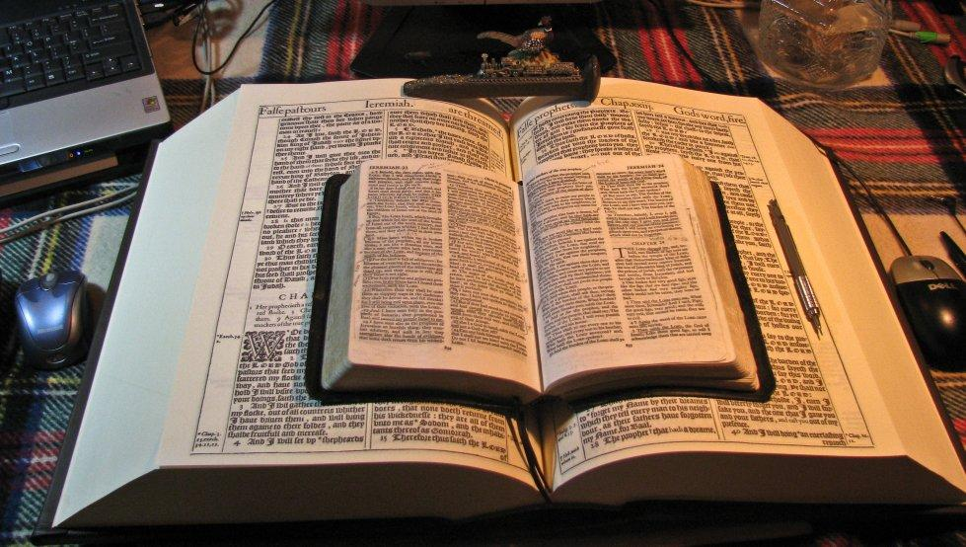
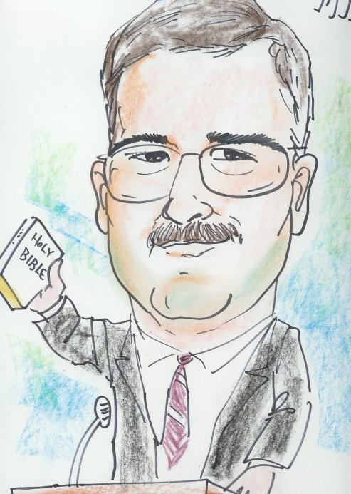
This PowerPoint was designed by Mike Paulson, June, 2016 – www.scatteredchristians.org
This presentation is not copyrighted, of course, so if you can add more, and there is a lot more that I am sure can be added to this, feel free to do so. My only expectation and requirement is that you use ONLY a King James 1611 Bible.
But truthfully, that is not a huge concern of mine because if you do try to use any other modern bibles, you will find they wouldn’t fit with this anyway; thus we see once again, the importance of a rightly divided 1611 KJB ONLY. ☺
If you do add more comments, scripture references, etc. for your own use – or to pass on to others,
please pass it on to me, as well. I would be glad to update yours to the website.

Slide 2
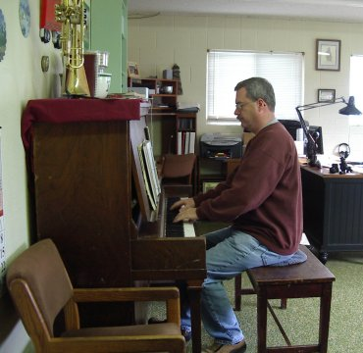
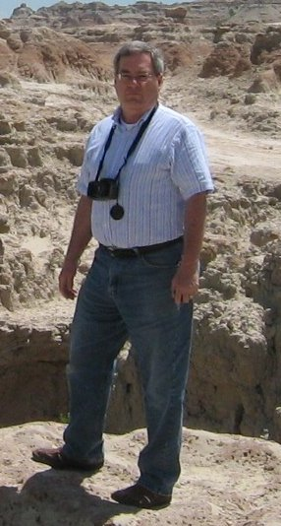
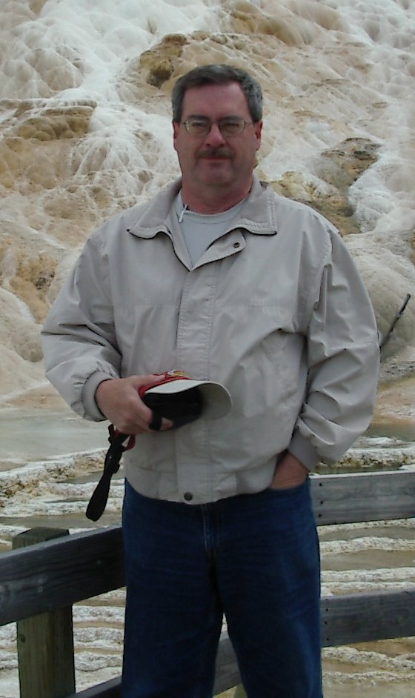
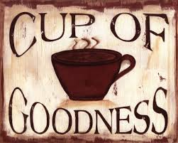
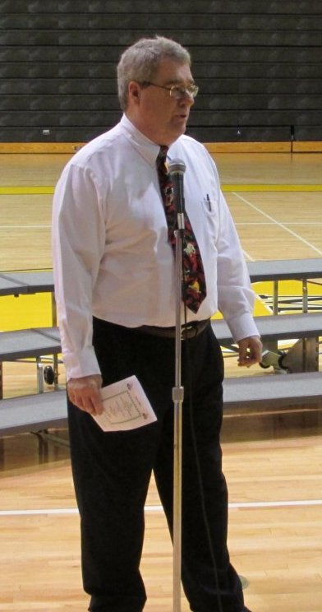
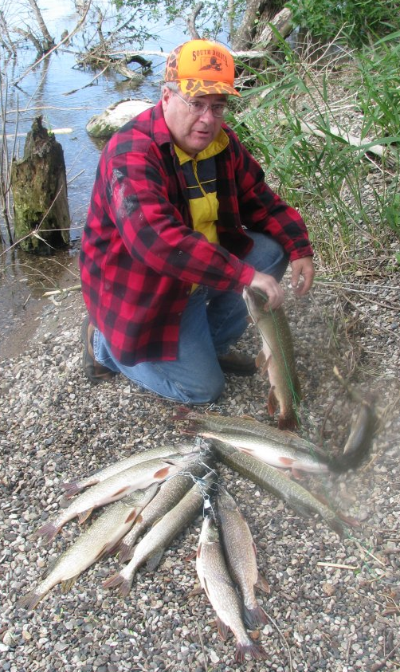
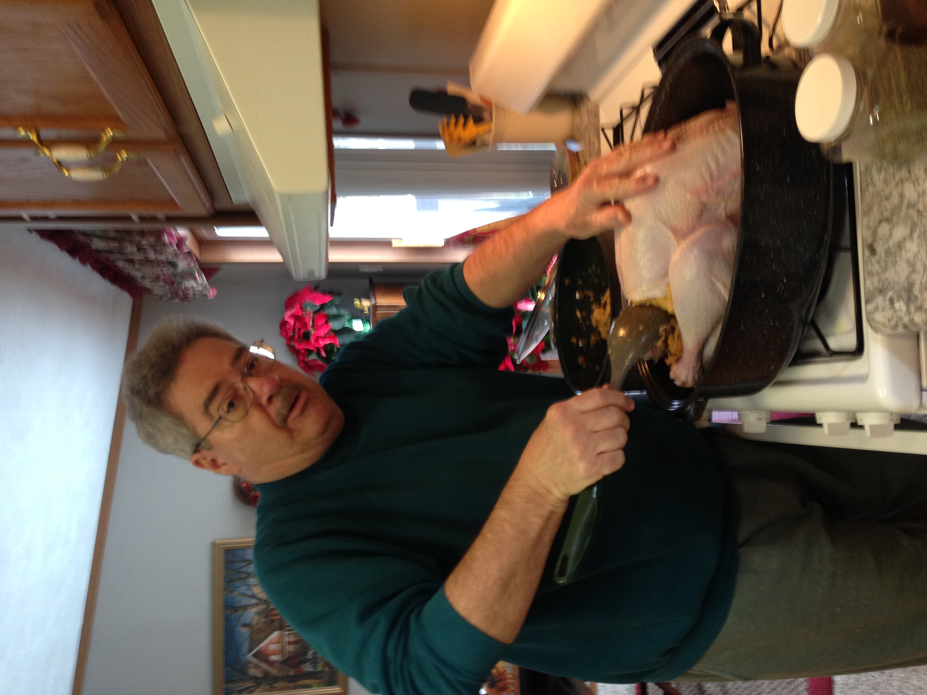
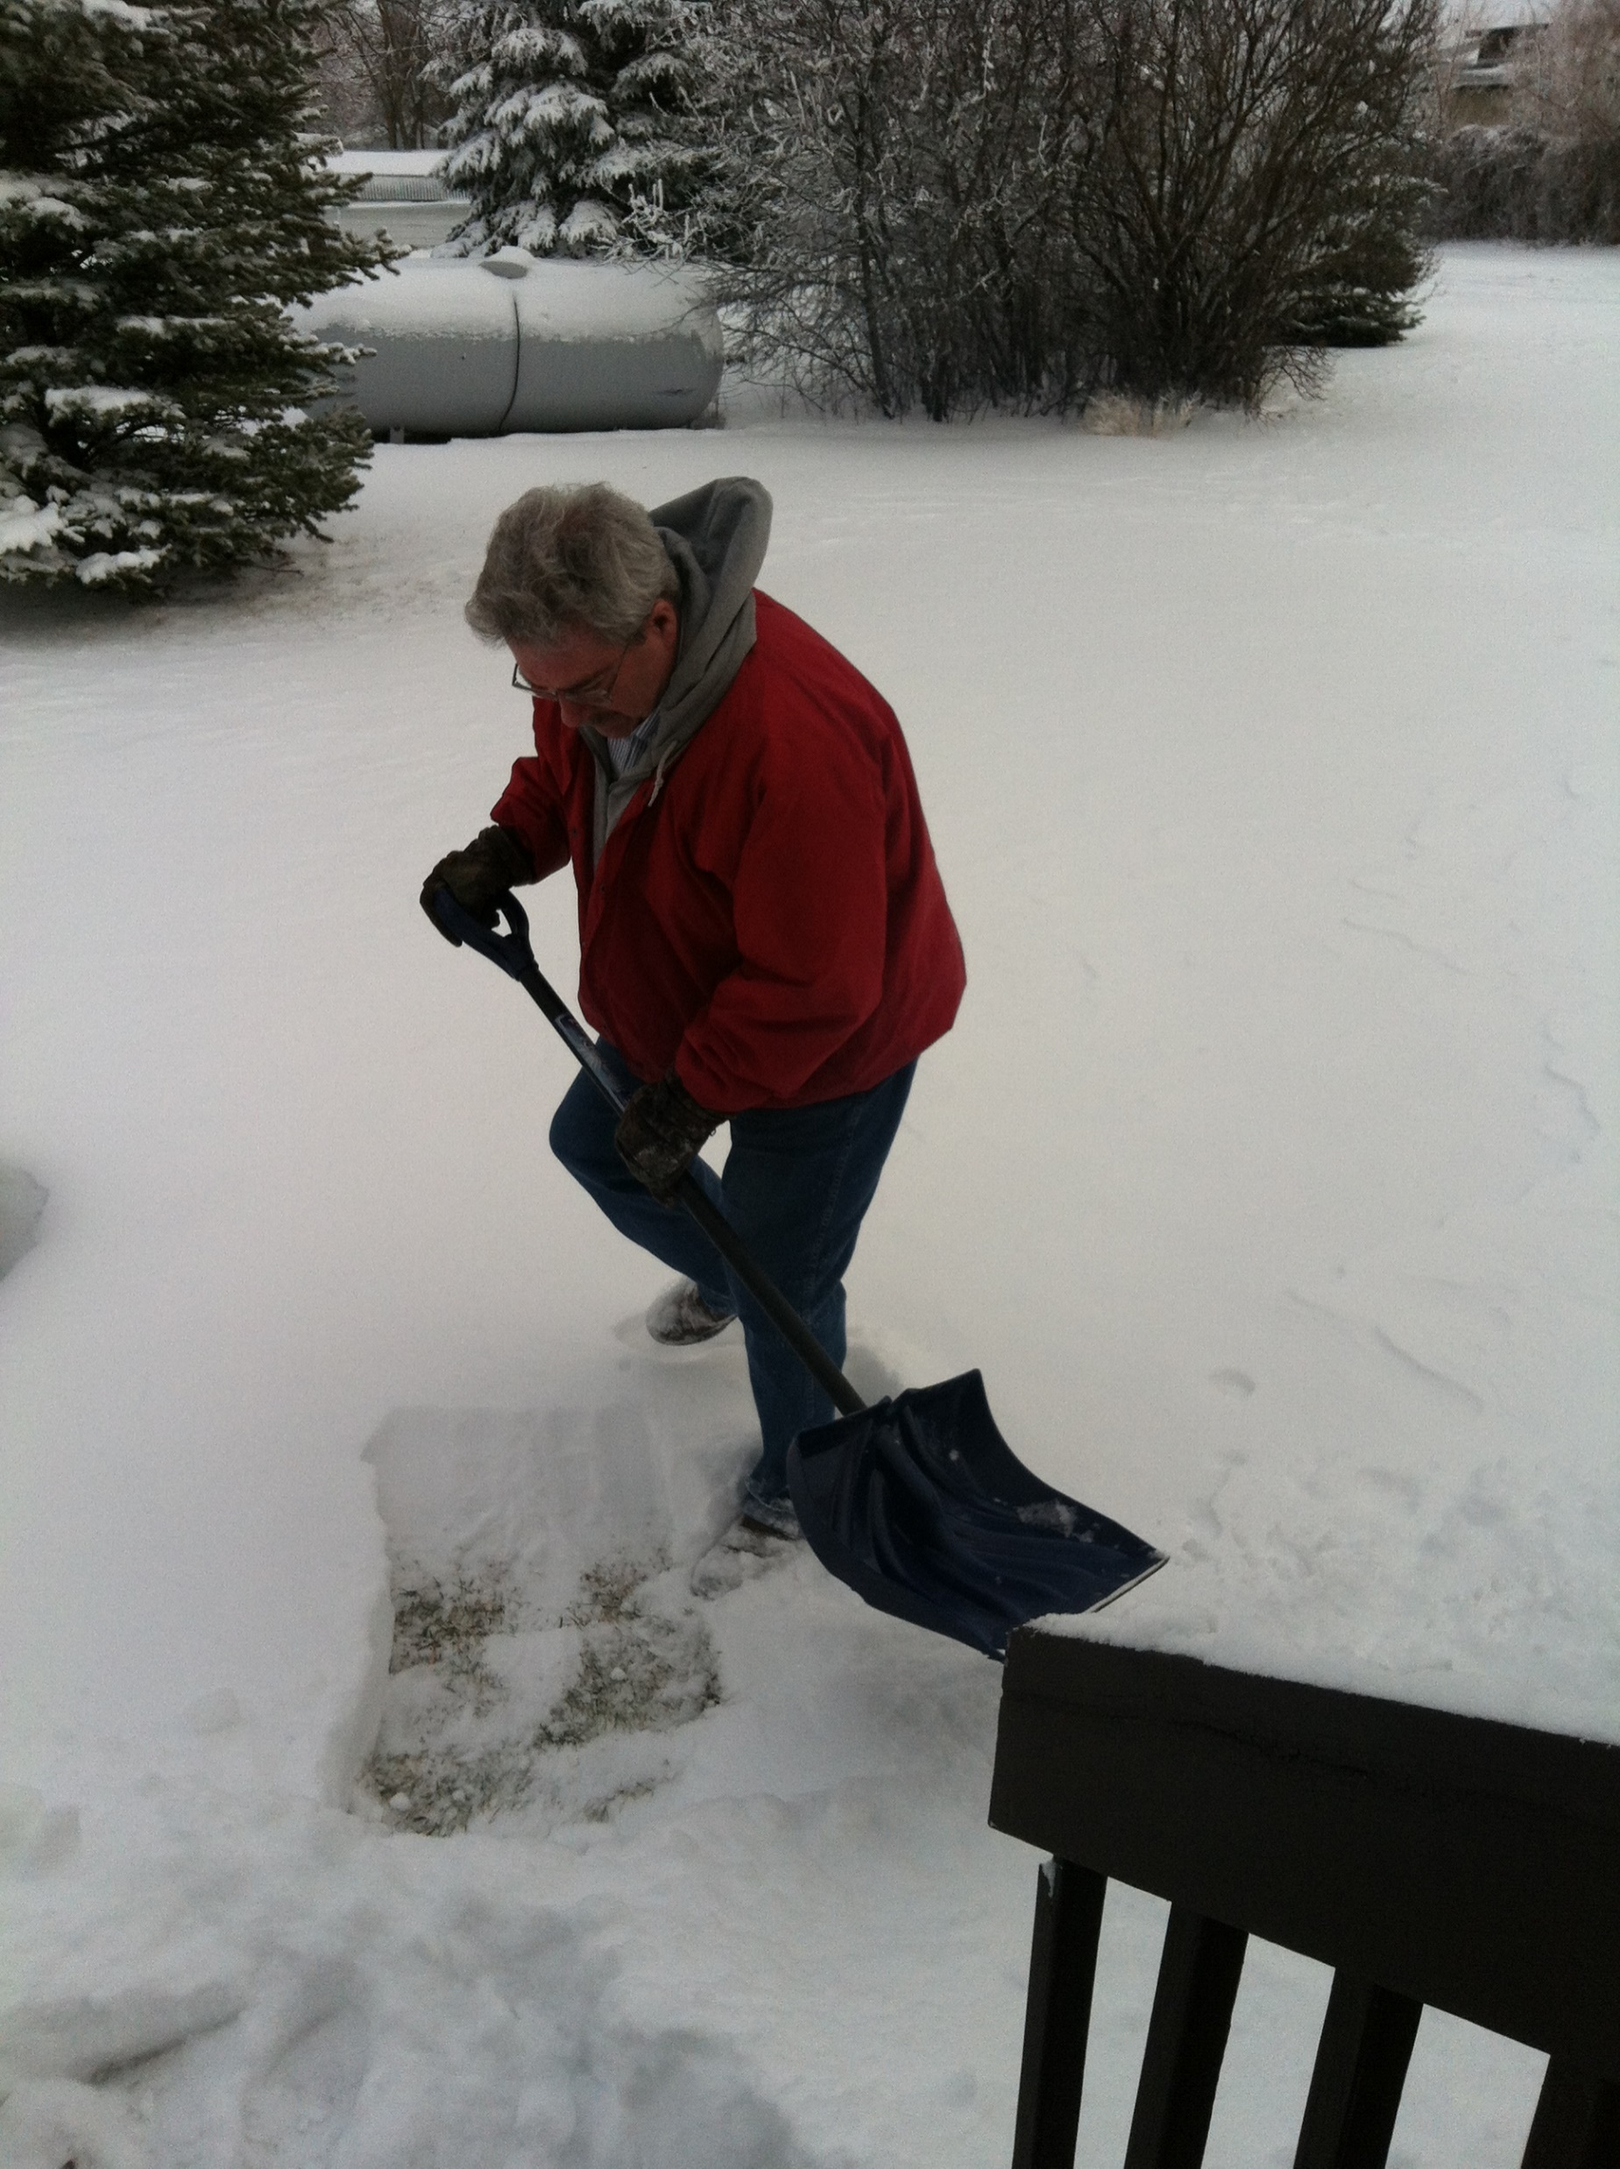
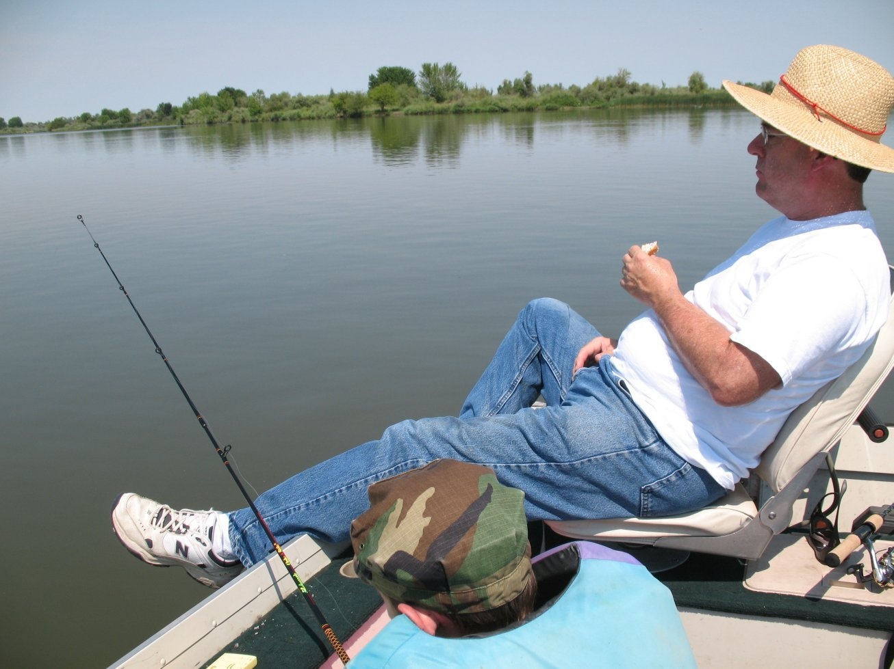
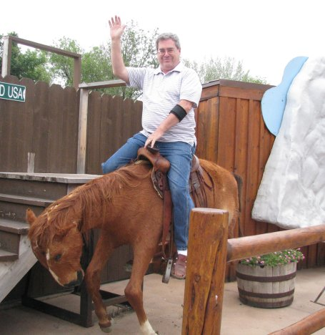
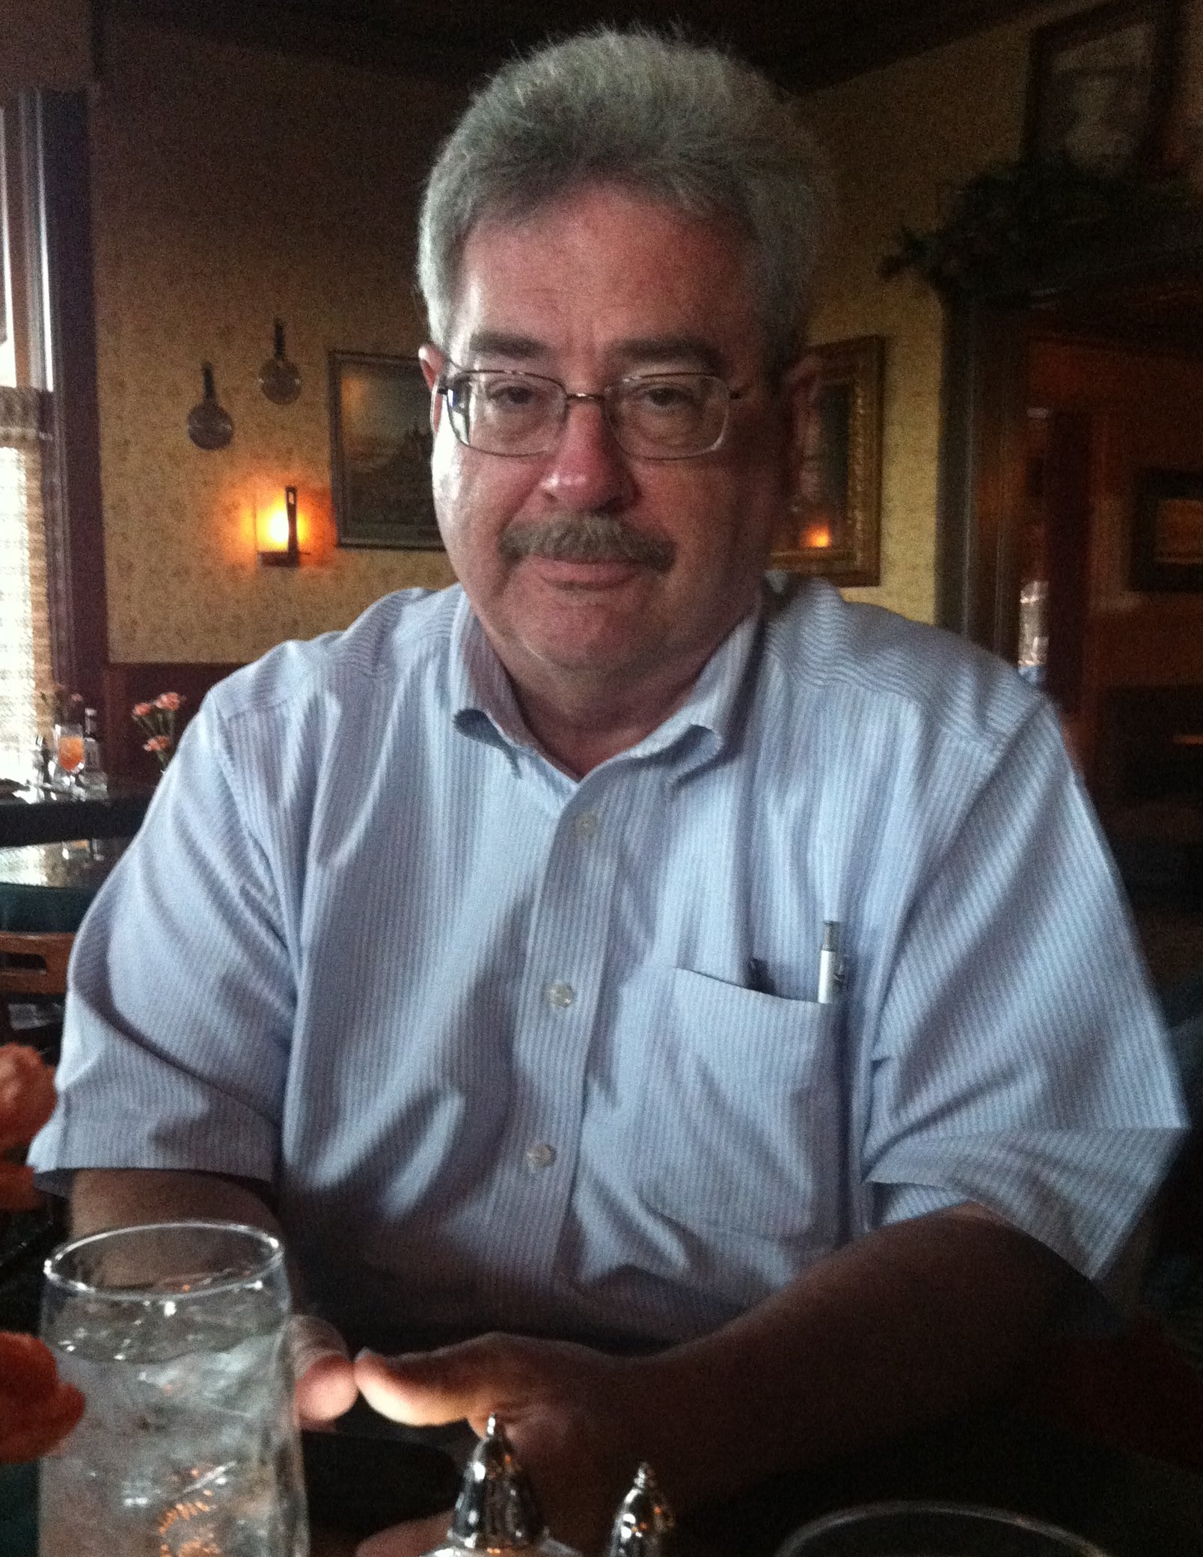
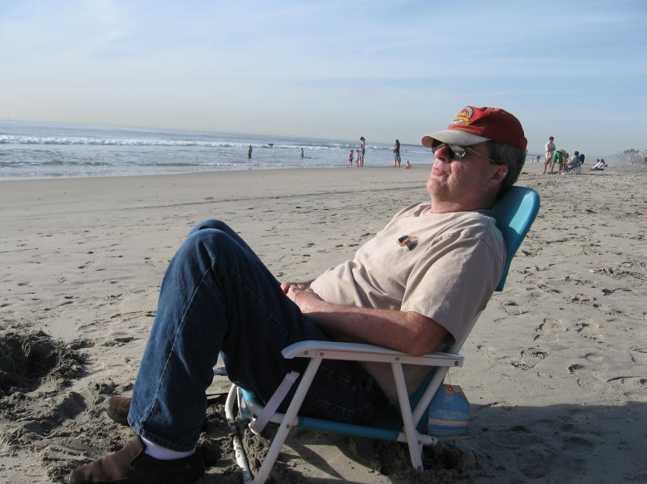
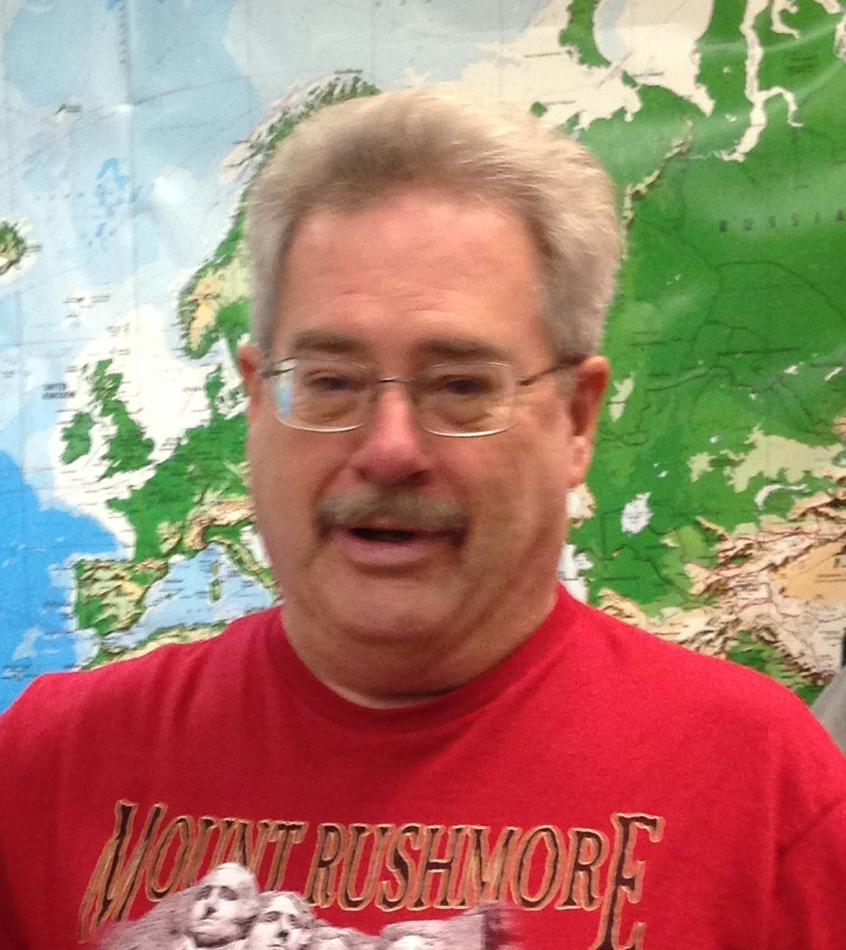
The first half of this ‘sermon presentation’
consists of Scriptures only. It has always been my goal
to help people learn to read the KJB by themselves – no other book needed – no Hebrew/Greek knowledge, special history/ dictionaries, etc. are necessary; and because so many pastors are deceitful in their loving yet lying approach, I want folks to realize they can actually learn to understand their KJB themselves, without any outside “modern scholarly” pastoral assistance.
Mikel Paulson
The Holy Spirit is all one needs to understand the KJB! However, one must also be able to know the difference between God’s words and Satan’s words; the truth of the Holy Spirit vs their own good ‘feelings’.
So, in the second half of this ‘sermon presentation,’ I include a few of my notes and references I would normally want to mention if I were to try to teach this particular subject ‘live’ to any and all who would be wanting to listen.
Ah yes, as you will see, it is still really hard for me not to stick my teaching into my preaching as well as it being equally hard for me to not add preaching into my teaching.

Slide 3
My purpose – goal – objective with this short
visual sermon is to remind ourselves that the wickedness that is going on these days is a direct result of the pastors, professors, publishers, scholars, teachers, etc. doing their ‘corrupting’ of the King James Bible. It is that simple. I don’t figure people actually realize just how important the KJB is since it came about in 1611.
Mikel Paulson
Not only did the KJB change the whole doctrinal scene with Paul in the modern times by putting all the spiritual emphasis, application, etc. into the KJB itself, the constant attack and ‘changing’ of the very words of God has brought about all this wickedness, perversion and corrupted society that has come upon us all. We who say we are true Bible believers should not be surprised as you will see here that the Scriptures are still true…
…even for today

Slide 4
Part I
Scriptures Only

Slide 5
What is Really Going On These Days…and Why?
OR
Just How Important is a Rightly Divided
King James 1611 Bible Today

Slide 6
The Gospel of Christ
For I am not ashamed of the gospel of Christ:
for it is the power of God unto salvation to every one that believeth;
to the Jew first, and also to the Greek.
For therein is the righteousness of God revealed from faith to faith:
as it is written,
The just shall live by faith.
Romans 1:16,17

Slide 7
For the wrath of God is revealed from heaven
against all ungodliness and unrighteousness of men,
who hold the truth in unrighteousness;
Romans 1:18

Slide 8
Because that which may be known of God is manifest in them;
for God hath shewed it unto them.
For the invisible things of him from the creation of the world are clearly seen,
being understood by the things that are made,
even his eternal power and Godhead;
so that they are without excuse:
Romans 1:19,20

Slide 9
Because that, when they knew God,
they glorified him not as God
neither were thankful
but became vain in their imaginations,
and their foolish heart was darkened.
Romans 1:21

Slide 10
Professing themselves to be wise,
they became fools,
And changed the glory of the uncorruptible God
into an image made like to corruptible man,
and to birds,
And fourfooted beasts,
and creeping things.
Romans 1:22,23

Slide 11
Wherefore
God also gave them up to uncleanness
through the lusts of their own hearts,
to dishonour their own bodies between themselves:
Who changed the truth of God into a lie,
and worshipped
and served the creature
more than the Creator,
who is blessed for ever. Amen.
Romans 1:24,25

Slide 12
For this cause God gave them up unto vile affections:
for even their women
And likewise also the men,
did change the natural use
leaving the natural use of the woman,
into that which is against nature:
burned in their lust one toward another;
men with men working that which is unseemly,
and receiving in themselves
that recompence of their error which was meet.

Slide 13
And even as they did not like to retain God in their knowledge
God gave them over to a reprobate mind,
to do those things which are not convenient;
Being filled with
full of
whisperers,
inventors of evil things,
all unrighteousness,
envy
Backbiters,
disobedient to parents,
fornication,
murder
haters of God,
Without understanding
wickedness,
debate,
despiteful,
Covenant-breakers
covetousness,
deceit,
proud,
without natural affection
maliciousness;
malignity;
boasters,
implacable,
unmerciful:

Slide 14
Who knowing the judgment of God,
that they which commit such things,
are worthy of death
not only do the same,
but have pleasure in them that do them.

Slide 15
Therefore thou art inexcusable, O man,
whosoever thou art that judgest:
for wherein thou judgest another,
thou condemnest thyself;
for thou that judgest doest the same things.

Slide 16
But we are sure that the judgment of God
is according to truth
against them
which commit such things.

Slide 17
And thinkest thou this, O man,
that judgest them which do such things,
and doest the same,
that thou shalt escape the judgment of God?

Slide 18
Or despisest thou the riches
of his goodness
and forbearance
and longsuffering;
not knowing
that the goodness of God
leadeth thee to repentance?

Slide 19
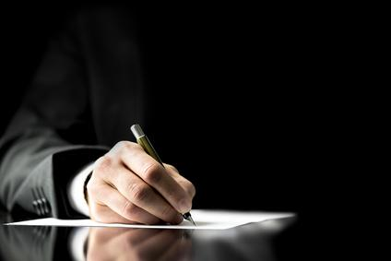
Part II
Scriptures With Written Comments
Ok, I hope you read those previous verses carefully, slowly, thoughtfully and were able to discern what all takes place within those very words of God.
Now, I have some things I would like to emphasize and bring out to show folks what I believe to be a few comments worth your while. Click on, if you would…

Slide 20
What is Really Going On These Days…and Why?
OR
Just How Important is a Rightly Divided
King James 1611 Bible Today

Slide 21
I am not ashamed of
Paul, either.
Be not thou therefore ashamed of the testimony of our Lord, nor of me his prisoner: but be thou partaker of the afflictions of the gospel according to the power of God; II Tim 1:8
Note: This is the gospel
of CHRIST – not the gospel
of Jesus. There is a difference.
The ‘gospel of ‘Christ’ is what the risen Christ taught to Paul then on to the Gentiles AFTER He rose. The ‘Jesus gospel’ you hear taught today is only what Jesus taught to the Jews while He was on
earth – which was before
His death and resurrection.
The Gospel of Christ
For I am not ashamed of the gospel of Christ:
See Heb 9:16,17
for it is the power of God unto salvation to every one that believeth;
to the Jew first, and also to the Greek.
For therein is the righteousness of God revealed from faith to faith:
as it is written,
Note that the faith that folks
lived by in the Old Testament
was ‘their own’ faith. “The just
shall live by his faith.” Hab 2:4.
The just shall live by faith.
The faith Paul speaks of is the faith OF Jesus Christ. Rom 3:22; Gal 2:16,20; Gal. 3:22; Phil 1:27; 3:9
Today, we are justified by the faith OF Christ, not our own. Gal 2:16
Romans 1:16,17

Slide 22
What we are
seeing more and more these
days is not the wrath of God
against a nation – world – etc. We
are seeing God’s wrath against having his Words changed into a lie. The result of that which is spoken in detail in I Tim 6:3-5 is the new perverted lifestyles to which people are turning today.
The very lifestyles that pastors preach against are caused by those very same pastors who reject the ‘KJB ONLY’
or even those not rightly
dividing the KJB.
For the wrath of God is revealed from heaven
against all ungodliness and unrighteousness of men,
who hold the truth in unrighteousness;
Thy word is truth,
so we have everyone today,
who was born with the truth
‘in’ them, living in ungodliness and unrighteousness – EVEN if they are good people. They cannot please God if they are ‘in the flesh’ – meaning if they have NOT had their soul cut away from their flesh.
Gal 2:11-16
To understand the unrighteousness of
‘good’ people and their ‘good works’ is to
know the difference between man’s righteousness and the imputed righteousness of God. God ‘makes’ us his righteousness; unless folks look to Paul ONLY in a KJB 1611 ONLY, they will never understand the marvelous meaning of these verses.
II Cor 5:21
As kids, or whenever, people have to be ‘taught’ that the KJB is ‘not’ the Word of God – truth! Today, that topic is seldom verbally brought
up anymore. The false lifestyles teachings now permeate
American society.
Romans 1:18

Slide 23
Because that which may be known of God is manifest in them;
for God hath shewed it unto them.
For the invisible things of him from the creation of the world are clearly seen,
being understood by the things that are made,
even his eternal power and Godhead;
This is the
simple answer to those
who wonder if God will hold the
works of those who ‘don’t know the truth’ concerning God.
so that they are without excuse:
The answer is “Yes He will!” because He created them without excuse. They learned or were taught ‘away’ from the truth that was manifest in them!
Am I talking about ‘election’ here? No! It is up to us still to try to steer these people away from those false teachings – and show them the simple ‘original truth’
about the risen Christ.
Romans 10:13-17
Romans 1:19,20

Slide 24
I put this
squarely on all pastors,
teachers, Sunday school
teachers, parents (including
myself), relatives, etc. from
The years when the KJB was
commonly accepted as ‘only’,
because it was the ‘only’ in most cases.
Because that, when they knew God,
they glorified him not as God
Everyone loves their babies and children but not enough to tell and SHOW them the truth. We are seeing the
sad results today.
neither were thankful
but became vain in their imaginations,
Here we go… today, we not only
know, we actually can see the results
of people lifting themselves up to the humanistic level of godhood – exactly what the devil told Eve in the garden.
and their foolish heart was darkened.
Vain in their imaginations!
Foolish heart!
Foolish heart darkened!
Sounds like typical people today… but you could never
convince them
now!
Romans 1:21

Slide 25
Professing themselves to be wise,
they became fools,
And changed the glory of the uncorruptible God
into an image made like to corruptible man,
and to birds,
And fourfooted beasts,
and creeping things.
I have nothing to
add to this… either you know and understand or you don’t know and don’t understand these verses.
However… I will reiterate what I have been saying all along that this is all being brought to you by today’s Great Commission pastors and Bible changers, correctors
and professors.
Romans 1:22,23

Slide 26
We don’t have
to go to the OT Law to get the perfect definition of today’s shameful and perverted lifestyles. It is right here in Romans 1.
Wherefore
God also gave them up to uncleanness
through the lusts of their own hearts,
to dishonour their own bodies between themselves:
Who changed the truth of God into a lie,
If any man
teach otherwise, and
consent not to wholesome
words, even the words of our
Lord Jesus Christ, and to the doctrine
which is according to godliness;
He is proud, knowing nothing,
but doting about questions and
strifes of words, whereof cometh
envy, strife, railings, evil surmisings,
Perverse disputings of men of
corrupt minds, and destitute of
the truth, supposing that gain
is godliness: from such
withdraw thyself.
and worshipped
Pastors, preachers, teachers, ministers, authors, professors, publishers, scholars,
SS teachers, parents, etc. - GUILTY
and served the creature
more than the Creator,
who is blessed for ever. Amen.
In the
beginning
God created the heaven and the earth.
Genesis 1:1
I Timothy 6:3-5
Romans 1:24,25

Slide 27
Who shall change our
vile body, that it may be
fashioned like unto his glorious body, according to the working whereby he is able even to
subdue all things
unto himself.
Phil 3:21
And in his estate shall
stand up a vile person, to whom they shall not give the honour of the kingdom: but he shall come in peaceably, and obtain the kingdom by flatteries. Daniel 11:21
Vile: Baseness; meanness; despicableness. Moral baseness or depravity; degradation by sin; extreme wickedness;
For this cause God gave them up unto vile affections:
Yahoo – that will be ME! You?
for even their women
And likewise also the men,
did change the natural use
leaving the natural use of the woman,
into that which is against nature:
burned in their lust one toward another;
men with men working that which is unseemly,
Ahhh… see –
now we know the
‘rest of the story …all because of messing with the King James 1611 Bible!
and receiving in themselves
that recompence of their error which was meet.
Try telling that to people!
Recompence - an equivalent returned for any thing given,
done or suffered; compensation; return of suffering or other equivalent; as a punishment.
Websters 1828
But at least you can show them the Scriptures…
if they let you.
Key word here is ‘THEMSELVES’’
Romans 1:26

Slide 28
Did not LIKE???
Reprobate
That which is rejected on account of its own worthlessness
So they made a choice!
And even as they did not like to retain God in their knowledge
God gave them over to a reprobate mind,
Convenient:
fit; suitable; proper; adapted to use or to wants; commodious; followed by to or for; usually by for.
Websters 1828
to do those things which are not convenient;
Being filled with
full of
whisperers,
inventors of evil things,
all unrighteousness,
envy
Backbiters,
disobedient to parents,
fornication,
murder
haters of God,
Without understanding
wickedness,
debate,
despiteful,
Covenant-breakers,
covetousness,
deceit,
proud,
without natural affection
maliciousness;
malignity;
boasters,
implacable,
unmerciful:
Harboring ill
will or enmity without provocation; malevolent in the extreme; malignant in heart; disposition to injure
Websters 1828
Extreme enmity, or evil dispositions of heart towards another; malice without provocation, malevolence with baseness of heart; deep rooted spite
Not to be appeased;
that can not be pacified
and rendered peaceable; inexorable; stubborn or constant in enmity;
Websters 1828
Romans 1:24,25

Slide 29
Key word is “KNOWING.”
Another key word is ‘commit’ – that means much more
than simply ‘do.’
Who knowing the judgment of God,
that they which commit such things,
are worthy of death
not only do the same,
but have pleasure in them that do them.
Key word – ‘them.’
Note in THEM that do them. They all make great buddies together – they are all just one happy perverted family… and they will vote for their own family members!
That they all might be damned who believed not the truth, but had pleasure in unrighteousness.
II Thess 2:12

Slide 30
People just love to
‘play’ with bible quotes as they try to throw these ‘judging’ verses towards us. The context here is to the lost person doing those things, etc. They try to judge us, actually and have no tolerance for us – not the other way around… although, we really could do without them!
Therefore thou art inexcusable, O man,
whosoever thou art that judgest:
for wherein thou judgest another,
thou condemnest thyself;
for thou that judgest doest the same things.

Slide 31
This is certainly
not talking about the judgment seat of Christ.
They will have
their day in ‘court’
with a judge they don’t
believe in… at least
not now, anyway.
Revelation 20:11-15
Daniel 7:9,10
This is also not talking about a personal daily judgment by God – there
is none… yet!
See Romans 2:5
But we are sure that the judgment of God
is according to truth
This is to whom this whole ‘sermon’ is addressing – THEM; not the sincere and truly saved Christian.
against them
which commit such things.

Slide 32
It appears that they all seem to be in the same boat – and their boat is going to sink – actually, it will burn.
And they thought they would escape the judgment of God, but not the others.
And thinkest thou this, O man,
that judgest them which do such things,
and doest the same,
that thou shalt escape the judgment of God?

Slide 33
However, the message today is NOT to be the ‘severity of God on a daily basis’… but it is to be the ‘goodness of God’ that would ‘win’ people to the Lord. Sad to say, but most, almost all, pastors have it wrong today!
And to you street preachers out there doing your “Jeremiah” thing – do you preach the ‘severity of God’ judging those people for what they do or do you preach the forbearance of God; the longsuffering of God all topped off with
the goodness of God?
Or despisest thou the riches
of his goodness
and forbearance
and longsuffering;
not knowing
that the goodness of God
leadeth thee to repentance?

Slide 34
Behold therefore the goodness and severity of God: on them which fell, severity;
but toward thee, goodness, if thou continue in his goodness:
otherwise thou also shalt be cut off. Romans 11:22
And when the Gentile Nation is cut off from the goodness of God, then the Tribulation begins!
And when the Tribulation begins, there is a gospel change again.
And if you are hearing this gospel being preached today – or if you are hearing the gospel of Jesus from the apostles and gospels today… you are hearing the wrong gospel.
The Everlasting Gospel
And I saw another angel fly in the midst of heaven, having the everlasting gospel to preach unto them that dwell on the earth, and to every nation, and kindred, and tongue, and people…
I marvel that ye are so soon removed from him that called you into the grace of Christ unto another gospel:
Which is not another;
but there be some that trouble you,
and would pervert the gospel of Christ.
Saying with a loud voice, Fear God, and give glory to him; for the hour of his judgment is come: and worship him that made heaven, and earth, and the sea, and the fountains of waters. Revelation 14:6,7
But though we, or an angel from heaven,
preach any other gospel unto you than that which we have preached unto you, let him be accursed.
Here is the patience of the saints: here are they that keep the commandments of God, and the faith of Jesus. Revelation 14:12
As we said before, so say I now again, If any man preach any other gospel unto you than that ye have received, let him be accursed.
Galatians 1:6-9

Slide 35
There ya have it, folks!
Today, we are seeing the results of God’s words being corrupted over the past 100+ years.
For we are not as many, which corrupt the word of God: but as of sincerity, but as of God, in the sight of God speak we in Christ.
II Corinthians 2:17
But continue thou in the things which thou hast learned and hast been assured of, knowing of whom thou hast learned them;
And that from a child thou hast known the holy scriptures, which are able to make thee wise unto salvation through faith which is in Christ Jesus.
All scripture is given by inspiration of God, and is profitable for doctrine, for reproof, for correction, for instruction in righteousness: That the man of God may be perfect, throughly furnished
unto all good works.
II Timothy 3:14-17
Study to shew thyself approved unto God, a workman that needeth not to be ashamed, rightly dividing the word of truth. But shun profane and vain babblings: for they will increase unto more ungodliness.
I Timothy 2:15,16
But we are bound to give thanks alway to God for you, brethren beloved of the Lord, because God hath from the beginning chosen you to salvation through sanctification of the Spirit and belief of the truth:
Whereunto he called you by our gospel, to the obtaining of the glory of our Lord Jesus Christ.
Therefore, brethren, stand fast, and hold the traditions which ye have been taught, whether by word, or our epistle.
Now our Lord Jesus Christ himself, and God, even our Father, which hath loved us, and hath given us everlasting consolation and good hope through grace, Comfort your hearts, and stablish you in every good word and work.
II Thessalonians 2:13-17
Bonus Comment: Maybe now this verse makes more sense for us, not just meaning Timothy as a child. Knowing what Romans 1:18,19 says, we can see that we also have known the holy scriptures from a child! I just have to say: “This KJB is the greatest book with the greatest words anywhere. A physical book with a spiritual life. The KJB is a true living bible as the Living God!“

Slide 36
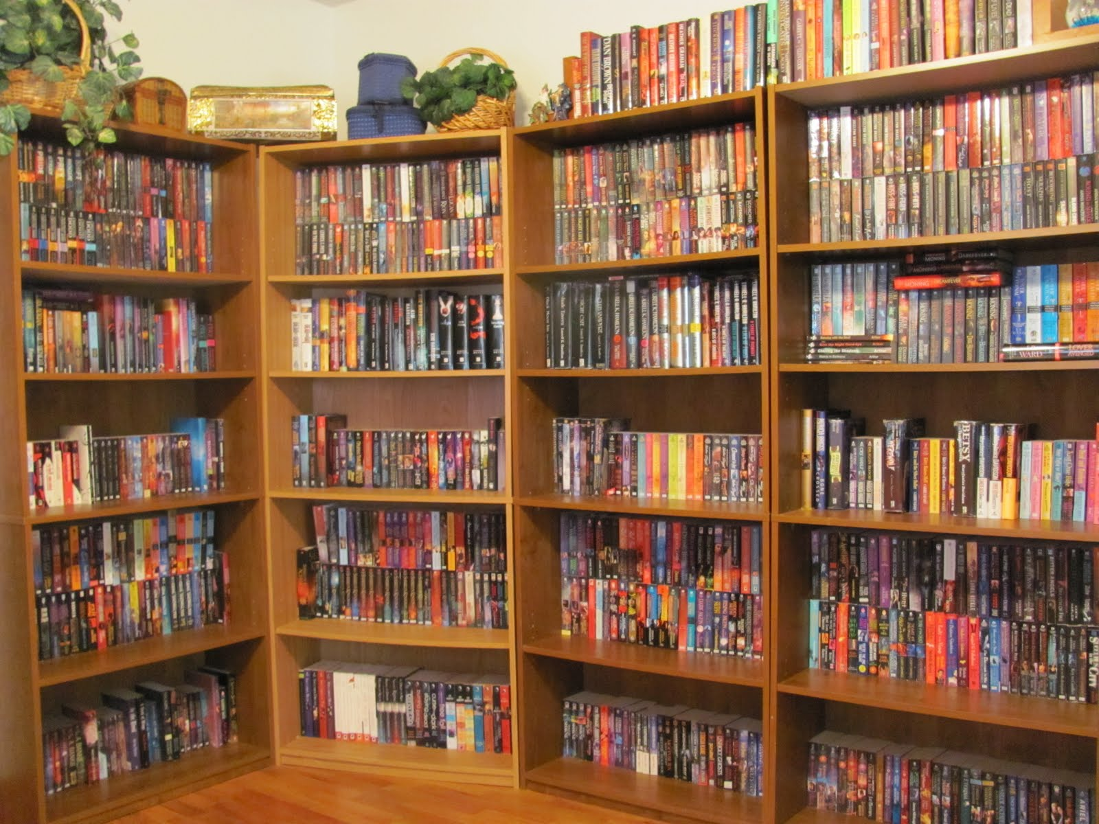
King James 1611 Bible
Scholarship, Education, Degrees, Bible Institutes, Courses, Workshops, Retreats, Conventions – books, books, books,
and more books…
Religion
S
Ever learning, and never able to come to the knowledge
of the truth.
The Truth

Slide 37
Get one while you still can!

Slide 38
Behold, the days come, saith the Lord GOD, that I will send a famine in the land, not a famine of bread, nor a thirst for water...
…but of hearing the words of the LORD
And they shall wander from sea to sea, and from the north even to the east, they shall run to and fro to seek the word of the LORD,
…and shall not find it.
Amos 8:11,12
www.scatteredchristians.org

Slide 39
This is just a friendly reminder that this PowerPoint was designed by Mikel Paulson,
June, 2016 – www.scatteredchristians.org
This presentation is not copyrighted, of course, so if you can add more information, and there is a lot more that I am sure can be added to this, feel free to do so. My only expectation and requirement is that you use ONLY a King James 1611 Bible. Actually, that can’t be a big problem because if you tried to use any other modern bibles, you would find they wouldn’t work with this anyway, thus we see once again the importance of a rightly divided 1611 KJB ONLY. ☺
If you do add more comments, scripture references, etc. for your own use – or to pass on to others,
please pass it on to me, as well. I would be glad to update yours to the website.
But watch thou in all things, endure afflictions,
do the work of an evangelist, make full proof of thy ministry.
One more thing: everything stated within this presentation is supported by KJB Scripture. If you want to know the specific verses used, then contact me, or look them up yourself. They are in there, and they are taken from the correct books written TO us today – Paul’s!!
- KJB1611 ONLY -

Slide 40
Religion is Never the Truth
The Truth is Never a Religion

Slide 41
The King James 1611 Bible is Truth

Slide 42
The grace of our Lord Jesus Christ be with your spirit. Amen

