Slide 1
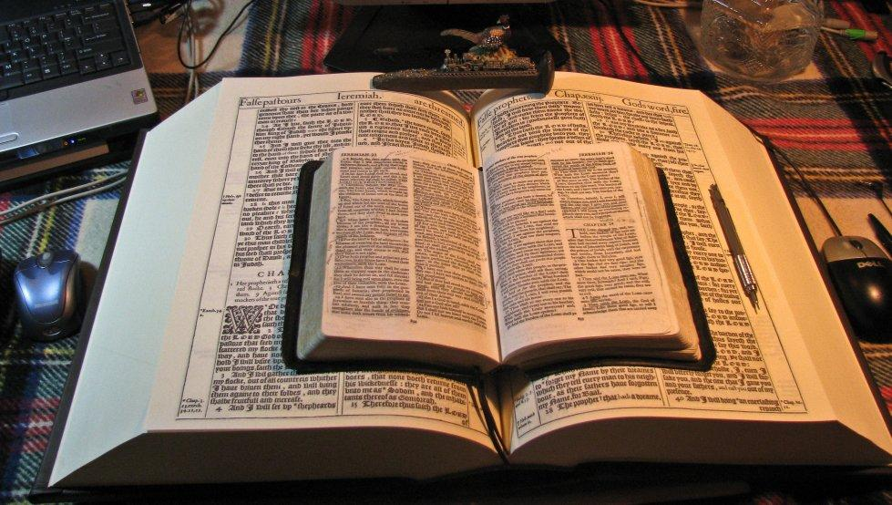
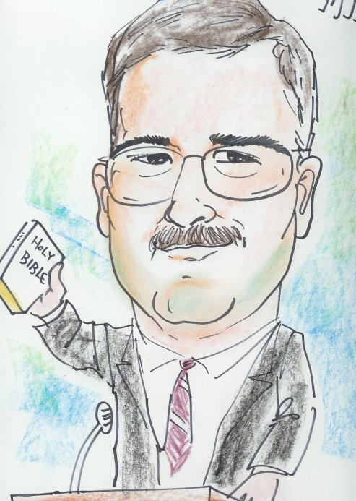
This PowerPoint was put together by Mike Paulson, July, 2016 – www.scatteredchristians.org
This presentation is not copyrighted, of course, so if you want to add more, and there is a lot more that I am sure can be added to this, feel free to do so. My only expectation and requirement is that you use ONLY a King James 1611 Bible.
But then again, that is not a huge concern of mine because if you do try to use any other modern bibles, you will find they wouldn’t fit with this anyway; thus we see once again, the importance of a rightly divided 1611 KJB ONLY. ☺
If you do add more comments, scripture references, etc. for your own use – or to pass on to others,
please pass it on to me, as well. I would be glad to update yours to the website.

Slide 2
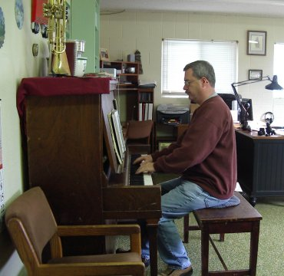
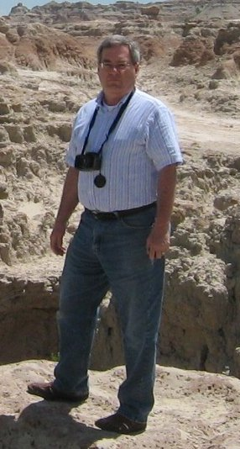
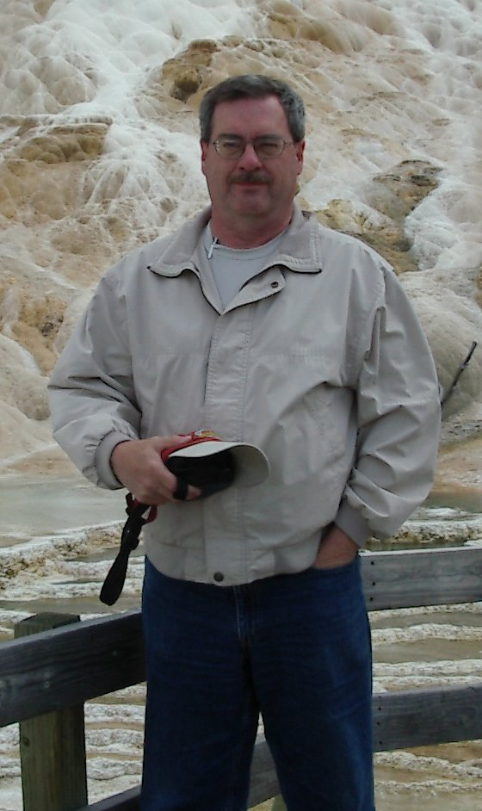
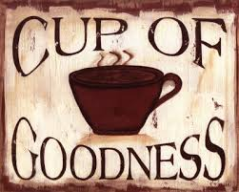
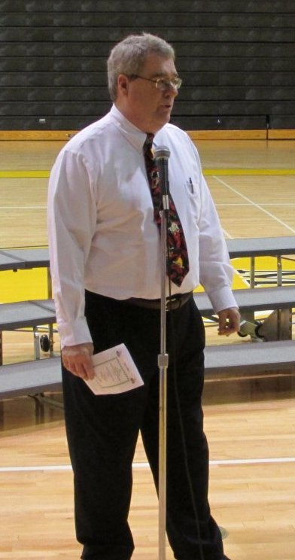
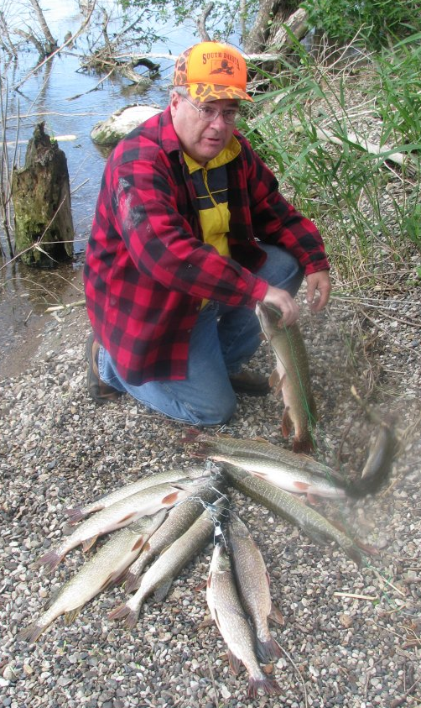
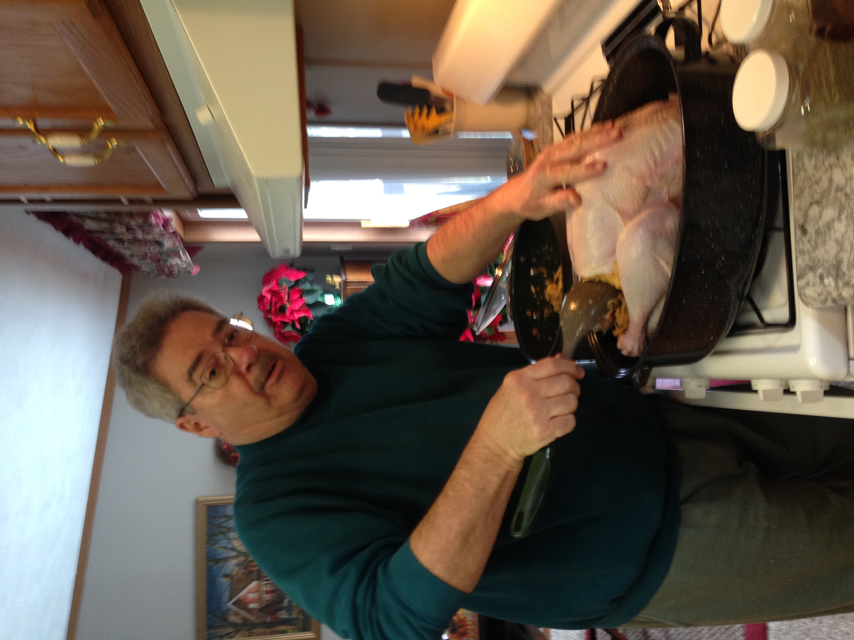
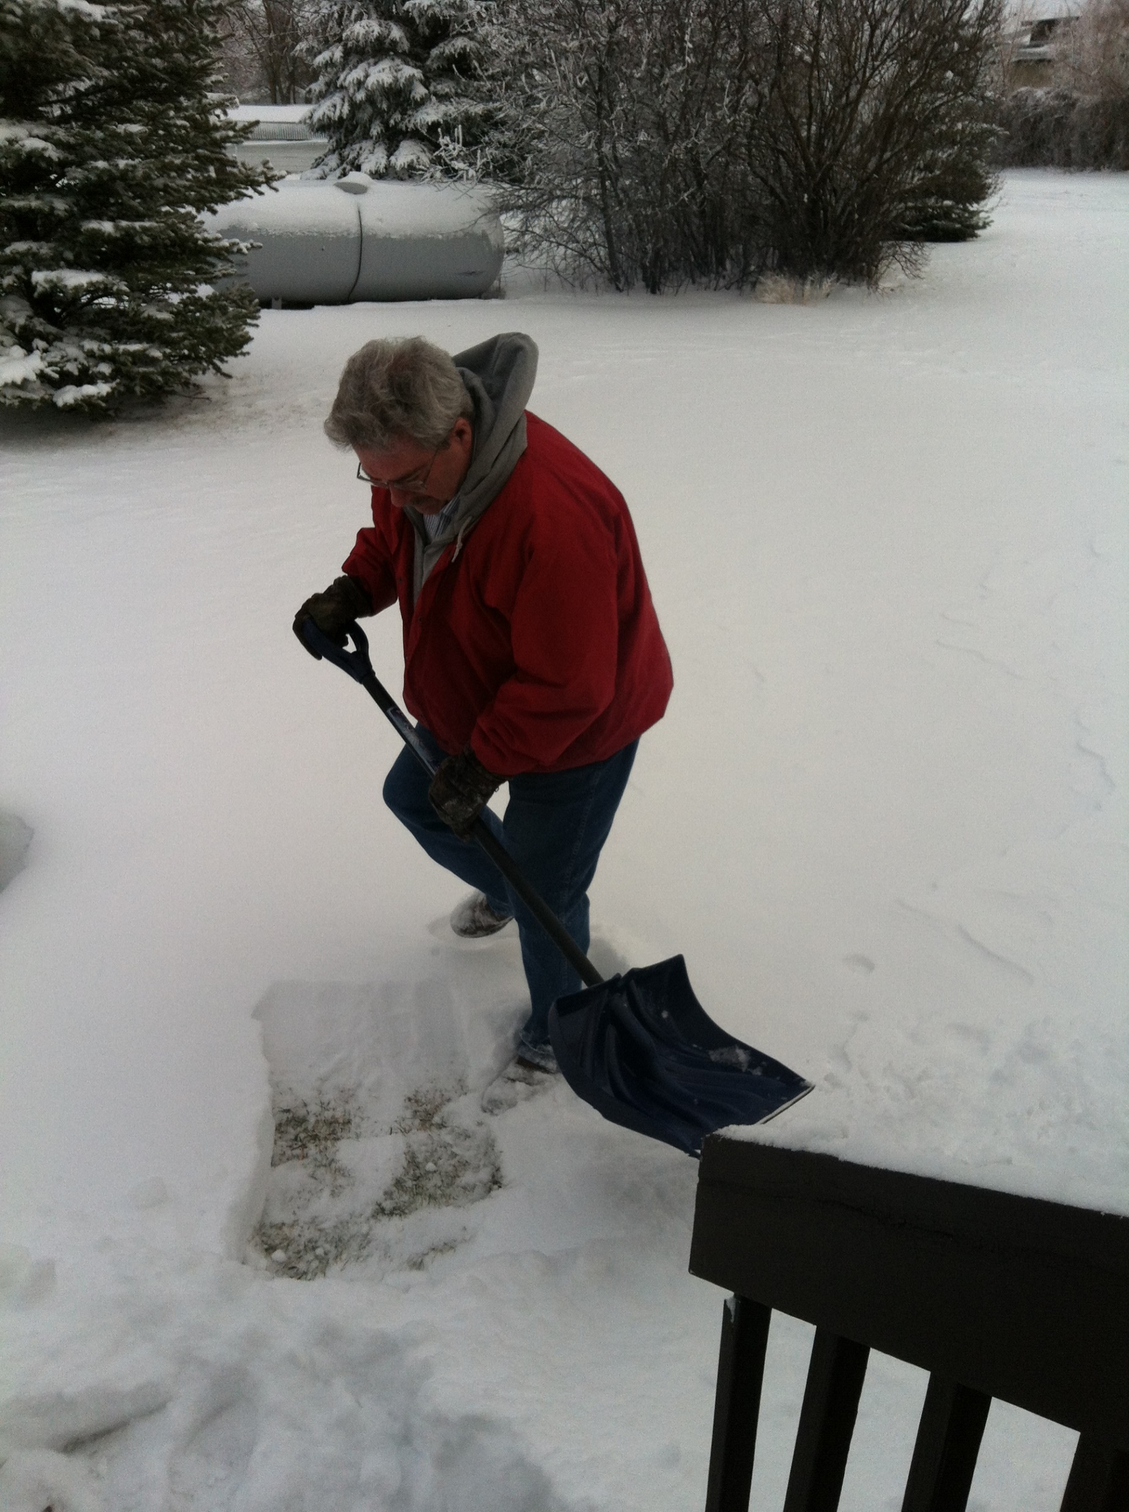
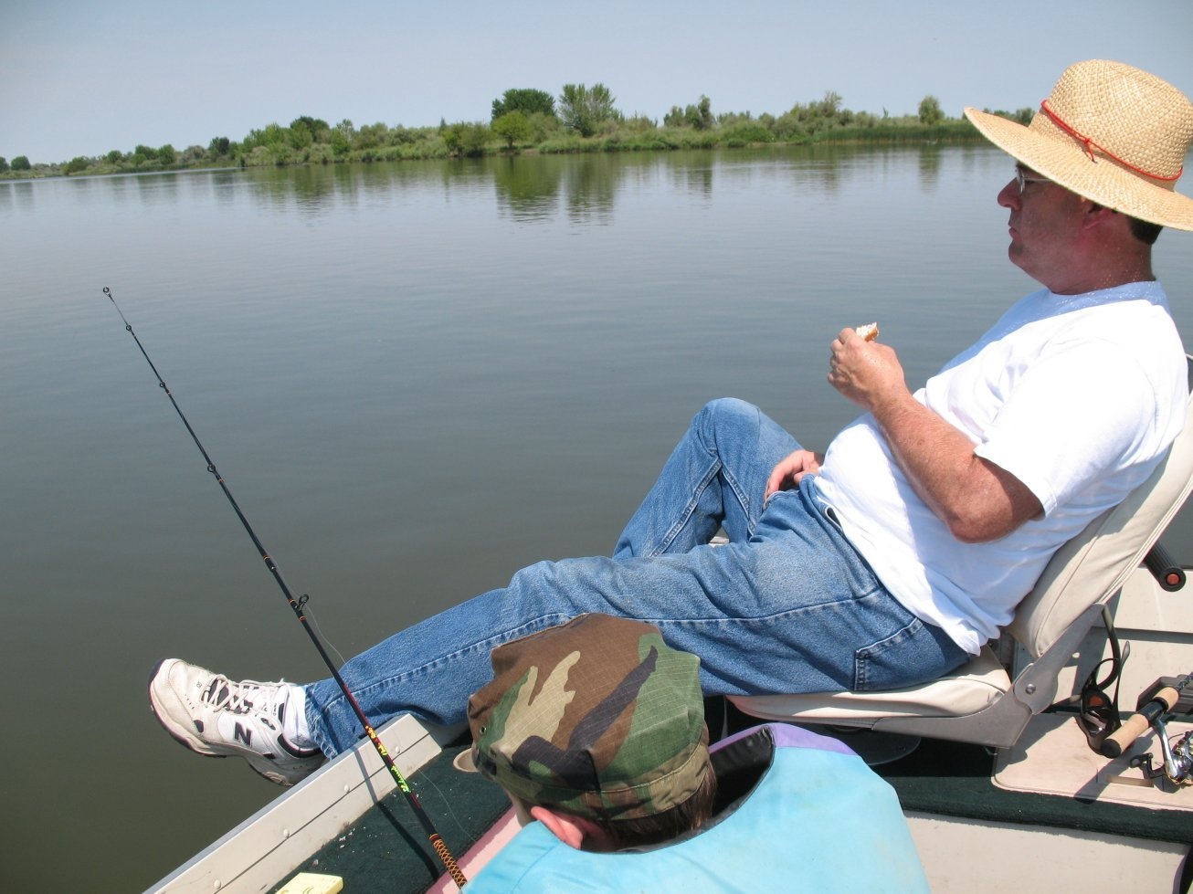
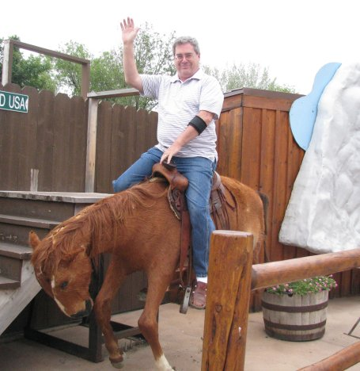
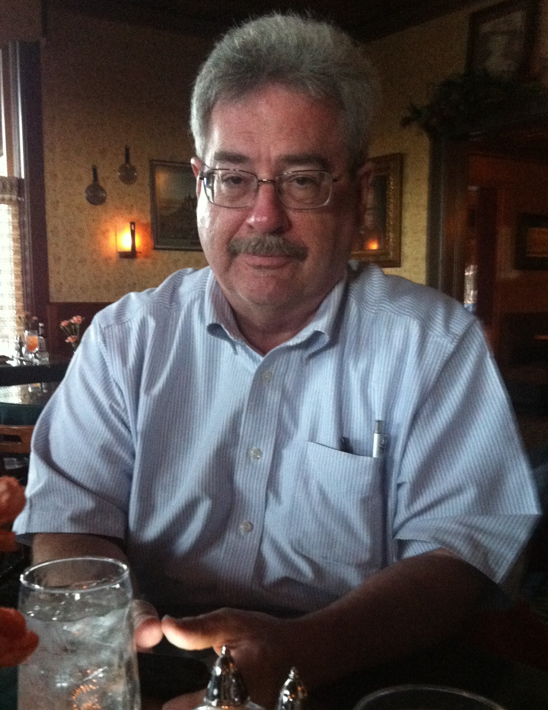
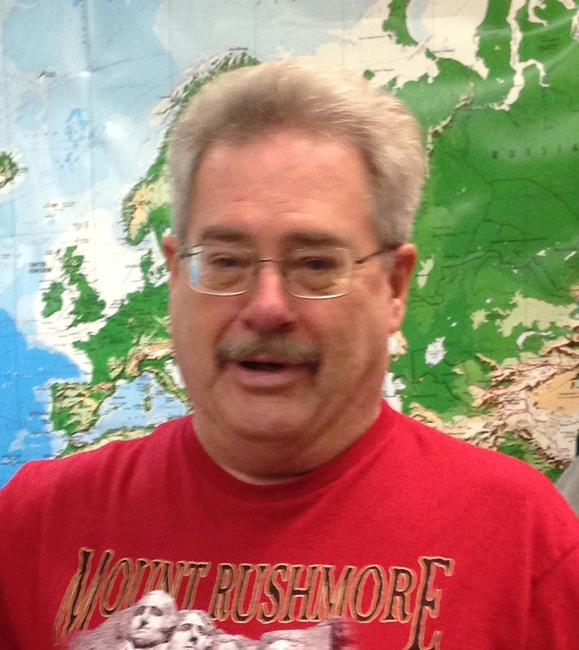
The first half of this ‘sermon presentation’
consists of Scriptures only. It has always been my goal
to help people learn to read the KJB by themselves – no other book needed – no Hebrew/Greek knowledge, special history/ dictionaries, etc. are necessary; and because so many pastors are deceitful in their loving yet lying approach, I want folks to realize they can actually learn to understand their KJB themselves, without any outside “modern scholarly” pastoral assistance.
Welcome to my visual video
‘Bible Sermon /Bible Study’ Presentation.
Mikel Paulson
The Holy Spirit is all one needs to understand the KJB! However, one must also be able to know the difference between God’s words and Satan’s words; the truth of the Holy Spirit vs their own good ‘feelings’.
In the second half of this ‘presentation,’ I include a few of my notes and references I would normally want to mention if I were to try to teach this particular subject ‘live’ to any and all who would be wanting to listen.
And, as you will see, it is still really hard for me not to stick my teaching into my preaching as well as it being equally hard for me to not add preaching into my teaching.

Slide 3
Today’s Presentation Study
Hope in a Hopeless Situation
Mikel Paulson
We are seeing our own country self-destruct; we are seeing the economy being taken over; we are seeing our personal lives challenged by all the difficulties of today’s modern living; some of us are even experiencing the increasingly difficult challenges of aging along with health issues that put us to the test. Sure, we understand the Scriptures as to what is going on ‘out there’ and even ‘with each of us,’ but we can still find ourselves having ‘our own hope’ challenged through these growing difficult times.
In this presentation, let us look to the KJB for the comfort of the scriptures so that we can
continue in that hope..

Slide 4
Part I
Scriptures Only
This section has no added commentary, opinions, footnotes, references, teachings, etc.
You will be reading the simple, inspired and preserved plain text from a 1611 King James Bible – nothing else.

Slide 5
Therefore being justified by faith, we have peace with God through our Lord Jesus Christ:
By whom also we have access by faith into this grace wherein we stand,
and rejoice in hope of the glory of God.
And not only so, but we glory in tribulations also:
knowing that tribulation worketh patience;
And patience, experience; and experience, hope:
ROMANS
And hope maketh not ashamed;
because the love of God is shed abroad in our hearts
by the Holy Ghost which is given unto us.
For we are saved by hope:
but hope that is seen is not hope:
for what a man seeth, why doth he yet hope for?
But if we hope for that we see not,
then do we with patience wait for it.
Rejoicing in hope;
For whatsoever things were written aforetime were written for our learning,
that we through patience and comfort of the scriptures might have hope.
Now the God of hope fill you with all joy and peace in believing,
that ye may abound in hope, through the power of the Holy Ghost.
5:1-5
8:24,25
12:12
15:4
15:13

Slide 6
II
CORINTHIANS
And our hope of you is stedfast, knowing,
that as ye are partakers of the sufferings,
so shall ye be also of the consolation.
Seeing then that we have such hope,
we use great plainness of speech:
Not boasting of things without our measure, that is, of other men's labours;
but having hope, when your faith is increased,
that we shall be enlarged by you according to our rule abundantly,
1:7
3:12
10:15

Slide 7
COLOSSIANS
For we through the Spirit wait for the hope of righteousness by faith.
GALATIANS
EPHESIANS
The eyes of your understanding being enlightened;
that ye may know what is the hope of his calling,
and what the riches of the glory of his inheritance in the saints,
That at that time ye were without Christ, being aliens from the commonwealth of Israel, and strangers from the covenants of promise,
having no hope, and without God in the world:
For the hope which is laid up for you in heaven,
whereof ye heard before in the word of the truth of the gospel;
If ye continue in the faith grounded and settled,
and be not moved away from the hope of the gospel,
which ye have heard, and which was preached to every creature which is under heaven; whereof I Paul am made a minister;
To whom God would make known what is
the riches of the glory of this mystery among the Gentiles;
which is Christ in you, the hope of glory:
5:5
1:18
2:12
1:5
1:23
1:27

Slide 8
I
THESSAOLONIANS
II
THESSAOLONIANS
Remembering without ceasing your
work of faith,
and labour of love,
and patience of hope
in our Lord Jesus Christ, in the sight of God and our Father;
For what is our hope, or joy, or crown of rejoicing?
Are not even ye in the presence of our Lord Jesus Christ at his coming?
But I would not have you to be ignorant, brethren,
concerning them which are asleep,
that ye sorrow not, even as others which have no hope.
But let us, who are of the day, be sober, putting on the breastplate of faith and love;
and for an helmet, the hope of salvation.
Now our Lord Jesus Christ himself, and God, even our Father, which hath loved us,
and hath given us everlasting consolation and good hope through grace,
1:3
2:19
4:13
5:8
2:16

Slide 9
Paul, an apostle of Jesus Christ
I
TIMOTHY
by the commandment of God our Saviour, and Lord Jesus Christ,
which is our hope
TITUS
In hope of eternal life,
which God, that cannot lie,
promised before the world began;
Looking for that blessed hope,
and the glorious appearing of the great God and our Saviour Jesus Christ;
That being justified by his grace,
we should be made heirs
according to the hope of eternal life.
1:1
1:2
2:13
3:7

Slide 10
Part II
Scriptures With Written Comments
You will find my personal comments in little ‘clouds’ like this when you reach the end of each page – if I have any comments to make, that is.
I trust you read those verses on ‘hope’ very carefully, very slowly and with great meditation. Hopefully, you were able to discern in the way the living God would encourage you from His very words; words that are not only “…given by inspiration of God” but preserved, just as He promised He would do “…from this generation for ever.”
So now, as a former pastor and Bible teacher, I have some personal thoughts along with some emphasis placed onto a few scripture words that I believe to be worth your while.
Click-on to continue on…

Slide 11
Preface
Hope in a Hopeless Situation
After reading the exact scriptures on ‘hope,’ we can now take a few minutes and see how they can be grouped into an easy, thoughtful and encouraging format. The context of a group of verses can be very important to understanding; we can also often group verses into an outline form that helps us organize our own personal thoughts.
Introduction
As is always the best way to start, let’s look at the definition of hope, first according to the Scriptures and then, for man’s input, a Webster’s 1828.
For we are saved by hope: but hope that is seen is not hope: for what a man seeth, why doth he yet hope for?
When it comes to preparing a sermon, this is probably the best way I have found for me to organize and present any subject from the Bible.
But if we hope for that we see not, then do we with patience wait for it.
Once I heard and came to believe that each word in my KJB is pure, then I also figured the best way for me to prepare sermons, etc. was to study each word as it stands – no Greek, no Hebrew, no commentaries, etc. That is called a ‘word study’ and I have been doing them for years… and years!
Romans 8:24,25
HOPE, noun
1. A desire of some good, accompanied with at least a slight expectation of obtaining it, or a belief that it is obtainable. hope differs from wish and desire in this, that it implies some expectation of obtaining the good desired, or the possibility of possessing it. hope therefore always gives pleasure or joy; whereas wish and desire may produce or be accompanied with pain and anxiety.
2. Confidence in a future event; the highest degree of well founded expectation of good;
HOPE, verb intransitive
To cherish a desire, with some expectation of obtaining it,
or a belief that it is obtainable.
2. To place confidence in; to trust in with confident expectation of good.
HOPE, verb transitive
To desire with expectation of good, or a belief that it may be obtained.
And anyone can do a Word Study!
Sermon Notes

Slide 12
For we are saved by hope: but hope that is seen is not hope: for what a man seeth, why doth he yet hope for?
At this time, I think some of you who know me, would expect me to take a bunny trail, as we call them, and would have to mention the word patience from vs 25.
But if we hope for that we see not, then do we with patience wait for it.
Romans 8:24,25
It seems that as we get discouraged, fearful, anxious as to all that is going on these days, it is our patience that we are losing first; then we start losing hope.
I do believe that ‘we’ tend to want to ‘see’ things these days that we believe would give us more hope.
Sadly, we just ‘see’ a lot of things that tend to only diminish our hope – from the ‘state of the world, country and state; politics; evil media; the workings of our own little towns; the people in them; the school; the kids around town; and then what goes on within our own families…
Many of us are very aware of the scriptures on ‘hope’; we must just be running out of patience. So, we should trail off for a few minutes and check on the word ‘patience’ in the Scriptures.
However, as soon as you look up the word ‘patience,’ you will see another complete study, or in my case, it would have been another sermon; we would have had the ‘evening’ sermon ready as well. In the case of a website audio, we could see the beginning of another series. But now for you...
…and of course, as Paul had his own battles according to Romans 7:15-25, we also have battles with our own flesh, winning a few… but more often losing, right?
There is no hope in trying to see; we see mostly disappointment and frustration resulting in more loss of hope.
…you can take this as an opportunity to do your own personal study, either for yourself or for your family.
Our hope should be in what we do not see and in what we know to be a true hope!
These are the verses on patience that would give you a great ‘word study’ from Paul ONLY, of course.
Rom 5:3,4; Rom 8:25; Rom 15:4; II Cor 6:4; II Cor 12:12; Col 1:11; I Thess 1:3; II Thess 1:4; I Tim 6:11; II Tim 3:10; Titus 2:2
Sermon Notes
Whoever does study ‘patience’ will find out that
patience does actually have a lot to do with our ‘hope’.

Slide 13
Ok – I just got to thinking the other day that there might be a seriously notable truth to learn about ‘patience.’ So I went ahead and did my own study. While I will not include the entire study here on this page, I will at least throw this much in. If you want the full study for yourself, just look up the word patience in the KJB scriptures and you will consistently notice the following observations:
1. The word ‘patience’ is not in the Old Testament; I always find that interesting when I see words used in the NT but not in the OT.
2. You will notice there are differences in usage of the word ‘patience’ when you separate the verses into the three different ‘rightly divided’ sections of the KJB: A) the Gospels including Acts 1-8, to the Jews; B) Paul’s books, to us Gentiles in the dispensation of grace, and 3) Hebrews to Revelation – the tribulation books.
And now, doesn’t the phrase that everyone uses today,
‘the patience of Job’ make more sense?
3. In the gospels, which we all should know is still to be considered Old Testament doctrine, (See Hebrews 9:16,17) we see that the there is a greater importance put to having patience. In fact, in Luke 21:19, we see “In your patience possess ye your souls.” We also see in Luke 8:15, they were to bring forth fruit with patience. So we see an active ‘work’ involving patience – more than just something to have to help, it was eternally ‘necessary’ to have. We will see ‘just how necessary’ when we look to the Tribulation books, which again will be directed towards the Jews.
The patience of Job was all about ‘enduring;’ the ‘end of the Lord;’ the Lord being very pitiful and of tender mercy. They will need the patience of Job during the coming Tribulation. We don’t need the ‘patience of Job’ today – so stop saying it.
4. Paul makes mention of gospel patience when he mentions the apostles, saying that the signs of those apostles were not only what we all know today as being signs, wonders and might deeds… but those signs also were in all patience. See II Corinthians 12:12. So Paul reminds us of the importance patience was then during the times of the apostles – and what importance patience will have in the future, but NOT during his dispensation of grace – OUR time.
Remember, our patience is actually there to help, encourage and comfort us – our patience is a ‘patience of hope,’ not to endure!
5. During this time of dispensational grace, Paul is clear about patience as he often states we need to have patience in many areas, etc. Paul himself is an example in having patience in II Timothy 3:10; Paul also tells us we are to follow after patience, etc.; He tells us in Titus that us ‘aged’ men are to be sound in patience.
Be thankful for that!
6. But what I want you to see is that the patience we are to have today is a patience of hope! As we see in the gospels and in the tribulation, patience will be in that their ‘works’ will require patience – and thus patience will be a necessity in their salvation. Today, our patience comes from our hope; in the tribulation, patience will be in their good works, etc.
7. To prove my observational point and conclusion, when we look at Hebrews through Revelation, we see that ‘patience’ has a much more serious application than for today: Hebrews 6:12, they will inherit the promises through faith AND patience; Hebrews 10:36, they will need patience to do the will of God to receive the promise; James 1:4, they are to let ‘patience’ have her perfect work! And in Revelation, we read about the ‘patience of the saints’ – it will take patience to keep the commandments of God, and the faith of Jesus. Their patience will be in their obedience to the law – and when they lose their patience, they also lose the faith of Jesus – thus they lose their ‘earned’ salvation! See Hebrews 6:1-6 for that study.
Our patience today is the patience of hope! But during the tribulation, their patience will be in their works, only ‘hoping’ they are doing the right thing, confessing as often as they can, hoping they had enough patience necessary to do the right thing for their eternity..

Slide 14
OK, back onto the original trail – ‘HOPE’.
For whatsoever things were written aforetime were written
for our learning, that we through patience
and comfort of the scriptures
might have hope.
Oh, I see another bunny trail I do need to get onto, although this is a tiny step off the trail… and that is the word might.
I can hear someone using the word ‘might’ as a word of doubt… meaning that, 1) a better word would be _______, [which is a bogus response] or 2) maybe someone will say hope really isn’t attainable for everyone; they say one ‘might’ / ‘maybe’ can have hope; ‘maybe yes or maybe no,’ ‘who can know,’ etc. Well, they are WRONG!
Romans 15:4
See right there – ‘patience’ pops up again.
But so does the word ‘scriptures’ – so our hope is to be derived NOT from what we ‘see’ going on or not going on around us; we are to get our hope from the comfort of the scriptures.
MIGHT, noun
preterit tense of may. Had power or liberty.
1. It sometimes denotes was possible, implying ignorance of the fact in the speaker.
So my first question would be, “Do you have the scriptures?” If you do, then you can rest assure that God is not a liar… and with you being aware of rightly dividing the word of truth, you will find comfort in those scriptures. The more you read, the more comfort you will have and with more comfort, the more your hope grows; the more you keep reading the scriptures, the stronger your hope becomes!
Simply put, to those folks having patience and deriving comfort from the scriptures, hope is not only available, it is possible! In fact, it is there for them – no ‘maybe’ about it!
However, for those who do not have confidence in their ‘bible’ as scriptures – or for those who don’t read what they even know to be the very words of God – or those who run low on patience because of all that is going down these days, well, the hope for them may be waning – or maybe they can’t find that hope. Hope is there for them… IF…
If people ‘lose’ hope or ‘can’t find it’, it certainly isn’t God’s fault. It’s there for them - if they so choose!
Sermon Notes

Slide 15
OK, back to the original trail… again.
One’s hope will waver – or even be non-existence if their hope is on:
Paul, an apostle of Jesus Christ by the commandment of God our Saviour, and Lord Jesus Christ, which is our hope;
Jesus of the Gospel books:
That is doctrine to Jews only – and during Gospel days!
I Timothy 1:1
This point is an easy point to make!
Jesus of Hebrews to Jude:
That is doctrine to the Jews / world during the Tribulation. It is not a doctrine ‘to us’ today.
The Lord Jesus Christ is our hope!
Jesus of the ecumenical world:
This doctrine, created by the Catholic church, fits any and all denominations claimed today – even Baptists!
That seems easy enough to understand…
But wait… it can get complicated very easily because of the pastors that are preaching the Great Commission as well as the modern pastors and teachers that reject ‘PAUL ONLY’ / ‘KJB ONLY’ a simple truth becomes a complicated church doctrine.
The Jesus of whatever…
…their religion / denomination / modern bible describes
with their varied doctrinal descriptions.
You see, the name “Jesus” was the earthly name.
Christ – the Lord Jesus Christ, etc. is the name given that refers to the ‘RISEN’ SAVIOUR and will only be found with Paul or in reference to the risen Saviour.
Honestly, I would find it very difficult to find any comfort in the doctrinal teachings of Jesus in today’s churches. Those are all based on the ‘severity of God’, not the ‘goodness of God’ as taught by Paul and is ONLY taught by Paul!
See Romans 2:4; 11:22
Sermon Notes
True sincere hope is from and in the RISEN SAVIOUR,
not the earthly Jesus, no matter how modern pastors present Him.

Slide 16
Why Live Like Those With No Hope?
But after that the kindness and love
of God our Saviour toward man appeared,
Titus 3:3,4
We certainly don’t have to live like we ‘were before’ or like most people ‘are’ these days.
They not only
reject God’s goodness, they reject his kindness, love and saving grace.
But I would not have you to be ignorant, brethren, concerning them which are asleep, that ye sorrow not,
even as others which have no hope.
Wherefore remember, that ye being in time past Gentiles in the flesh, who are called Uncircumcision by that which is called the Circumcision in the flesh made by hands;
For if we believe that Jesus died and rose again, even so them also which sleep in Jesus will God bring with him
That at that time ye were without Christ, being aliens from the commonwealth of Israel, and strangers from the covenants of promise, having no hope, and without God in the world:
While it is true that we are cut away, this stuff is still in us and can still wreck havoc in our lives.
Rom 7:15-25
I Thessalonians 4:13,14
But now in Christ Jesus ye who sometimes were far off are made nigh by the blood of Christ.
This I say therefore, and testify in the Lord, that ye henceforth walk not as other Gentiles walk, in the vanity of their mind,
Ephesians 2:11-13
Having the understanding darkened,
being alienated from the life of God
through the ignorance that is in them,
because of the blindness of their heart:
For we ourselves also were sometimes…
foolish, disobedient, deceived,
serving divers lusts and pleasures, living in malice and envy,
hateful, and hating one another.
If we choose to
walk the way of the world, then we shouldn’t complain when these things exist in our lives!
Who being past feeling have given themselves over unto lasciviousness,
to work all uncleanness with greediness.
A rightly divided KJB to hear from the risen Christ through Paul!
But ye have not so learned Christ;
If so be that ye have heard him,
and have been taught by him, as the truth is in Jesus:
That ye put off concerning the former conversation the old man, which is corrupt according to the deceitful lusts;
Sermon Notes
And be renewed in the spirit of your mind;
Ephesians 4:17-23

Slide 17
Ok, one more introductory point to be made here before we get into the main body of this presentation.
Finally, the MAIN BODY:
Therefore being justified by faith,
we have peace with God through our Lord Jesus Christ:
Rejoice
By whom also we have access by faith into this grace wherein we stand, and rejoice…
Rejoicing in hope
Romans 12:12
…in hope of the glory of God.
As we lose our patience, we lose our hope; as we lose our hope, we tend to no longer rejoice like we should as a Christian.
Romans 5:1,2
This rejoicing is all part of presenting our bodies a living sacrifice, holy, acceptable unto God, which is your reasonable service. as we read in Romans 12.
IN HOPE OF…
Could it be possible that some of those, you, us, who have ‘the knowledge of the truth’ simply are not doing well when it comes to presenting their physical life – or even trying – as a living sacrifice, but would just rather conform to this world, etc.? See Romans 12:2
I. The Glory of God
By whom also we have access by faith
into this grace wherein we stand,
and rejoice in hope of the glory of God.
Thus we lose some ‘hope’ and eventually we tend to think we have little in which to rejoice?
Romans 5:2
II. Glory
To whom God would make known what is
the riches of the glory of this mystery among the Gentiles; which is Christ in you, the hope of glory:
Colossians 1:27
Sermon Notes

Slide 18
For he hath made him to be sin for us, who knew no sin;
that we might be made the righteousness of God in him.
III. Righteousness By Faith
Take note: We are MADE free from sin!!!!!
For we through the Spirit wait
for the hope of righteousness by faith.
II Corinthians 5:21
Our faith IN Christ gives us HIS faith,
thus we have the hope of righteousness BY faith!
Galatians 5:5
‘OF’
All modern bibles change to ‘in’!
Being then made free from sin,
ye became the servants of righteousness.
Knowing that a man is not justified by the works of the law, but by the faith of Jesus Christ,
Romans 6:18
even we have believed in Jesus Christ,
that we might be justified by the faith of Christ,
For with the heart man believeth unto righteousness;
and with the mouth confession is made unto salvation.
and not by the works of the law:
for by the works of the law shall no flesh be justified.
Romans 10:10
Galatians 2:16
But of him are ye in Christ Jesus,
who of God is made unto us wisdom, and righteousness,
and sanctification, and redemption:
For they that have used the office of a deacon well
purchase to themselves a good degree,
and great boldness in the faith which is in Christ Jesus.
I Corinthians 1:30
I Timothy 3:13
And be found in him,
not having mine own righteousness, which is of the law,
but that which is through the faith of Christ,
the righteousness which is of God by faith:
Philippians 3:9
But the scripture hath concluded all under sin,
that the promise by faith of Jesus Christ
That’s ME! You?
might be given to them that believe.
Sermon Notes
Galatians 3:22

Slide 19
IV. The Gospel
Gospel does NOT simply mean ‘good news!’
If ye continue in the faith grounded and settled,
and be not moved away from the hope of the gospel, which ye have heard,
and which was preached to every creature
which is under heaven;
whereof I Paul am made a minister;
Colossians 1:23
Go spel - God spel - God spell - God’s spelling - God’s words!
Makes simple sense to me!
“The history of the birth, life, actions, death, resurrection, ascension and doctrines of Jesus Christ; or a revelation of the grace of God to fallen man through a mediator, including the character, actions, and doctrines of Christ, with the whole scheme of salvation, as revealed by Christ and his apostles.” Webster’s 1828
Ah yes, the ‘gospel.’ There lies one of the main difficulties from the Great Commission pastors. They love to go to I Corinthians 15:1-5 and say, “See, Paul’s gospel is that Jesus died, rose again, etc.” So they just go back to preaching the Gospels and they throw in a little of Paul’s teachings so they can also then say, “See, we teach Paul, too!”
In fact, the gospel that Paul preached was a lot more than the simple facts about the death, burial, resurrection. His ‘gospel’ and the gospel our hope is in is what Paul taught – and Paul taught it all; it is what the resurrected Christ taught him to teach!
If you want to do your own study, do a word study on the word ‘gospel’ – it covers a lot more than most realize!
What are these gospels and who teaches them and when?
Gospel of the kingdom
Gospel of his Son
Gospel of Jesus Christ
Gospel of Christ
Gospel of the kingdom of God
Gospel of our Lord Jesus Christ
Gospel of the grace of God
My gospel
Gospel of God
Gospel of peace
Sermon Notes
Gospel of the uncircumcision
Everlasting gospel

Slide 20
V. Inheritance
In whom also we have obtained an inheritance,
being predestinated according to the purpose of him
who worketh all things after the counsel of his own will:
For the hope which is laid up for you in heaven, whereof ye heard before
in the word of the truth of the gospel;
Just the ‘earnest’ – I can’t wait to see the rest of the purchase!
Colossians 1:5
Ephesians 1:11
And now, brethren, I commend you to God,
and to the word of his grace, which is able to build you up,
and to give you an inheritance among all them which are sanctified.
Which is the earnest of our inheritance
until the redemption of the purchased possession,
unto the praise of his glory.
Act 20:3
Ephesians 1:14
To open their eyes, and to turn them from darkness to light, and from the power of Satan unto God,
that they may receive forgiveness of sins,
and inheritance among them which are sanctified
by faith that is in me.
The eyes of your understanding being enlightened;
that ye may know what is the hope of his calling,
and what the riches of the glory of his inheritance in the saints,
Ephesians 1:18
Act 26:18
Giving thanks unto the Father,
which hath made us meet
to be partakers of the inheritance of the saints in light:
Colossians 1:12
Knowing that of the Lord
ye shall receive the reward of the inheritance:
for ye serve the Lord Christ.
Colossians 3:24
Sermon Notes

Slide 21
VI. His Calling
Well, that is the conclusion I came to after doing my own word study. I chose to quit learning from other pastors studies; I discovered that so many teachings were from the wrong ‘dispensation’ – from the wrong part of the Bible – from a totally false teaching based on ‘corrected’ or ‘changed’ wording from the scriptures to their teachings. Nowhere could I find that certain people are called to certain jobs, ministries, towns, schools, pastoring, etc.
The eyes of your understanding being enlightened; that ye may know what is the hope of his calling,
and what the riches of the glory
of his inheritance in the saints,
KNOW! Not just hope for, not just think, wonder, etc.
Ephesians 1:18
If we were to follow Paul as he followed Christ, which includes his manner of life, reading and studying his words, etc. and being willing to pass on to others what the risen Christ has taught you, everything will fall into place. You might not like where it falls, but let it fall where it will and be willing and ready to take the risen Saviour to those who seek Him… but first YOU must be ready and it must be about Christ – to glorify Him, not yourself – not your own flesh!
Again, going contrary to the preaching and teaching of today’s ‘guilt’ pastors who try to make you fit to a certain ‘calling’ that benefits his ministry or their own ego, we find from a ‘word study’ on ‘calling,’ ‘called,’ etc. that we do not have any special personally designed calling except one:
Follow Paul!
For ye see your calling, brethren, how that not many wise men after the flesh, not many mighty, not many noble, are called: But God hath chosen the foolish things of the world to confound the wise; and God hath chosen the weak things of the world to confound the things which are mighty; And base things of the world, and things which are despised, hath God chosen, yea, and things which are not, to bring to nought things that are:
That’s it? Seriously?
This sure does help us
reject even more all those educated, “called to the ministry”, degree’d pastors and professors who change the words of God into a lie
and preach the Great Commission, etc., eh!
That no flesh should glory in his presence.
I Corinthians 1:26-29
Wherefore also we pray always for you, that our God would count you worthy of this calling, and fulfil all the good pleasure of his goodness, and the work of faith with power: That the name of our Lord Jesus Christ may be glorified in you, and ye in him, according to the grace of our God and the Lord Jesus Christ. II Thessalonians 1:11,12
Sermon Notes

Slide 22
VII. Salvation
For so hath the Lord commanded us, saying,
I have set thee to be a light of the Gentiles,
that thou shouldest be for salvation unto the ends of the earth.
But let us, who are of the day, be sober, putting on the breastplate of faith and love;
Acts 18:37
and for an helmet, the hope of salvation.
Be it known therefore unto you,
that the salvation of God is sent unto the Gentiles,
and that they will hear it.
I Thessalonians 5:8
What a great hope! – and folks, it is NOT just ‘hoping’ we are saved! We ‘know’ we are saved based on the Scriptures and Paul’s teachings to us; thus the security an assurance of our salvation is our ‘hope’ because we know it is coming someday!
Act 28:28
This is what I call Paul’s ‘Greater Commission.” THIS is the ‘commission’ for which we should be witnessing…
not the ‘Great Commission’
in Matthew and Mark!
That we should be to the praise of his glory,
who first trusted in Christ.
In whom ye also trusted,
after that ye heard the word of truth,
the gospel of your salvation:
in whom also after that ye believed,
ye were sealed with that holy Spirit of promise,
Which is the earnest of our inheritance
until the redemption of the purchased possession,
unto the praise of his glory.
NOT meaning confess your sins, by the way!
And take the helmet of salvation …
Ephesians 6:17a
This is not the same ‘salvation’ as offered in the gospels nor is it the same ‘procedure!’
That hope of salvation is our helmet!
It is part of the armour of God
Note the order here;
it is actually stated in reverse order.
Hear the word of truth, the gospel of your salvation – the 1611 KJB
Believed what you heard about Him.
Trusted in Him
Sealed!
Ephesians 1:12,13
That if thou shalt confess with thy mouth the Lord Jesus, and shalt believe in thine heart
that God hath raised him from the dead,
thou shalt be saved.
For with the heart man believeth unto righteousness; and with the mouth confession is made unto salvation.
Sermon Notes
Romans 10:9,10

Slide 23
For the grace of God that bringeth salvation
hath appeared to all men,
For I am not ashamed of the gospel of Christ:
for it is the power of God unto salvation
They are all without excuse. See Romans 1 – However, they all will certainly have their excuses!
Titus 2:11
to every one that believeth;
to the Jew first, and also to the Greek.
But after that the kindness
and love of God our Saviour toward man appeared,
Romans 1:16
Not by works of righteousness which we have done,
but according to his mercy he saved us,
For God hath not appointed us to wrath,
but to obtain salvation by our Lord Jesus Christ,
by the washing of regeneration,
and renewing of the Holy Ghost;
I Thessalonians 5:9
So why do people think they will go through the Tribulation?
That also is God’s wrath!
Which he shed on us abundantly
through Jesus Christ our Saviour;
That being justified by his grace,
we should be made heirs
according to the hope of eternal life.
But we are bound to give thanks alway to God for you,
brethren beloved of the Lord,
because God hath from the beginning chosen you to salvation
No need for
speaking in
tongues to prove having Holy Ghost.
through sanctification of the Spirit and belief of the truth:
II Thessalonians 2:13
Titus 3:4-7
We can have the
Holy Ghost
abundantly!
We are not the ‘chosen ones’ – nor were we individually picked before time, etc.
This tells us that from the beginning, sanctification of the Spirit and belief of the truth was how salvation could be obtained!
VIII. Eternal Life
Paul, a servant of God, and an apostle of Jesus Christ, according to the faith of God's elect,
and the acknowledging of the truth which is after godliness;
In hope of eternal life, which God, that cannot lie,
promised before the world began;
Titus 1:1,2
That being justified by his grace,
we should be made heirs according to
Sermon Notes
the hope of eternal life.
Titus 3:7

Slide 24
And whether we be afflicted,
it is for your consolation and salvation,
which is effectual in the enduring
of the same sufferings which we also suffer:
or whether we be comforted,
IX. From Each Other – You / Me
Not boasting of things without our measure,
that is, of other men's labours;
I am so greatly encouraged when I hear from you and how you have grown in faith through my website and studies, sermons, etc.!
but having hope, when your faith is increased,
See – even Paul wanted out! That is one of the many reasons I like Paul; he was a man, too, and knew the difficulties of trying to live the risen life!
that we shall be enlarged by you
according to our rule abundantly,
it is for your consolation and salvation.
II Corinthians 10:15
And our hope of you is stedfast, knowing,
that as ye are partakers of the sufferings,
so shall ye be also of the consolation.
Blessed be God, even the Father of our Lord Jesus Christ,
the Father of mercies, and the God of all comfort;
Who comforteth us in all our tribulation,
For we would not, brethren,
have you ignorant of our trouble which came to us in Asia,
that we were pressed out of measure, above strength,
insomuch that we despaired even of life:
that we may be able to comfort them
which are in any trouble,
As hard as it is for us to learn, there is a purpose for our troubles, etc. and that is to learn how to help someone else who gets into similar situations…
by the comfort wherewith we ourselves are comforted of God.
For as the sufferings of Christ abound in us,
so our consolation also aboundeth by Christ.
Delivered from our past, from our present and for our future messes!
But we had the sentence of death in ourselves,
that we should not trust in ourselves,
but in God which raiseth the dead:
Who delivered us from so great a death, and doth deliver:
in whom we trust that he will yet deliver us;
…if we ourselves were comforted from God through our KJB
Ye also helping together by prayer for us,
that for the gift bestowed upon us
by the means of many persons
thanks may be given by many on our behalf.
Sermon Notes
II Corinthians 1:3-11

Slide 25
From Paul to us:
Conclusion
Now our Lord Jesus Christ himself, and God, even our Father, which hath loved us,
and hath given us everlasting consolation
and good hope through grace,
Now the God of hope fill you with all joy and peace in believing, that ye may abound in hope,
through the power of the Holy Ghost.
Do you abound in hope?
And I myself also am persuaded of you, my brethren,
that ye also are full of goodness, filled with all knowledge,
able also to admonish one another.
Comfort your hearts,
and stablish you in every good word and work.
Paul and ONLY Paul! Not the apostles,
OT prophets,
etc.
II Thessalonians 2:16,17
Nevertheless, brethren,
I have written the more boldly unto you in some sort,
as putting you in mind,
because of the grace that is given to me of God,
We give thanks to God always for you all,
making mention of you in our prayers;
Remembering without ceasing your work of faith,
and labour of love,
and patience of hope in our Lord Jesus Christ,
in the sight of God and our Father;
That I should be the minister of Jesus Christ to the Gentiles, ministering the gospel of God,
that the offering up of the Gentiles might be acceptable,
being sanctified by the Holy Ghost.
I Thessalonians 1:2,3
For the grace of God that bringeth salvation hath appeared to all men,
Romans 15:13-16
Teaching us that, denying ungodliness and worldly lusts,
we should live soberly, righteously, and godly, in this present world;
Looking for that blessed hope,
and the glorious appearing of the great God
and our Saviour Jesus Christ;
But they sure do, don’t they – and they will… we just can’t let it
bother us!
Who gave himself for us, that he might redeem us from all iniquity,
and purify unto himself a peculiar people, zealous of good works.
These things speak, and exhort, and rebuke with all authority.
Sermon Notes
Let no man despise thee.
Titus 2:11-15

Slide 26
For whatsoever things were written aforetime were written for our learning, that we through patience and comfort of the scriptures might have hope. Romans 15:4
But as it is written, Eye hath not seen, nor ear heard,
neither have entered into the heart of man,
the things which God hath prepared for them that love him.
I Corinthians 2:9

Slide 27
King James 1611 Bible
Scholarship, Education, Degrees, Bible Institutes, Courses, Workshops, Retreats, Conventions – books, books, books,
and more books…
Religion
S
Ever learning, and never able to come to the knowledge
of the truth.
The Truth

Slide 28
Get one while you still can!

Slide 29
Behold, the days come, saith the Lord GOD, that I will send a famine in the land, not a famine of bread, nor a thirst for water...
…but of hearing the words of the LORD
And they shall wander from sea to sea, and from the north even to the east, they shall run to and fro to seek the word of the LORD,
…and shall not find it.
Amos 8:11,12
www.scatteredchristians.org

Slide 30
This is just a friendly reminder that this PowerPoint was designed by Mikel Paulson,
June, 2016 – www.scatteredchristians.org
This presentation is not copyrighted, of course, so if you can add more information, and there is a lot more that I am sure can be added to this, feel free to do so. My only expectation and request is that you use ONLY a King James 1611 Bible. Actually, that can’t be a big problem because if you tried to use any other modern bibles, you would find they wouldn’t work with this anyway, thus we see once again the importance of a rightly divided 1611 KJB ONLY. ☺
If you do add more comments, scripture references, etc. for your own use – or to pass on to others,
please pass it on to me, as well. I would be glad to update yours to the website.
But watch thou in all things, endure afflictions,
do the work of an evangelist, make full proof of thy ministry.
One more thing: everything stated within this presentation is supported by KJB Scripture. If you want to know the specific verses used, then contact me, or look them up yourself. They are in there, and they are taken from the correct books written TO us today – Paul’s!!
- KJB1611 ONLY -

Slide 31
Religion is Never the Truth
The Truth is Never a Religion

Slide 32
The King James 1611 Bible is Truth

Slide 33
The grace of our Lord Jesus Christ be with your spirit. Amen

