Slide 1
Click your mouse or keyboard arrow to begin this presentation and then just keep clicking – but don’t be in a hurry; give the click a few seconds to possibly move on to the next point / scripture, automatically.
Hopefully, I have created this presentation in a manner that this will be self-instructing to the readers.
Feel free to pause at any time to check out the Scriptures for yourself – or to just meditate on the thought presented.
Note: This presentation will work ONLY with a King James Bible. No other Bible teaches this!
Take your time clicking – you will not only get a great overview of the Bible, including all of the main characters / kings / leaders, etc. but you will eventually see how Paul fits in to the picture, followed at the end by the true blessings you can receive from “following Paul.”
God revealed His Son to Paul and then directed Paul to reveal His Son to us! I just wish the pastors in America would realize that simple and obvious fact – and if they don’t want to, at least the readers of this presentation can make that choice for themselves.

Slide 2
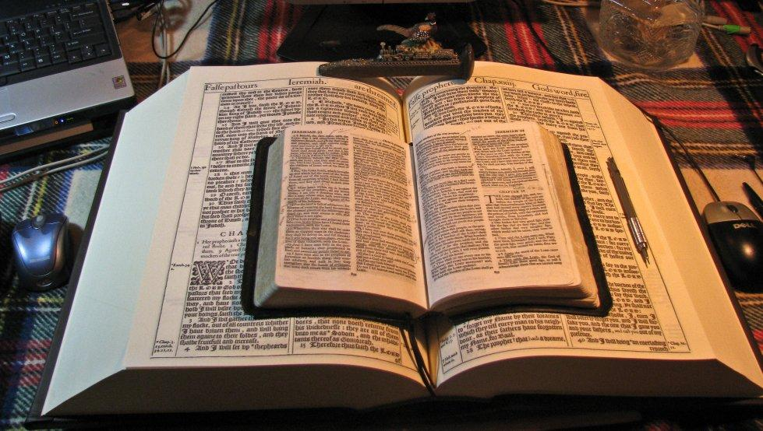
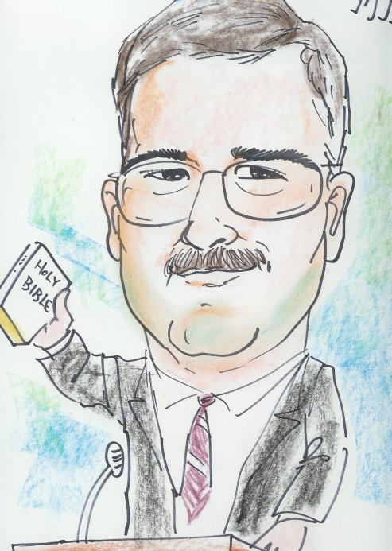
Today’s smaller KJB 2016 is identical in text with large King James 1611 Bible
Only smaller in size!
The words of the LORD are pure words: as silver tried in a furnace of earth, purified seven times.
Thou shalt keep them, O LORD, thou shalt preserve them from this generation for ever. Ps 12:6,7
This PowerPoint was redesigned by Mike Paulson, June, 2016
This presentation is not copyrighted, of course, so if you can add more, and there is a lot more that I am sure can be added to this; feel free to do so. My only expectation and requirement is that you use ONLY a King James 1611 Bible for your specific scripture references.
But truthfully, I suppose that is not a huge concern of mine because if you do try to use any other modern bibles, you will find they wouldn’t fit with this anyway; thus we see once again, the importance of a rightly divided 1611 KJB ONLY. ☺
If you do add more comments, scripture references, etc. for your own use – or to pass on to others,
please pass it on to me, as well. I would be glad to update yours to the website.
www.scatteredchristians.org

Slide 3
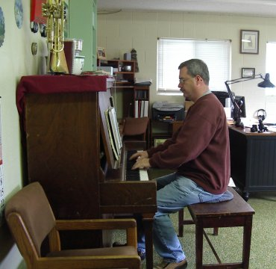
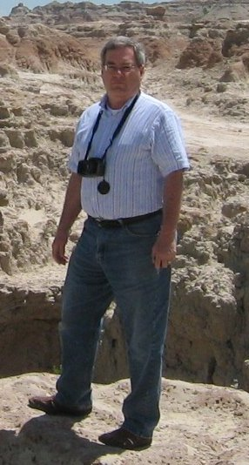
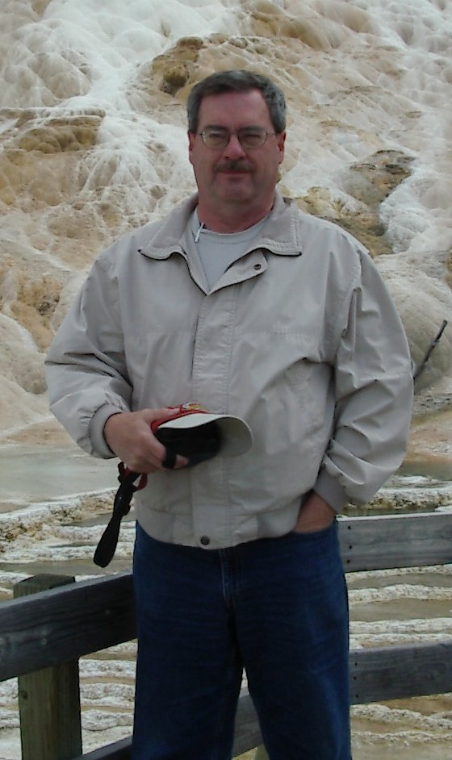
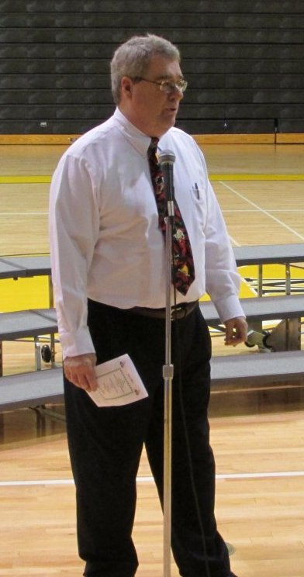
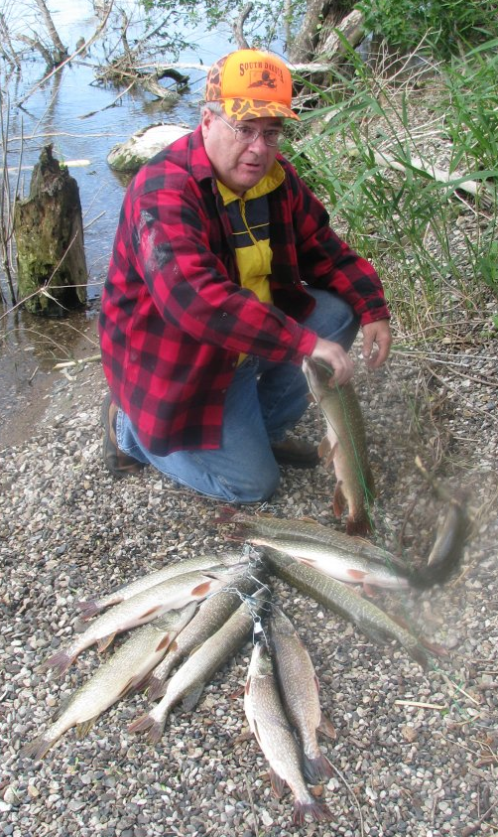
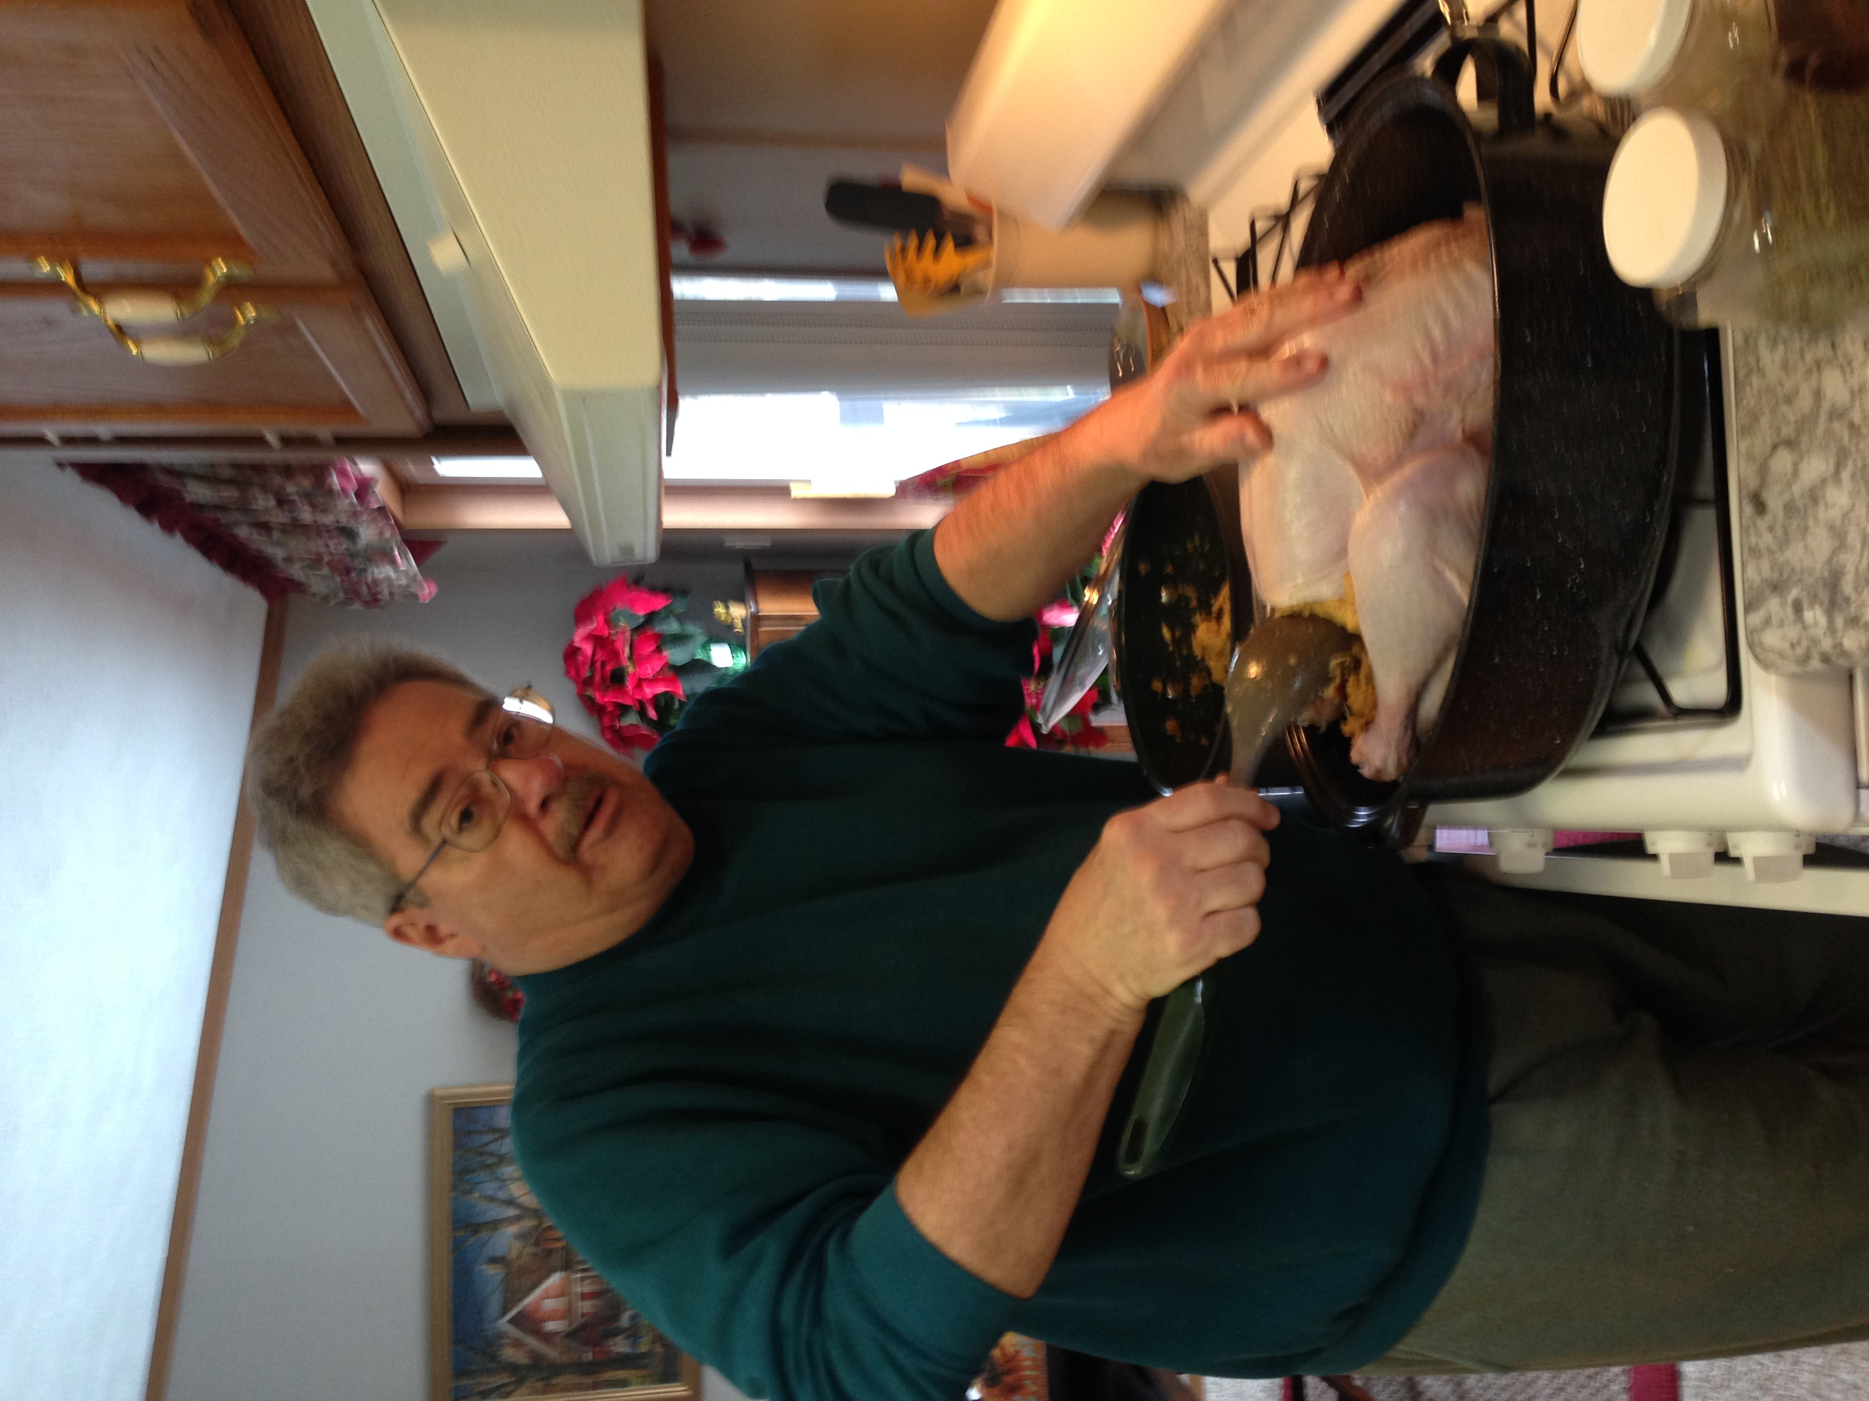
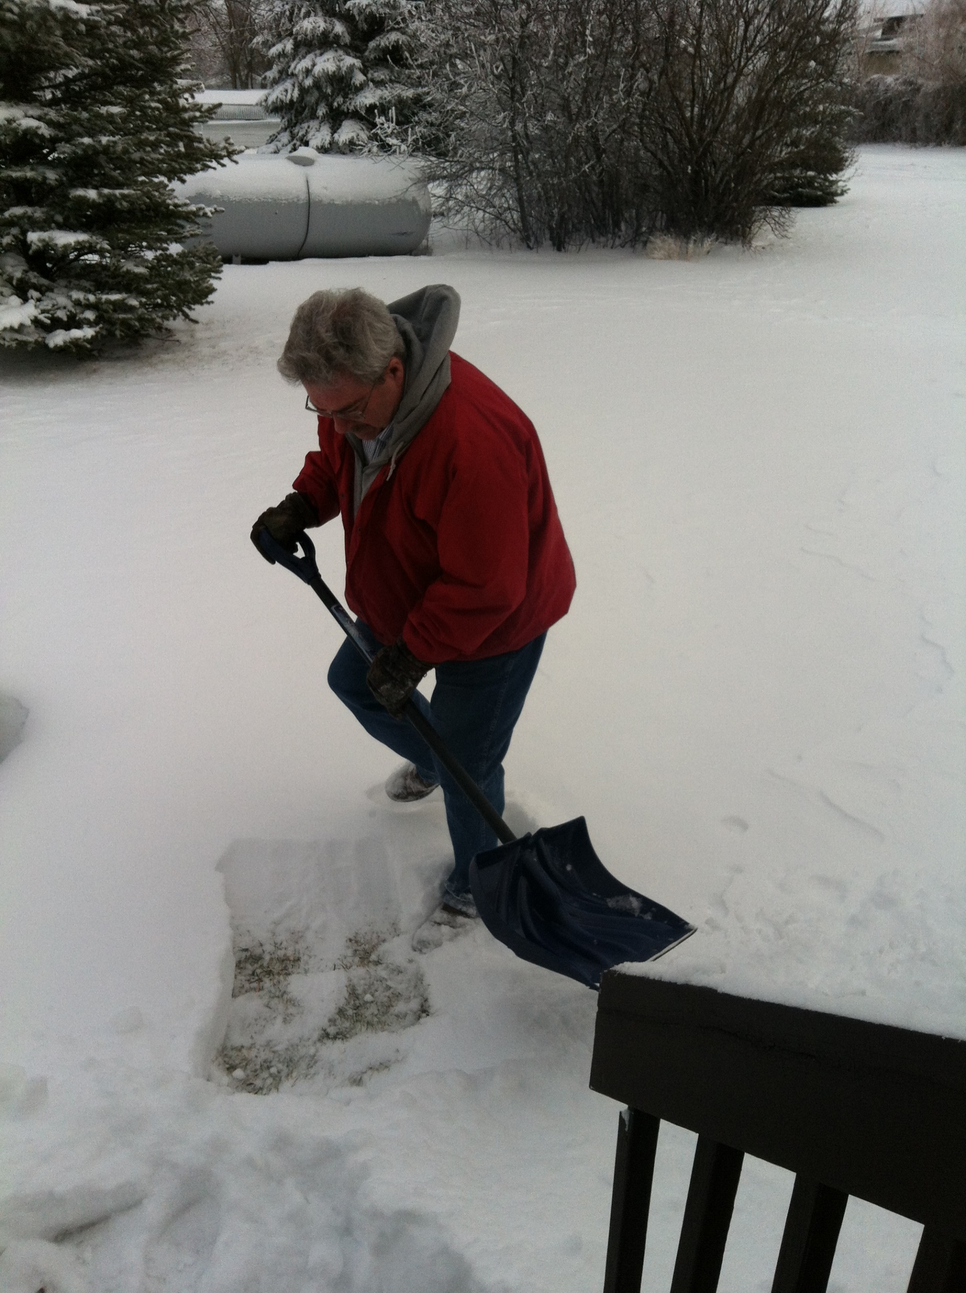
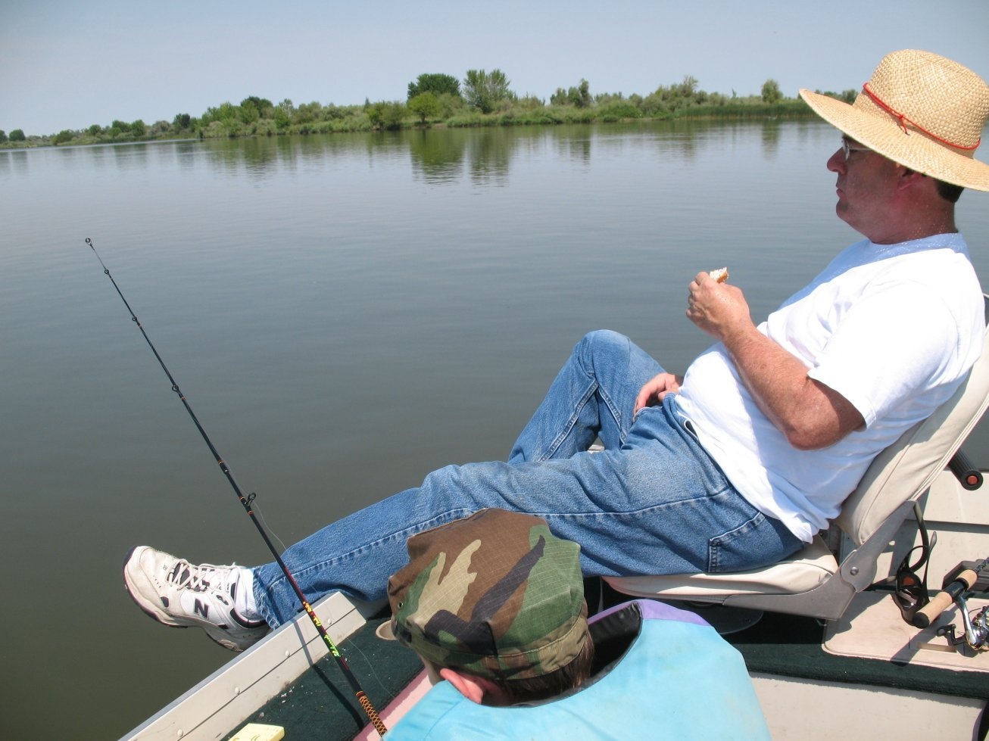
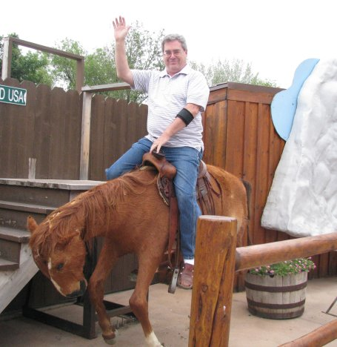
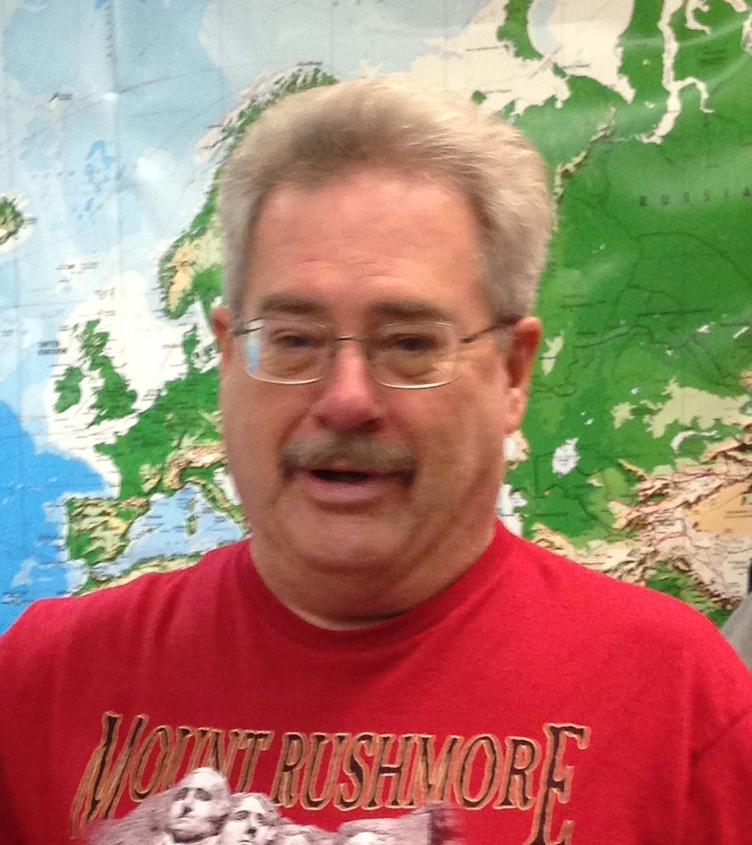
As a pastor, preacher, teacher, it has always been my goal
to help people learn to read the KJB by themselves – no other
book needed. Any Hebrew/Greek knowledge, special history/ dictionaries, etc. are not only never necessary, they are often wrong today; and because so many pastors are deceitful in their loving yet lying approach, I want folks to realize they can actually learn to understand their KJB themselves, without any outside “modern scholarly” pastoral assistance.
Mikel Paulson
Welcome to my visual video
‘Bible Sermon /Bible Study’ Presentation.
The Holy Spirit is all one needs to understand the KJB! However, one must also be able to know the difference between God’s words and Satan’s words; the truth of the Holy Spirit vs their own good ‘feelings’.

Slide 4
Today’s Presentation Study
Paul’s Greater Commission
Mikel Paulson
This presentation is one that I am most pleased. I am hoping that readers will be able to understand this entire presentation when they complete it through to the end.
This is a ‘visual map’ through the entire KJB, from Genesis to Revelation. You will see how the Old Testament worked, which included the gospels, of course, with the Jews. After the crucifixion, you will see the design of Paul’s ministry to the Gentiles. When that is completed, you will see what is coming in the near future for everyone - who is still here.

Slide 5
Part I
The Complete Map KJB Bible
Genesis
Revelation
to

Slide 6
I Show Unto You A More Excellent Way I Corinthians 12:31
Paul's
Greater Commission
“Expounding the Way of God More Perfectly” with Paul’s Gospel of Grace to the Gentiles “to the ends of the earth”! See Acts 13:47; 18:24-28; Romans 2:16
Those things, which ye have both learned, and received, and heard, and seen in me, do: and the God of peace shall be with you. Philippians 4:9
But when it pleased God, who separated me from my mother's womb, and called me by his grace, To reveal his Son in me, that I might preach him among the heathen – Galatians 1:16
Living the Risen Life
Unto me, who am less than the least of all saints, is this grace given, that I should preach among the Gentiles the unsearchable riches of Christ; Ephesians 3:8
If ye have heard of the dispensation of the grace of God which is given me to you-ward: Ephesians 3:1-7
For this cause have I sent unto you Timotheus, who is my beloved son, and faithful in the Lord, who shall bring you into remembrance of my ways which be in Christ, as I teach every where in every church. I Corinthians 4:17
Furthermore then we beseech you, brethren, and exhort you by the Lord Jesus, that as ye have received of us how ye ought to walk and to please God, so ye would abound more and more. I Thessalonians 4:1

Slide 7
What you are about to watch is the ‘coming, leaving, returning, leaving and eventually coming to permanently remain’ on earth - of the ‘kingdom of heaven’ and the ‘kingdom of God’.
Follow these crowns throughout the chart.
The kingdom of heaven is a physical, visible, literal, material kingdom on earth. That would include the OT tabernacle, churches, kings, leaders, kingdoms, physical events, daily physical lives, etc.
The kingdom of God is a spiritual kingdom of “righteousness, peace, joy in Holy Ghost – invisible, spiritual kingdom,
For the kingdom of God is not meat and drink; but righteousness, and peace, and joy in the Holy Ghost. Rom 14:17
(Note: this is not referring to heaven in the sky or being with God, etc.)
Hopefully, this ‘kingdom location preview’ will help you through the presentation:
Adam – both kingdoms present in the garden; a spiritual kingdom in a physical kingdom – on earth.
The Fall – kingdom of God departs, cursing the physical world, leaving the physical kingdom of heaven on earth,
the earthly OT kingdom of ‘kings,’ leaders, buildings, works, laws, etc.
Noah through Solomon – leaders / ‘kings’ of the earthly Jewish OT called the kingdom of heaven.
Je-coniah – the kingdom of heaven departs when God says no more male seed on the throne. Both kingdoms absent.
Nebuchadnezzar – a type of anti-christ with no kingdoms on earth - Israel is taken captive, etc. A type of the Tribulation
Daniel – foresees the details of the coming NT kingdom.
John the Baptist – comes announcing the returning of both kingdoms upon Jesus’ arrival.
The Jews reject both kingdoms and kill Christ!
Peter and Stephen - The risen Christ offers both kingdoms one more time – but they kill Stephen! Christ then chooses Paul!
Paul - the kingdom of heaven departs, leaving a spiritual kingdom only - the kingdom of God – for Gentiles!
Satan - When the Gentiles tire of the goodness of God, God will take up the saved as He takes up the kingdom of God, leaving no kingdoms again, as it was during Nebuchadnezzar’s time – now the real antichrist arrives.
Jesus Christ – Christ returns with both kingdoms – all kingdoms are His now – an earthly-spiritual kingdom – called the Millennium.

Slide 8
The Entire Bible is about a Throne – a King – a Kingdom! Is 14:11-14 / Lam 5:16-19 / Rev 22:3-5
Study to shew thyself approved unto God, a workman that needeth not to be ashamed, rightly dividing the word of truth. But shun profane and vain babblings: for they will increase unto more ungodliness. II Timothy 2:15,16
Kingdoms of this world – Now belong to Satan - prince of this world, god of this world, until Rev 11:15
Kingdom of heaven – Kingdom of Israel – physical, visible, literal, material kingdom - Gen 12
Kingdom of God – Righteousness, peace, joy in Holy Ghost – invisible, spiritual kingdom - Rom 14:17
Power of air; Ruler of darkness; enemy; Lucifer; devil; Eph 6:11; ruler of Gentiles.
Old Testament
Jews: God’s chosen people – led by law – Gen 12 / Gentiles: dogs; not people Matt 7:6; 15:26; Romans 10:19 – Gentiles are heathen led by Conscience – Romans 2:14; Gen 3:22
Satan
Fall K of G kingdom gone
Kingdom of the Type of Anti-christ!
God of this world
Je-Coniah
Major and Minor Prophets preaching during these OT times!
Is 14:11-13; Ez 28:13-19 II Cor 4:4
Adam
Noah
Abram
Isaac
Jacob
Judah
Moses
Saul
David
Solomon
Zedekiah
Babylon
Daniel
Son of God God’s Image
Genesis 6-9
Genesis 12:1-4; 17:16 22:15-18
Genesis 17:19; 25:5 26:1-4
Genesis 27:29 25:24 28:13
Genesis 49:8-10
Ex 19:5+
Not God’s chosen King!
God’s choice from Judah
Kingdom Divided
Male Seed Cursed
King over nothing
Nebuchadnezzar builds an image!
A dream of the Kingdom
Gen 1-5
Shem, Ham, Japheth
The Law John 1:17
…from Benjamin
I Chronicles 11:1-3
I Kings 11:1-11
II Kings 24:18
Lam 5:15-19 Dan 3
Daniel 2,7,8,11
Jer 22:30
Make ready a people prepared for the Lord.
For Both Kingdoms
The Gospels - Old Testament - To Israel First Acts 1:22; Hebrews 9:11-28 Also see Matthew 28:9 vs John 20:17
After Crucifixion
Kingdoms Offered to Jews
“Messenger”” “A Voice”
NT Begins
Peter
Stephen
John the Baptist
John did water baptize in the wilderness, and preached the baptism of repentance for the ‘remission’ of sins. Mark 1:4
Both Kingdoms at Hand
Follow Jesus...
Heb 9:11-28 Matt 27:50 Mark 15:37 Luke 23:46 John 19:30
Acts 1-10; 1:19,20
Acts 7
Matt 3:2; 4:17; 6:33; Mark 1:14; Luke 4:43
Mt 16:24,25; 19:16-24 Mk 8:34-38 Lk 9:23-26
Stoned
Matt 3; 11:7-14 Mk 1; Luke 1:17
Jesus Christ
Jewish Great Commission
Kingdom of heaven Postponed
God manifest in the flesh I Timothy 3:16
To Jewish Nation
…as a Nation
Rom 1:16; 3:2; Jn 3:3
Jn 3; Lk 24:47
Matt 28:19,20; Mk 16:15-20; Acts 1-8; II Cor 12:12
Signs followed them that believe; cast out devils, spoke with new tongues, took up serpents, drank poison, healed the sick.
Acts 7; 13:44-48; 18:6; 24:13,14; Romans 11:25
Son of Man
Not to Gentiles, yet
Must Sell All!
Peter / Jews / Apollos Corrected Acts 10:9-28; 15:7; 19:3-5; Galatians 2:7-16; Acts 18:24-28
When John had first preached before his coming the baptism of repentance to all the people of Israel. Acts 13:24
Son of God
Matthew 6:31,32 10:5,18; 12:18-21; 15:24; 24:13,14
Matthew 19:21 Mark 10:21 Lk 12:33; 18:22
Paul
Kingdom of God only!
New Testament - Paul’s Gospel of Grace – Romans to Philemon
Both Kingdoms Absent
Apostle to the Gentiles Only
Only a spiritual kingdom today
Satan Walketh About
I Peter 5:8
Paul’s Calling & Ministry
Paul’s Gospel of Grace
Paul Preaches Faith for Salvation
Rom 11:13; I Tim 2:7; II Tim 1:11
Acts 26:16 – To be a minister and witness of what he has seen and for what Christ shows him.
Eph 4:11-16; I Cor 4:17 – Reveal the purposes and design of “church” today.
Galatians 1:11,12,15-16; Romans 1:9; 2:16; 15:8,9; 16:25,26; Acts 20:24; Eph 3:1-6; I Cor 15:1-8; II Tim 1:1-14; 2:8
Romans 3:28; 4:5,24; 5:1,2; 6:17,18; 8:1-2,9,10, 24,25; 10:9-10,13,17; 12:3; 3:15; 15:1-8, 11-17; II Cor; 5:17,18-21; Gal 2:16,20,21; 3:11,22-29; 5:6; Eph 1:12-15; 2:5-9,12,13; 3:1,2,12,17 Col 1:11-14; 2:11-12; I Thess 1:8-10; 2:13-16; 3:2,5,7-8; II Thess 2:13; I Tim 1:14-16; 2:4-6; 4:10; 6:12,17; II Tim 1:9-10,13,14; 2:10,11; 3:15; Titus 3:5-7, etc.
False Peace
Rom 1:11; 12:4-8; 13:9,10 Impart to us spiritual gifts.
Antichrist
God’s Will - to Jesus
Acts 26:18; Rom 15:16 – To open our eyes - turn Gentiles from darkness to light and from the power of Satan unto God.
Follow Paul to Risen Saviour
God’s Wrath
John 6;39,40 - Raise “it” up and raise “him” up. inheritance & salvation.
Romans 12:1,2; Eph 5:14-17 Col 1:10-12;4:12 – Guide us to walk worthy of the Lord.
Romans 11:13,14; 15:15,16; I Cor 3:10; 4:16,17*; Philippians 3:17; 4:9*; I Thess 1:5,6; 4:1,2; II Thess 2:15*; 3:7-9; I Timothy 1:15,16*; II Timothy 2:7; 4:16,17.
Mat 24:13; Rev 4-19; II Thess 2:1-17; Acts 2:16-19; Acts 1-8; Heb - Jude
Jesus Christ - Gone
Acts 26:20 – Turn us to God, and do works meet for repentance.
Rom 16:25,26; Eph 3:1-7 Col 1:24-29 – Reveal God’s mysteries kept hidden until Paul’s dispensation of grace.
Second Coming
John 13:31-36; 14:1-31; *14:19,26,28; 16:13-16
Acts 20:19-24 – Preach & teach repentance toward God and faith toward Jesus Christ.
Paul’s Ways Deliver Us
Revelation 19:11-21
Rom 11:13; I Tim 2:7 II Tim 1:11; 3:16,17; Acts 18:24-28 Expound to us the way of God more perfectly... KJB
Romans 7:5,6; 7:24; II Cor 1:8-10; 4:5-11 Galatians 1:4; Colossians 1:13; I Thess 1:10; II Thess 3:2
Paul Meets Christ Face to Face
Eph 1:15-19; 3:14-19; Phil 1:9-11; Col 1:9-12; I Thess 3:10: Prayers for us as ensamples.
That Which is Perfect Is Come – KJB!
Millennium
Acts 9:1-22; 20:24; 26:15-28; Gal 1:11-16; I Cor 15:8; II Cor 12:1-6; Eph 3:1-7
He Guides Walk with Risen Christ
I Cor 13:8-12; Ps 12:6,7; I Thess 2:13; Heb 4:12
Both Kingdoms Established
Acts 28:28 – Show Gentiles that the way of Salvation is different than John’s baptism & Gospels.
I Cor 3; II Cor 5:10; Rom 2:16; 14:10 – Show us details of our Judgment Seat.
Rom 9:22,23; 14:17,19; Gal 2:20,21; Eph 2:10; 4:1; I Tim 5:10; 11-16 6:11,18; II Tim 2:22; 3:12-14; 4:17,18; Ti 2:14; I Thess 4:1-7; 5:15
FOR Us, but not TO us
Gospels; Heb-Rev; Mat 5-7; 25:34; Rev 11:25; 20:4-6; Gen 2:25; Mk 9:3; Rev 4:4; 21:23 Dan 12:2,3,44
Paul Continues with God’s Will
Romans 11:11,14 – Provoke the Jews to emulation so that they might get saved.
Heb - Rev have Trib & Mill application only! See Acts 2:16-21; 17:30,31; Gal 2:7-9
Acts 28:31; Rom 2:16; 15:17-19; I Thess 1:6; Ephesians 5:1; I Timothy 1:17; II Timothy 4:18 Give God His glory for all!
Live Beyond the Crucifixion
Fullness of Times Ephesians 1:10
Acts 9:15,16; 13:47; 26:18-20; 28:31; Eph 6:20
Gal 5:24; 6:14; Colossians 2:12; 3:1
Fulness of Gentiles
Gal 1:8,9; 3:1,2; II Cor 11:4 No other Gospel but his!
A More Excellent Way – I Cor 12:31
Rom 11:20-22, 25; I Thess 4:13-18
New Heavens / Earth
II Pt 3:13

Slide 9
The Riches of the Full Assurance of Understanding
from Paul’s Gospel
Knowing God’s will in your life!
Know the things of Christ for today!
Awareness of cunningly devised fables!
Understand how to live a life in newness of life and newness of spirit!
A quiet & peaceful marriage!
Colossians 2:2
Awareness of truth being evil spoken of!
Eliminate need and dependence on social welfare and recovery programs!
Awareness of doctrines of devils!
Let the Preaching and Teaching of Paul Deliver You From:
Learn to prepare and use your sword – life is more than just having the “right” one!
Ability to identify the spirit of anti-christ!
Eliminate confusion of bibles, churches, doctrines, salvations, confusing issues!
Hell and the lake of fire! Matt 23:33; Lk 12:15; Mk 9:43-48; Rev 11-15; Rom 2:3; II Cor 5:11
Help others properly as well as how to withdraw and turn away from whom those who walk contrary to Paul’s gospel!
Eliminate doubts about salvation, truth, world situations, present, past and future!
Know the truth of these latter times!
Lead a quiet and peaceable life in all godliness and honesty!
The law of sin and death! Romans 8:2; 3-8
Know the deceptions and smokescreens that draw folks towards ecumenicalism!
Hear the voice of joy and gladness!
The daily battles between our flesh and mind; sin that is in our flesh & the Spirit of God in our soul! Rom 7:23,24
Awareness of apostasy and identifying all the lies and deception that comes with it!
Knowing your spiritual gifts!
Better identify false teachers and teachings!
Hear those that truly say “Praise the Lord of hosts” and those who bring the sacrifice of praise into the house of the Lord!
Prepare you for your own Judgment Seat!
Ourselves: the frustrations and tribulations of daily living! II Cor 1:8,9
Prepare you for suffering for living godly!
Listen to the right voices & deny the wrong!
Be more thankful for all that God has done, is doing and will do!
Receive better help from the Psalms!
Ourselves: for Jesus’ sake away from a life ‘we’ want to walk! II Cor 4:10-12
Receive better guidance from Proverbs!
Enjoy the true peace “of” God, peace “from” God and peace “ with God!
Keeps you from doubtful disputations!
This present evil world! Galatians 1:4
Able to steer you clear of conversations and studies that bring about more questions and gender strife!
Know the things Paul expects us to know!
The power of darkness! Colossians 1:13
Know better than you were taught what to teach your children and grandkids!
Able to identify vain babblings!
Learn how to please God, and then do it in the right manner – not because of fear and bondage, but because of your love for God!
Able to live less ungodly and more godly without any self or pastoral bondage!
Unreasonable and wicked men that have not faith! II Thess 3:1,2
Find Scriptural strength to identify and endure sound doctrine!
Wrath to come! I Thessalonians 1:9,10; 5:9
Give God Glory in all that you do and try to stop grieving and quenching the Spirit!
Maintain awareness and understanding on all sins being forgiven & not imputed!
Love his appearing / crown of righteousness
Fighting the right battles!
Therefore I write these things being absent, lest being present I should use sharpness, according to the power which the Lord hath given me to edification, and not to destruction. II Corinthians 13:10
Develop proper boldness & confidence!
Learn a proper manner of living!

Slide 10
Now to him that is of power to stablish you
according to my gospel,
and the preaching of Jesus Christ,
- Paul
according to the revelation of the mystery,
which was kept secret since the world began,
But now is made manifest,
and by the scriptures of the prophets,
according to the commandment
of the everlasting God,
made known to all nations
for the obedience of faith:
To God only wise,
be glory through Jesus Christ for ever. Amen
Romans 16:25-27

Slide 11
Be not thou therefore ashamed
Of the testimony of our Lord,
Nor of me his prisoner:
- Paul
But be thou partaker of the afflictions
Of the gospel according
To the power of God;
II Timothy 1:8

Slide 12
Thou therefore, my son,
be strong in the grace
that is in Christ Jesus.
And the things that thou hast heard of me among many witnesses,
- Paul
the same commit thou to faithful men, who shall be able to teach others also.
II Timothy 2:1,2

Slide 13
Study
to shew thyself approved unto God,
a workman that needeth
Not to be ashamed,
rightly dividing the word of truth.
But shun profane and vain babblings:
For they will increase unto
More ungodliness.
II Timothy 2:15,16

Slide 14
For the grace of God that bringeth salvation
hath appeared to all men,
Teaching us that, denying ungodliness
and worldly lusts, we should live soberly, righteously, and godly, in this present world;
Looking for that blessed hope,
and the glorious appearing of the great God
and our Saviour Jesus Christ
Who gave himself for us,
that he might redeem us from all iniquity,
and purify unto himself a peculiar people,
zealous of good works.
II Timothy 2:15,16

Slide 15
Those ‘good works’ must be according to Paul’s teachings,
not the Old Testament law;
not the Gospel writings to the Jews;
not the writings to the Tribulation saints from Hebrews to Jude.
In the day when God shall judge the secrets of men
by Jesus Christ
according to my gospel.
Romans 2:16
- Paul
Romans Philemon
According to the grace of God which is given unto me,
as a wise masterbuilder, I have laid the foundation,
and another buildeth upon.
But let every man take heed
how he buildeth thereupon.
I Corinthians 3:10

Slide 16
Those things,
which ye have both learned,
and received, and heard,
and seen in me,
do:
- Paul
and the God of peace
shall be with you.
Romans 2:16

Slide 17
If any man think himself
to be a prophet,
or spiritual,
- Paul
let him acknowledge
that the things that I write unto you
Romans - Philemon
are the commandments of the Lord.
But if any man be ignorant,
let him be ignorant.
I Corinthians 14:37,38

Slide 18
King James 1611 Bible
Scholarship, Education, Degrees, Bible Institutes, Courses, Workshops, Retreats, Conventions – books, books, books,
and more books…
That which is perfect has come
Religion
S
Ever learning, and never able to come to the knowledge
of the truth.
The Truth

Slide 19
Get one while you still can!

Slide 20
Behold, the days come, saith the Lord GOD, that I will send a famine in the land, not a famine of bread, nor a thirst for water...
…but of hearing the words of the LORD
And they shall wander from sea to sea, and from the north even to the east, they shall run to and fro to seek the word of the LORD,
…and shall not find it.
Amos 8:11,12
www.scatteredchristians.org

Slide 21
This is just a friendly reminder that this PowerPoint was designed by Mikel Paulson,
June, 2016 – www.scatteredchristians.org
This presentation is not copyrighted, of course, so if you can add more information, and there is a lot more that I am sure can be added to this, feel free to do so. My only expectation and requirement is that you use ONLY a King James 1611 Bible. Actually, that can’t be a big problem because if you tried to use any other modern bibles, you would find they wouldn’t work with this anyway, thus we see once again the importance of a rightly divided 1611 KJB ONLY. ☺
If you do add more comments, scripture references, etc. for your own use – or to pass on to others,
please pass it on to me, as well. I would be glad to update yours to the website.
But watch thou in all things, endure afflictions,
do the work of an evangelist, make full proof of thy ministry.
One more thing: everything stated within this presentation is supported by KJB Scripture. If you want to know the specific verses used, then contact me, or look them up yourself. They are in there, and they are taken from the correct books written TO us today – Paul’s!!
- KJB1611 ONLY -

Slide 22
Religion is Never the Truth
The Truth is Never a Religion

Slide 23
The King James 1611 Bible is Truth

Slide 24
The grace of our Lord Jesus Christ be with your spirit. Amen

